Slide 1


Darsun Product Catalog

Slide 2
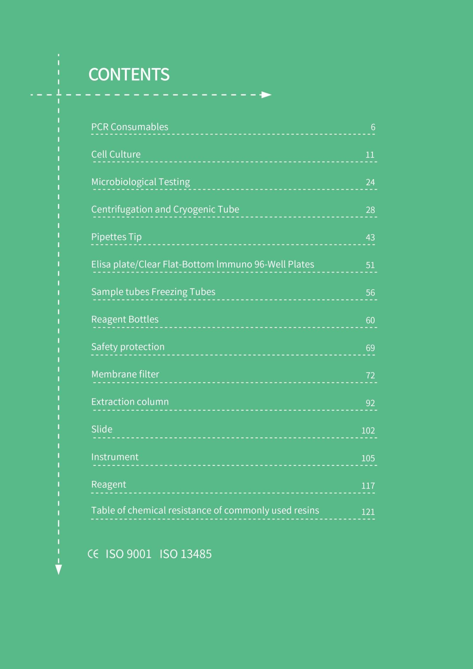

Slide 3
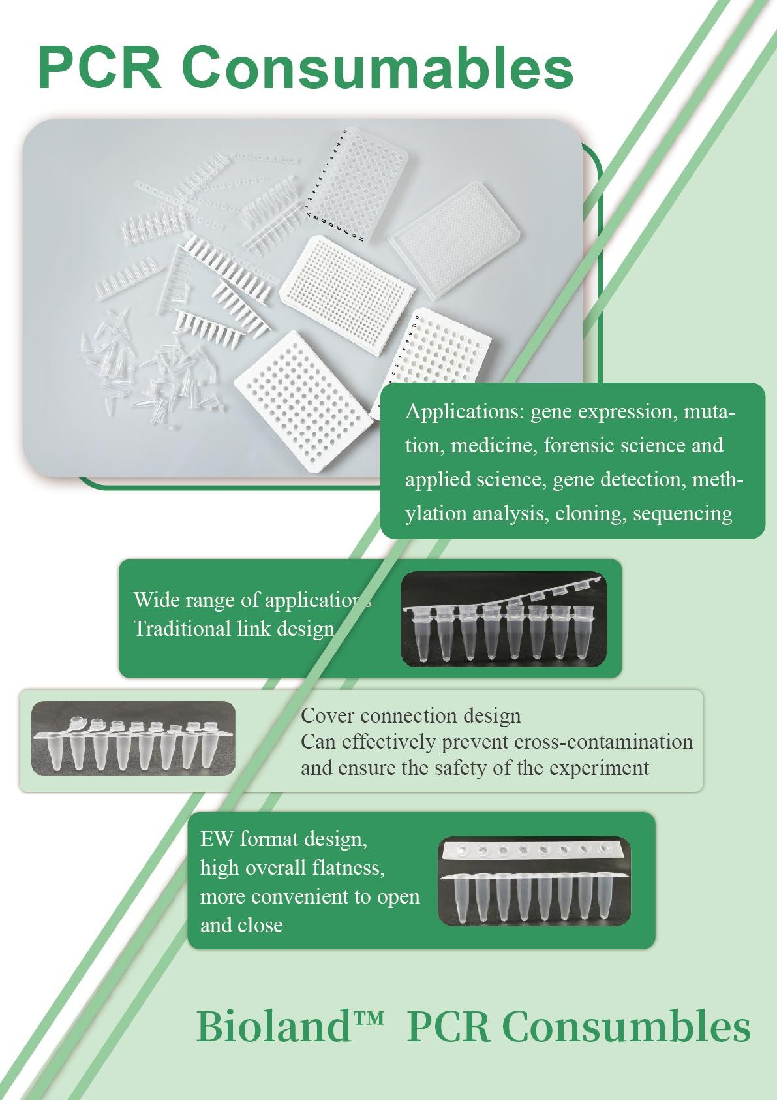
6
  DARSUN SCIENTIFIC

Slide 4
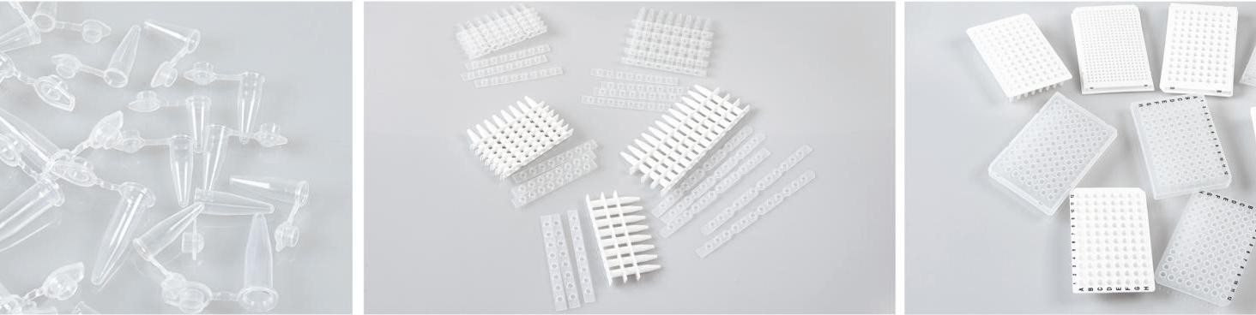
DARSUN
DARSUN PCR consumables are made of 100% virgin polypropylene.
The thin-wall designed for effective thermal conductivity and ensures efficient PCR reaction.
The tight sealing between the tube and cap ensure minimal evaporation and prevents sample leakages. High side holes ensure consistent sealing.Convenient positioning of each hole.
The Pcr cap is provided in 2 different forms：flat and dome,Flat type is useful when labeling is required ,while dome type
prevents the reaction solution from binding to the cap surface, Provided single pcr tube with a cap attached,and strip tubes,composed of 8 bodies and 8 caps connected horizontally.
RNase/DNase-free、Human DNA-free、Non-pyrogenic、Non-cytotoxic.
PCR Single Tube
PCR Strip Tube
PCR Plate
DARSUN™ PCR tube
Order number | Description | Package
PCR001-F | PCR Single Tube；0.1ml；Flat；Clear | 1000EA/Pk；10Pk/Cs
PCR001-FF | PCR Single Tube；0.1ml；Flat；Matte | 1000EA/Pk；10Pk/Cs
PCR001-C | PCR Single Tube；0.1ml；Dome；Clear | 1000EA/Pk；10Pk/Cs
PCR002-F | PCR Single Tube；0.2ml；Flat；Clear | 1000EA/Pk；10Pk/Cs
PCR002-C | PCR Single Tube；0.2ml；Dome；Clear | 1000EA/Pk；10Pk/Cs
PCR005-F | PCR Single Tube；0.5ml；Flat；Clear | 1000EA/Pk；10Pk/Cs
DARSUN™ PCR 8-Strips Tube
Order number | Description | Package
PCR001-8F | Pcr 8 strips tube；0.1ml；Flat；Clear | 125strip/Pk；10Pk/Cs
PCR001-8C | Pcr 8 strips tube；0.1ml；Dome；Clear | 125strip/Pk；10Pk/Cs
PCR001-8FD | Pcr 8 strips tube；0.1 ml；Connecting cap；Matte | 125strip/Pk；10Pk/Cs
PCR001-8FW | Pcr 8 strips tube；0.1ml；Flat；White | 125strip/Pk；10Pk/Cs
PCR002-8F | Pcr 8 strips tube；0.2ml；Flat；Clear | 125strip/Pk；10Pk/Cs
PCR002-8C | Pcr 8 strips tube；0.2ml；Dome；Clear | 125strip/Pk；10Pk/Cs
PCR002-8FD | Pcr 8 strips tube；0.2ml；Connecting cap；Clear | 125strip/Pk；10Pk/Cs
PCR002-8FW | Pcr 8 strips tube；0.2ml；Flat；White | 125strip/Pk；10Pk/Cs
PCR002-08-96 | Pcr 8 strips tube；Detachable；0.2ml；Flat；Clear | 125strip/Pk；10Pk/Cs
DARSUN™ PCR Plate
Order number Description |  |  | Package
PCR001-96 | 96-well, 0.1ml; No skirt; Clear |  | 15/PK；150/Cs
PCR001-96W | 96-well, 0.1ml; No skirt; White |  | 15/PK；150/Cs
PCR001-96S | 96-well, 0.1ml; Half skirt; Clear |  | 15/PK；150/Cs
PCR001-96SW | 96-well, 0.1ml; Half skirt; White |  | 15/PK；150/Cs
PCR002-96 | 6-well, 0.2ml; No skirt; Clear |  | 10/PK；100/Cs
PCR002-96W | 96-well, 0.2ml; No skirt; White |  | 10/PK；100/Cs
PCR002-96S | 96-well, 0.2ml; Half skirt; Clear |  | 10/PK；100/Cs
PCR002-96SW | 96-well, 0.2ml; Half skirt; White |  | 10/PK；100/Cs
PCR001-96C | 96-well, 0.1ml; Clear; Full skirt |  | 15/PK；150/Cs
www.sci-DARSUN.com |  | 7
DARSUN SCIENTIFIC

Slide 5
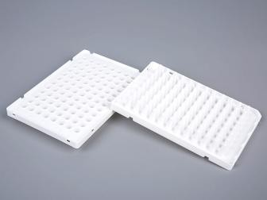
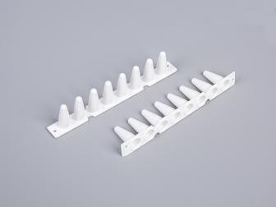
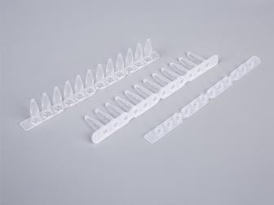
DARSUN
PCR001-96CW | 96-well, 0.1ml; White; Full skirt | 15/PK；150/Cs
PCR001-96P | 96-well, 0.1ml; Clear; Full skirt, enhancement | 15/PK；150/Cs
PCR001-96PW | 96-well, 0.1ml; White; Full skirtenhancement | 15/PK；150/Cs
PCR001-384S | 384 well plate; 25ul; With skirt; scrub | 15/PK；150/Cs
PCR001-384SW | PCR 384 well plate; 25ul; With skirt; white | 15/PK；150/Cs
DARSUN™ PCR 96-well plate
Suitable for ABI QPCR models
310 Genetic Analyzer,3130xl Genetic Analyzer,3500xl Dx Genetic Analyzer,3730xl DNA Analyzer,7500 Fast System,7900HT Fast System,StepOnePlus™,Veriti Dx Fast Thermal Cycler,Veriti Fast Thermal Cycler,3730 DNA Analyzer,3130 Genetic Analyzer,3500 Dx Genetic Analyzer,7500 Fast Dx System,ViiA™ 7Dx Fast System，ViiA™ 7 Fast System，3500 Genetic Analyzer，3500xl Genetic Analyzer
Order number | Description | Package
QPCR001-96S | 0.1ml; Half skirt; Frosted, suitable for QPCR | 15 pieces/box; 10Pk/Cs
QPCR001-96SW | 0.1ml; Half skirt; White, suitable for QPCR | 15 pieces/box; 10Pk/Cs
QPCR002-96S | 0.2ml; Half skirt; Clear, suitable for QPCR | 10 pieces/box; 10Pk/Cs
QPCR002-96SW | 0.2ml; Half skirt; White, suitable for QPCR | 10 pieces/box; 10Pk/Cs
DARSUN™ New EW PCR 8- Strips tubes
the latest launch EW designed PCR 8-tube strip,
Easier opening and closing Easy to open
No liquid splashing
Ensures experimental safety effectively
RNase/DNase-free Human DNA-free Non-pyrogenic Non-cytotoxic
Order number | Description | Package
PCR001N-8F | 0.1ml; Flat; Clear | 125strip/Pk；10Pk/Cs
PCR001N-8FW | 0.1ml; Flat; White | 125strip/Pk；10Pk/Cs
PCR002N-8F | 0.2ml; Flat; Clear | 125strip/Pk；10Pk/Cs
PCR002N-8FW | 0.2ml; Flat; White | 125strip/Pk；10Pk/Cs
DARSUN™ New EW PCR 12-Strips tubes
the latest launch EW designed PCR 12-tubes strip, Easier opening and closing
Easy to open
No liquid splashing
Ensures experimental safety effectively
RNase/DNase-free Human DNA-free Non-pyrogenic Non-cytotoxic
Order number | Description | Package
PCR001N-12F | 0.1ml; Flat; Clear | 125strip/Pk；10Pk/Cs
PCR001N-12FW | 0.1ml; Flat; White | 125strip/Pk；10Pk/Cs
PCR002N-12F | 0.2ml; Flat; Clear | 125strip/Pk；10Pk/Cs
PCR002N-12FW | 0.2ml; Flat; White | 125strip/Pk；10Pk/Cs
8
DARSUN SCIENTIFIC

Slide 6
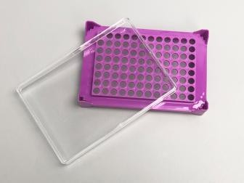
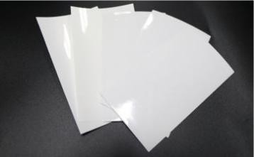
DARSUN
DARSUN™ PCR 8-StripsTube Rack
Suitable for most PCR 8-Strip tubes
Order NO. | Description | Package
CF08-96 | 8-StripsTube Rack；96well | 100Pcs/Cs
DARSUN™ PCR Self-adhesive sealing plate film
Clear Adhesive Film creates a secure seal across the entire microplate to prevent evaporation and well-to-well contamination.
Adhesive provides tight seal over wells to prevent leaks and evaporation.
Easy to apply and remove.
The high resolution allows for optical analysis during the real-time PCR process
Temperature range: -70~100℃
For general analysis, genomics, storage and bioanalysis, high-throughput screening, and drug discovery applications
Order NO. | Description | Package
CPM04-65A | Sealing film；lengthx Width：136x80mm；thinkness：65um | 100 片/包
CPM04-65B | Pressure sensitive film；lengthx Width：143x79mm；thinkness：65um | 100 片/包
CPM04-65C | Pressure sensitive film；lengthx Width：143x79mm；thinkness：65um sterile | 100 片/包
DARSUN SCIENTIFIC
9

Slide 7
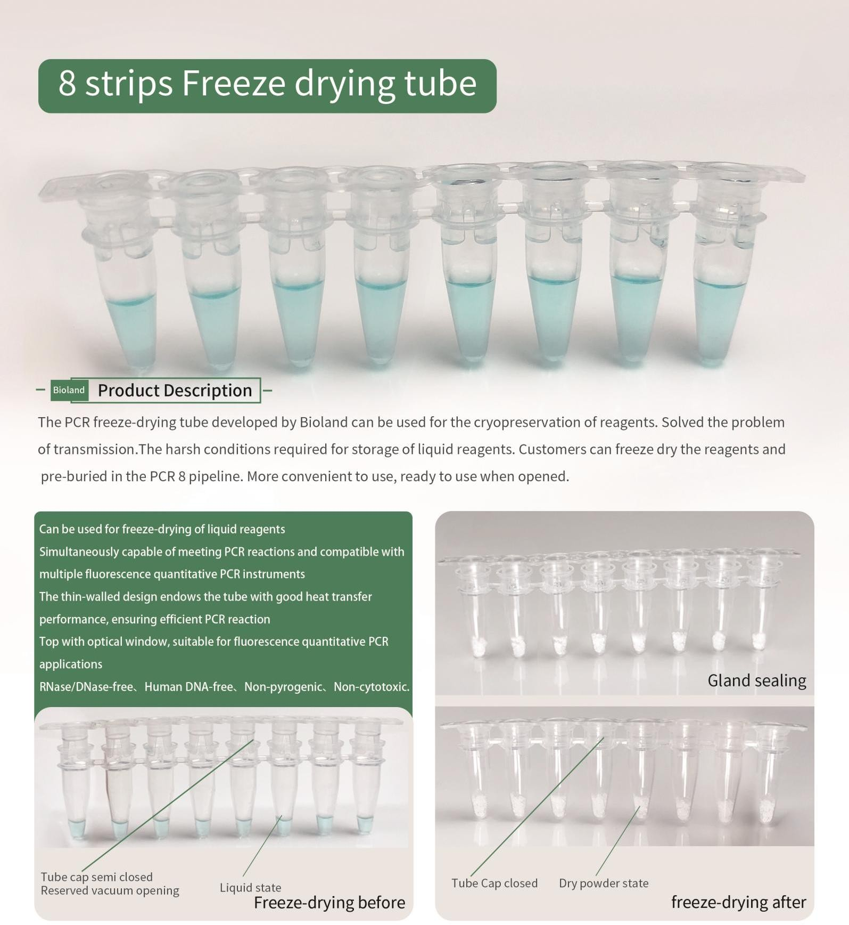
DARSUN
Order NO. | Description | Package
FD002-8 | 8-strips Freeze drying tube ， PP ， 0.2ml; with cap | 100 stes/Pk;10pk/Cs
FD002-8P | 8-strips Freeze drying tube ， PP ， 0.2ml; without cap | 100 strips/PK;10Pk/Cs
FD002-8C | 8-strips Freeze drying tube caps ， PP ， 0.2ml; with body | 100 strips/PK;10Pk/Cs
10
DARSUN SCIENTIFIC

Slide 8
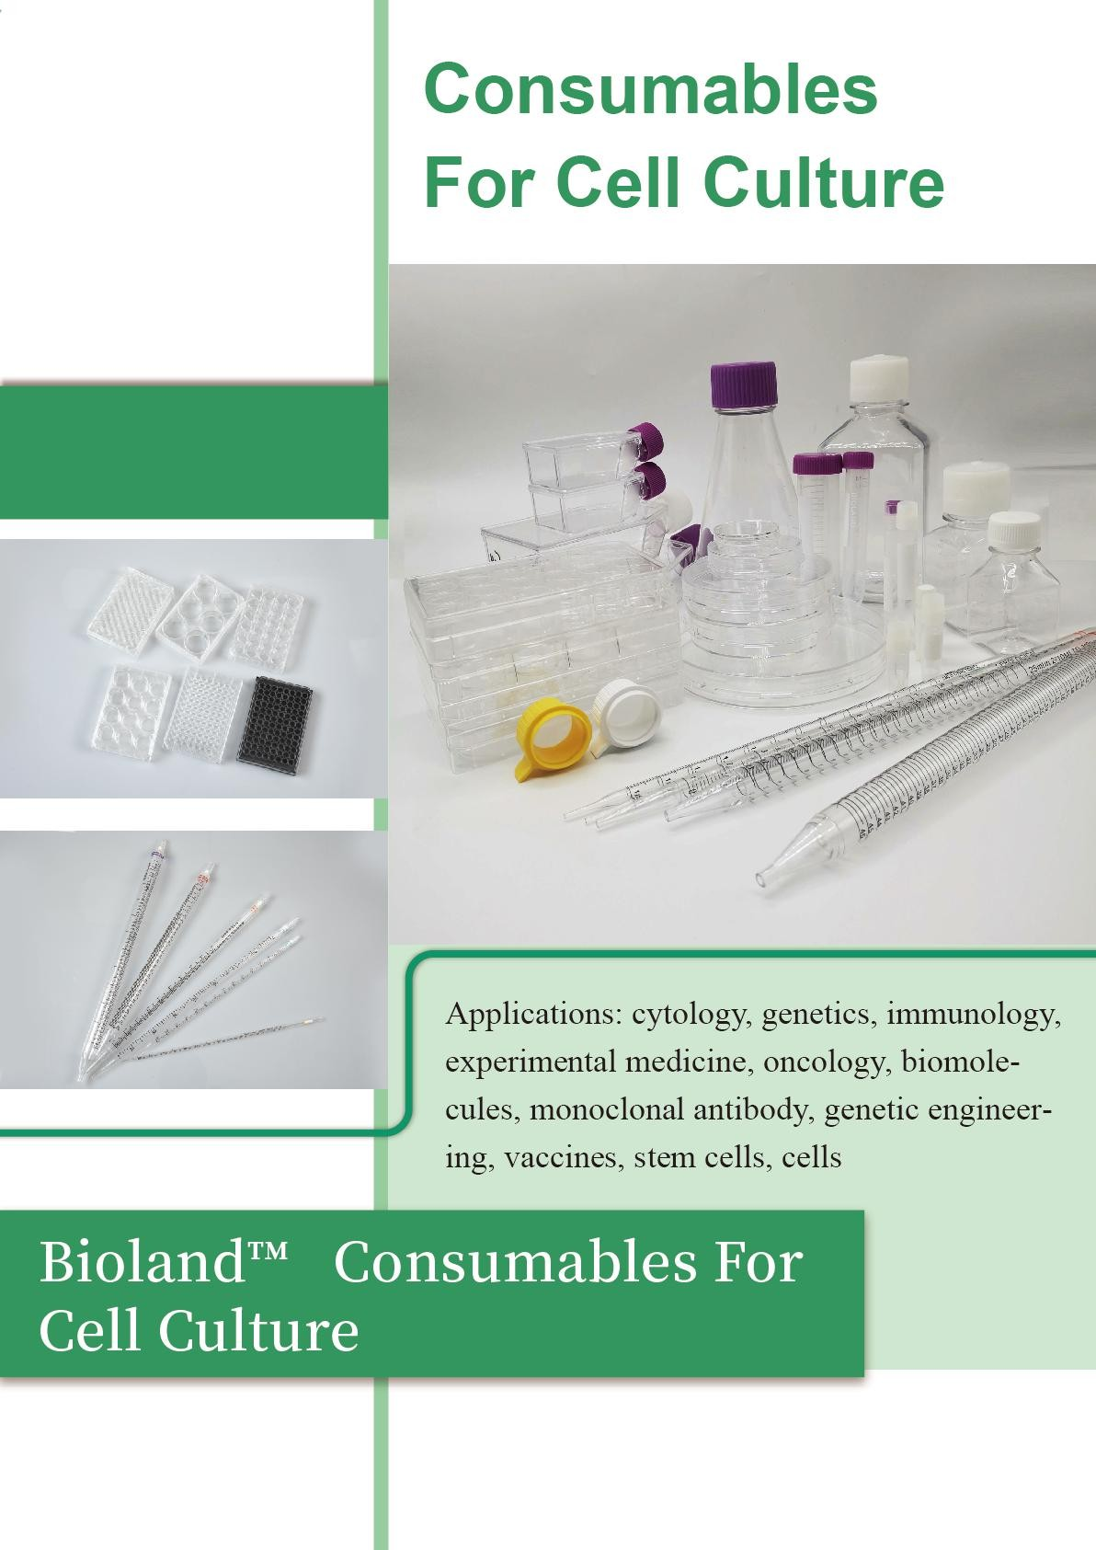
DARSUN
Darsun
DARSUN SCIENTIFIC
11

Slide 9
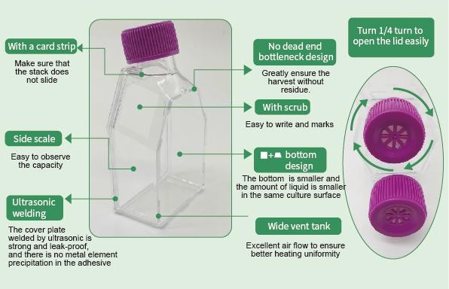
DARSUN
DARSUN™ Cell culture Flask
No dead end bottleneck design, greatly ensure the harvest without residue. The rectangular and trapezoidal bottom design makes our bottles smaller.
The cover plate welded by ultrasonic is strong and leak-proof, and there is no metal element precipitation in the adhesive. Wide vent tank, improve air flow to ensure heat uniformity.
25cm² for cell resuscitation and small scale expansion; 75cm² suitable for most cell expansion;
175cm² is suitable for eukaryotic protein expression and packaging of viruses.
Special surface treatment, better wall adhesion effect, more uniform
The upward-sloping neck design allows easier access to pipettes or cell scrapers/scoops
Irradiation sterilization
Made of polystyrene
RNase/DNase-free
Human DNA-free
Non-pyrogenic
Non-cytotoxic
Order number | Description | Package
CCB06-025 CCB06-025S CCB06-075 CCB06-075S CCB06-175 CCB06-175S CCB06-225 CCB06-225S | 25cm²; Filter membrane cover; Easy to stick wall; Recommended working volume: 5-7ml Full capacity: 71ml Maximum lying capacity: 16ml | 12/PK; 240/Cs
 | 25cm²; Seal cover; Easy to stick wall; Recommended working volume: 5-7ml Full capacity: 71ml Maximum lying capacity: 16ml | 12/PK; 240/Cs
 | 75cm²; Filter membrane cover; Easy to stick wall; Recommended working volume: 15-25ml Full capacity: 254ml Maximum lying capacity: 70ml | 5/PK; 100/Cs
 | 75cm²; Seal cover; Easy to stick wall; Recommended working volume: 15-25ml Full capacity: 254mll Maximum lying capacity: 70ml | 5/PK; 100/Cs
 | 175cm²; Filter membrane cover; Easy to stick wall; Recommended working volume: 45-55ml Full capacity: 635ml Maximum lying capacity: 210ml | 5/PK; 40/Cs
 | 175cm²; Seal cover; Easy to stick wall; Recommended working volume: 45-55ml Full capacity: 635ml Maximum lying capacity: 210ml | 5/PK; 40/Cs
 | 225cm²; Filter membrane cover; Easy to stick wall; Recommended working volume: 60-75ml Full capacity: 825ml Maximum lying capacity: 300ml | 5/PK; 30/Cs
 | 225cm²; Seal cover; Easy to stick wall; Recommended working volume: 60-75ml Full capacity: 825ml Maximum lying capacity: 300ml | 5/PK; 30/Cs
12
DARSUN SCIENTIFIC

Slide 10
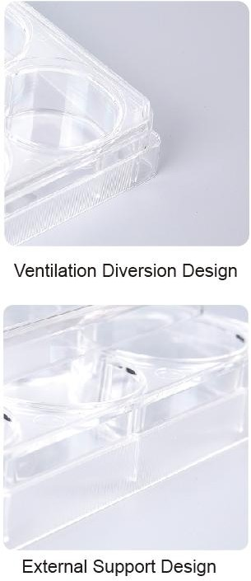
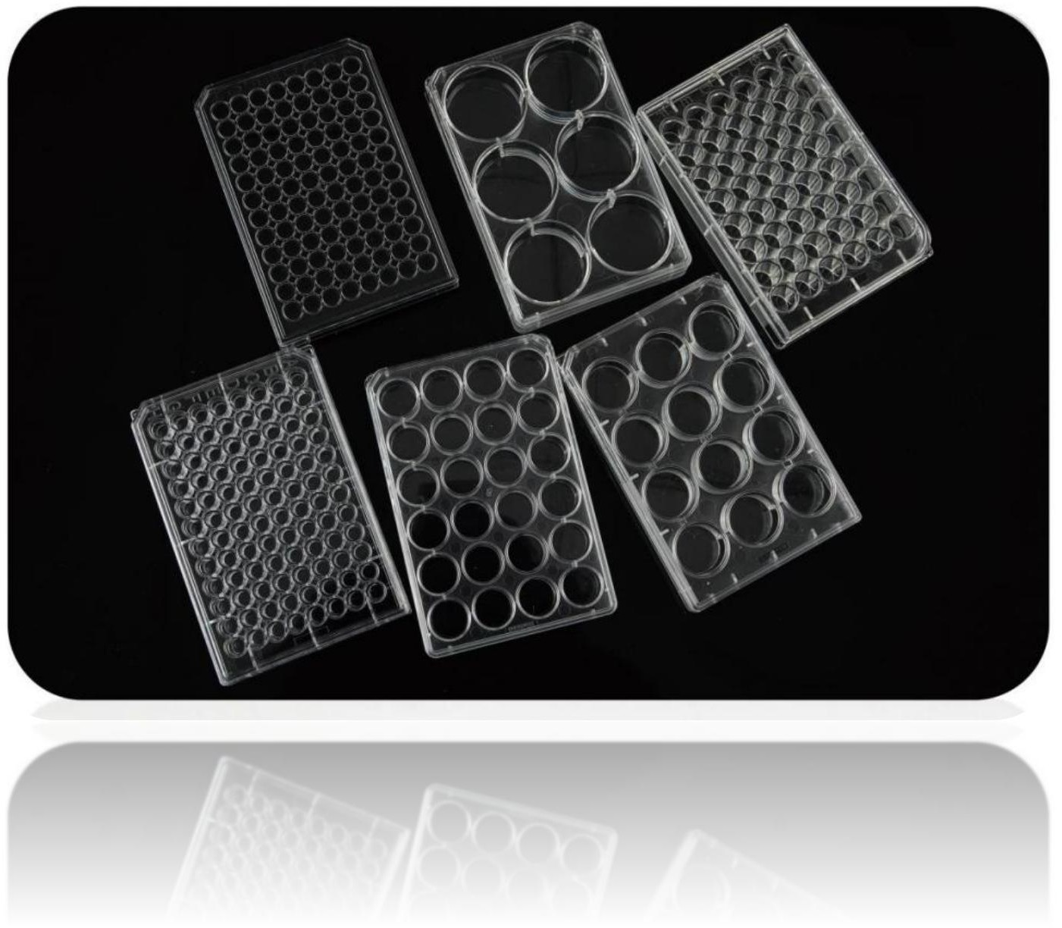
DARSUN
DARSUN™ Cell Culture Plate
Each well is marked with a number and a letter for easy location. One end of the cap has two bevel guides to prevent cross contamination. The low volatilization tank around the hole can effectively reduce the liquid evaporation in the hole. Increased hole edges greatly reduce the risk of cross-contamination.
The innovative cover edge diversion design greatly improves the air flow exchange in the board Special surface treatment, better wall adhesion effect, more uniform
6 Well, 12 Well, 24 Well, 48 Well, 96 Well available The bottom thickness is uniform and flat
irradiation sterilization RNase/DNase-free Human DNA-free
Non-pyrogenic Non-cytotoxic
Order number | Description Package
CCP06-006 | 6 Well；Clear；TC-treat | 1 / pack; 50 pieces/Cs
CCP06-012 | 12 Well；Clear；TC-treat | 1 / pack; 50 pieces/Cs
CCP06-024 | 24 Well；Clear；TC-treat | 1 / pack; 50 pieces/Cs
CCP06-048 | 48 Well；Clear；TC-treat | 1 / pack; 50 pieces/Cs
CCP06-096 | 96 Well；Clear；TC-treat | 1 / pack; 50 pieces/Cs
CCP06-096W | 96 Well; White ；TC-treat | 1 / pack; 50 pieces/Cs
CCP06-096S | 96 Well；Black；TC-treat | 1 / pack; 50 pieces/Cs
CCP06N-096W CCP06N-096S | Inspection Plate,96 Well; White ；TC Non-treat | 1 / pack; 50 pieces/Cs
 | Inspection Plate,96 Well; Black ；TC Non-treat | 1 / pack; 50 pieces/Cs
DARSUN SCIENTIFIC
13

Slide 11
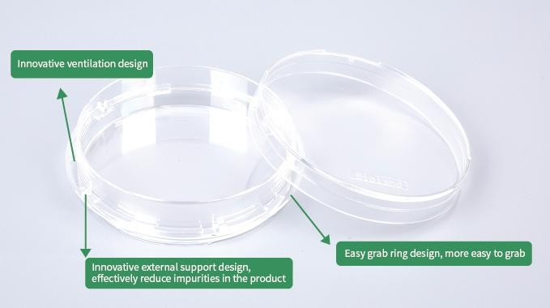
DARSUN
DARSUN™ Cell Culture Dish
Innovative design of cell culture dishes improved the guarantee of experimental results. At the same time, it brings more comfortable feeling in use
Innovative external support design reduces the risk of impurities from wear falling into the dish
Innovative easy-to-grab design effectively avoids the risk of the bottom dish not holding or falling when picking
easy to grab ring opening design, so that the air is more smooth, the air in the dish can get excellent exchange
Special surface treatment, better wall adhesion effect, more uniform
flat and Clear for microscopic observation
The bottom thickness is uniform and flat
irradiation sterilization
RNase/DNase-free
Human DNA-free
Non-pyrogenic
Non-cytotoxic
Order number | Description | Package
CCD06-035A | Easy to grasp ventilation type; 35x12mm | 10/package;500/Cs
CCD06-060A | Easy to grasp ventilation type; 60x15mm | 10/package;500/Cs
CCD06-100A | Easy to grasp ventilation type; 100x20mm | 10/package;300/Cs
CCD06-150A | Easy to grasp ventilation type；150x20mm | 5/package;100/Cs
14
DARSUN SCIENTIFIC

Slide 12
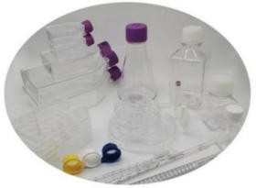
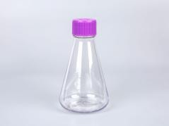
DARSUN
DARSUN™ Cell Culture Series，Non-Tc Treat
The suspension cells with round cell bodies have large growth space in culture medium, can grow for a long time, and have strong reproduction, which is convenient for cell metabolism research.
DARSUN offers specialized suspension cell culture consumables for this purpose. Typical examples are: S180 sarcoma cells/white blood cells /K562 cells /HL-60 cells
RNase/DNase-free
Human DNA-free
Non-pyrogenic
Non-cytotoxic
sterile
Order number | Description | Package
CCB06N-025 | 25cm² Cell culture Flask; Non-Tc Treat，Filter membrane cap | 12/PK; 240/Cs
CCB06N-025S | 25cm² Cell culture Flask; Non-Tc Treat，Seal cover | 12/PK; 240/Cs
CCB06N-075 | 75cm² Cell culture Flask; Non-Tc Treat，Filter membrane cap | 5/PK; 100/Cs
CCB06N-075S | 75cm² Cell culture Flask; Non-Tc Treat，Seal cover | 5/PK; 100/Cs
CCB06N-175 | 175cm² Cell culture Flask; Non-Tc Treat，Filter membrane cap | 5/PK; 40/Cs
CCB06N-175S | 175cm² Cell culture Flask; Non-Tc Treat，Seal cover | 5/PK; 40/Cs
CCB06N-225 | 225cm² Cell culture Flask; Non-Tc Treat，Filter membrane cap | 5/PK; 30/Cs
CCB06N-225S | 225cm² Cell culture Flask；Non-Tc Treat，Seal cover | 5/PK; 30/Cs
CCD06N-035A | Cell Culture Dish；Non-Tc Treat，35x12mm | 10/PK; 500/Cs
CCD06N-060A | Cell Culture Dish；Non-Tc Treat，60x15mm | 10/PK; 500/Cs
CCD06N-100A | Cell Culture Dish；Non-Tc Treat，100x20mm | 10/PK; 300/Cs
CCD06N-150A | Cell Culture Dish；Non-Tc Treat，150x20mm | 5/PK; 100/Cs
CCP06N-006 | 6-well Cell Culture Plate；Non-Tc Treat | 1/PK; 50/Cs
CCP06N-012 | 12-well Cell Culture Plate；Non-Tc Treat | 1/PK; 50/Cs
CCP06N-024 | 24-well Cell Culture Plate；Non-Tc Treat | 1/PK; 50/Cs
CCP06N-048 | 48-well Cell Culture Plate；Non-Tc Treat | 1/PK; 50/Cs
CCP06N-096 | 96-well Cell Culture Plate；Non-Tc Treat | 1/PK; 50/Cs
DARSUN™ Disposable sterile Erlenmeyer Flask
Made of PETG material, excellent clarity, the scale is molded
125ml, 250ml, 500ml, 1000ml are available
RNase/DNase-free
Human DNA-free
Non-pyrogenic
Non-cytotoxic
sterile
Erlenmeyer Flask suitable for Suspension culture. Such as: bacteria, fungi, animal cells,
plant cells and so on.
Can also be applied to some pairs
Cells with high oxygen requirements. It is also an ideal choice for medium preparation and storage.
Seal cover and filter cover are provided
Order number | Description | Package
FPB07-125 | Filter membrane cap; 125ml Recommended working volume: 25ml-45ml | 1 /PK； 40/CS
FPB07-125S | Seal Cap; 125ml Recommended working volume: 25ml-45ml | 1 /PK； 40/CS
FPB07-250 | Filter membrane cap; 250ml Recommended working volume: 50ml-90ml | 1 /PK； 40/CS
FPB07-250S | Seal Cap; 250ml Recommended working volume:50ml-90ml | 1 /PK； 40/CS
FPB07-500 | Filter membrane cap; 500ml Recommended working volume:100ml-175ml | 1 /PK； 20/CS
FPB07-500S | Seal Cap; 500ml Recommended working volume:100ml-175ml | 1 /PK； 20/CS
FPB07-1000 | Filter membrane cap; 1000ml Recommended working volume:200ml-350ml | 1 /PK； 15/CS
FPB07-1000S | Seal Cap; 1000ml Recommended working volume:200ml-350ml | 1 /PK； 15/CS
FPB07-3000 | Filter membrane cap; 3000ml Recommended working volume:600-1350ml | 1 /PK； 6/CS
FPB07-5000 | Filter membrane cap; 5000ml Recommended working volume:1000-2500ml | 1 /PK； 4/CS
SC05-3-100A | Sterile transfer Cap for 2L, 3L, 5L, MPC | 1 /PK； 2/CS
SC05-3-100B | Sterile transfer Cap for 2L, 3L, 5L，Heat seal | 1 /PK； 2/CS
SC05-3-100C | Sterile transfer Cap for 2L, 3L, 5L，Sampling | 1 /PK； 2/CS
DARSUN SCIENTIFIC
15

Slide 13
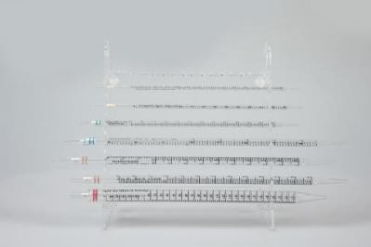
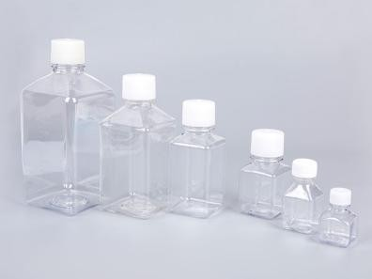
DARSUN
DARSUN™ Disposable Serological Pipette
It is suitable for tissue and cell culture
Tested for sterility, accuracy and endotoxin levels, certified pyrogen free Polystyrene material, high clarity, Clear scale, accurate pipetting
liquid-tight
RNase/DNase-free
Human DNA-free
Non-pyrogenic
Non-cytotoxic
Sterile
Order number | Description | Package
PT06-1 | 1ml，Sterile ,individual packaging | 50/PK；1000/CS
PT06-2 | 2ml，Sterile ,individual packaging | 50/PK；500/CS
PT06-5 | 5ml，Sterile ,individual packaging | 50/PK；200/CS
PT06-10 | 10ml，Sterile ,individual packaging Stretch type | 50/PK；200/CS
PT06-10A | 10ml，Sterile ,individual packaging Welded type | 50/PK；200/CS
PT06-25 | 25ml，Sterile ,individual packaging | 25/PK；200/CS
PT06-50 | 50ml，Sterile ,individual packaging | 25/PK；100/CS
PT06-100 | 100ml，Sterile ,individual packaging | 20/PK；100/CS
DARSUN™ Cell Strainer
Ideal for stem cell and tissue-derived primary cell preparation
Suitable for DARSUN, Corning, Thermo and other mainstream brands 50ml centrifuge tube/cell culture tube
Adopted PP shell, Nylon filter
Different pore size:40,70 or 100um.
Human DNA-free
Non-pyrogenic
Non-cytotoxic
  Sterile
Order number | Description | Package
CS05-040 | Blue；40um | 1 /PK；50/CS
CS05-070 | Natural；70um | 1 /PK；50/CS
CS05-100 | Yello；100um | 1 /PK；50/CS
DARSUN™ Sterile media square bottles / PET Serum bottle
Suitable for packaging and transporting liquid media, buffers and serums
Square design for greater use of storage space
Leak-proof, graduated
PET material, with durability and Clear clarity and other advantages
Human DNA-free
Non-pyrogenic
Non-cytotoxic
Sterile
Order number | Description | Package
MCB09-50 | 50ml； White Cap | 72 /PK；144/CS
MCB09-125 | 125ml；Natural Cap | 25/PK；100/CS
MCB09-250 | 250ml；Natural Cap | 30/PK；60/CS
MCB09-500 | 500ml；Natural Cap | 24/PK；48/CS
MCB09-1000 | 1000ml；Natural Cap | 12/PK；24/CS
16
DARSUN SCIENTIFIC

Slide 14
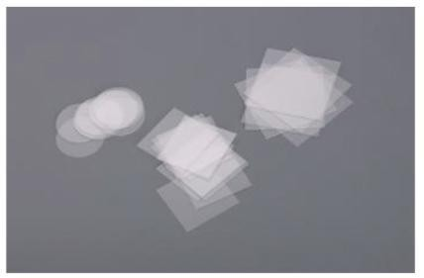
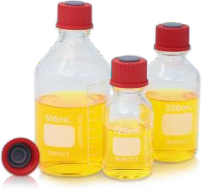
DARSUN
DARSUN™ Cell Culture Coverslip
High optical glass material, surface treatment, can promote the growth of cells directly on the slide
Stick to the wall, not easy to fall off, to avoid the loss of cells due to metastasis
No processing required, ready to use, No.1 thickness (0.13-0.17mm)
It is suitable for immunohistochemistry, immunofluorescence, in situ hybridization and other experiments
Order number | Description | Package
CCG33-12C | Circle; Diameter: 12mm | 100 /Box
CCG33-15C | Circle; Diameter: 15mm | 100 /Box
CCG33-20C | Circle; Diameter: 20mm | 100 /Box
CCG33-25C | Circle; Diameter: 25mm | 100 /Box
CCG33-28C | Circle; Diameter: 28mm | 100 /Box
DARSUN™ Glass culture medium bottle with scale
High borosilicate material, in line with USP Type I standards. Can keep the PH value of the medium or biological sample stable for a long time. No effluent pollution.
Made of German ISOLAB standard borosilicate hydrochloric acid 3.3 glass
Can withstand high temperature autoclave sterilization
Special dumping port design ensures that the dumping is solution avoiding dripping
with scale
With writing area
Optional standard Cap or puncture Cap
Order NO. | Description | Package
435-125 | 435-125 125ml medium bottle without lid, transparent; No Cap, 56x123mm | 60Pcs/CS
755-125A | 125ml medium bottle with lid, transparent; PBT resin Cap; Chloroprene rubber pad, 56x123mm | 60Pcs/CS
755-125B | 125ml culture medium bottle with puncture cap, transparent; PBT resin can puncture cap; Chloroprene rubber pad, 56x123mm | 60Pcs/CS
755-125W | 125ml culture medium bottle with puncture cap, transparent; With wheaton puncture Cap (DWK：240680), 56x123mm | 60Pcs/CS
437-250 | 250ml medium bottle without cap, transparent; 66x156mm | 40Pcs/CS
757-250A | 250ml medium bottle with lid, transparent; PBT resin Cap; Chloroprene rubber pad, 66x156 | 40Pcs/CS
757-250B | 250ml culture medium bottle with puncture cap, transparent; PBT resin can puncture cap; Chloroprene rubber pad, 66x156mm | 40Pcs/CS
757-250W | 250ml culture medium bottle with puncture cap, transparent; Fitted with wheaton Puncture Cap (DWK：240680) 66x156mm | 40Pcs/CS
439-500 | 500ml medium bottle without Cap, transparent, 85x182mm | 24Pcs/CS
759-500A | 500ml medium bottle with cap, transparent; PBT resin cap; Chloroprene rubber pad, 85x182mm | 24Pcs/CS
759-500B | 500ml culture medium bottle with puncture cap, transparent; PBT resin can puncture cap; Chloroprene rubber pad, 85x182mm | 24Pcs/CS
759-500W | 500ml culture medium bottle with puncture cap, transparent; With wheaton puncture cap (DWK：240680) 85x182mm | 24Pcs/CS
33-430A | standard Cap, PBT resin Cap; Chloroprene rubber pad, 33mm | 100 Pcs/Box
33-430B | puncture cap, PBT resin puncture cover; Chloroprene rubber pad, 33mm | 100 Pcs/ Box
DARSUN SCIENTIFIC
17

Slide 15
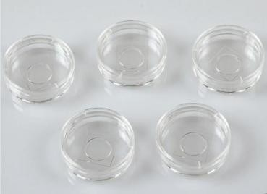
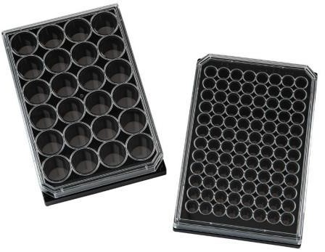
DARSUN
DARSUN™ Confocal Dish
DARSUN™ Confocal Dish easily performs high-quality imaging in a 35 mm petri dish.
Combining the convenience of a standard 35mm petri dish with the imaging benefits of a cover glass provides the excellent optical properties required for high magnification microscopy and confocal image analysis.
●
●
●
Improve the quality of high-resolution cell culture images Reduce evaporation and contamination of the medium Human DNA-free
Non-pyrogenic
Non-cytotoxic
Sterile
Recommended use:
Fluorescence microscopy imaging, phase contrast microscopy imaging, confocal microscopy imaging, live cell imaging Differential interferometric contrast microscopy, Fluorescence in Situ Hybridization (FISH)
Order number | Description | Package
CDG35-16 | Dish diameter: 35mm; Glass bottom diameter: 16mm | 10/PK；100/CS
CDG35-20 | Dish diameter: 35mm; Glass bottom diameter: 20mm | 10/PK；100/CS
DARSUN™ 96 Well Black/Clear Bottom Plate, TC Surface
96-Well Optical-Bottom Plates with Polymer Base have a solid polystyrene black or white upper structures with a polystyrene film at the bottom of the plate.
The plates are optimized for fluorescence and luminescence in cell culture and microscopic applications.
White or black polystyrene upper structure with polymer or coverglass bottom plates combine the optical clarity of virgin crystalline polystyrene with optimal surface for a wide range of HTS applications.
Background, autoflorescence and crosstalk are improved when you use Black microplates are recommended for florescence measurements; with minimum back-scattered light and background fluorescence
Black or White microplates
White microplates are recommended for luminescence measurements; with maximum reflection and minimal autoluminescence
Available in black for fluorescence assays or white for luminescence and fluorescence assays;
both with clear bottoms
Polymer base plate
Working range, 50-200μL/well
RNase/DNase-free
Human DNA-free
Non-pyrogenic
Non-cytotoxic
Sterile
Order number | Description | Package
PG06-W96CC | 96-well white glass bottom microporous plate; Cell culture surface | 1/PK；20/CS
PG06-96CC | 96-well black glass bottom microplate; Cell culture surface | 1/PK；20/CS
PG06-W96C | 96-well white polymer bottom microporous plate; Cell culture surface | 1/PK；20/CS
PG06-96C | 96-well black polymer bottom microporous plate; Cell culture surface | 1/PK；20/CS
PG06-W96 | 96-well white polymer bottom microporous plate; Untreated surface | 1/PK；20/CS
PG06-96 | 96-well black polymer bottom microporous plate; Untreated surface | 1/PK；20/CS
18
DARSUN SCIENTIFIC

Slide 16
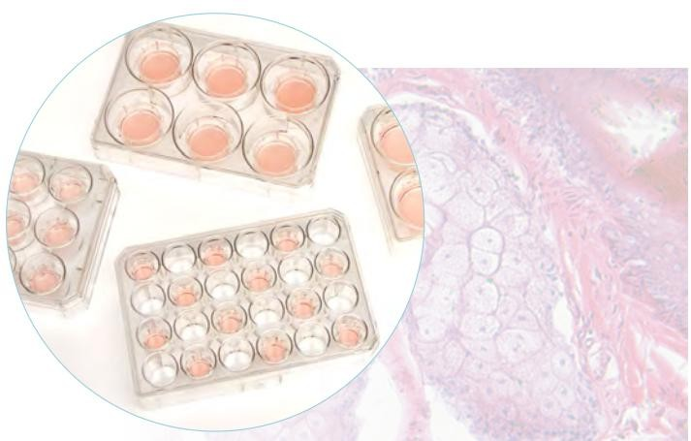
DARSUN
DARSUN™Cell Culture Inserts in Multi-Well Plates
The membrane is made of polycarbonate membrane with superhydrophilic surface
Most cell types can be grown without substrate coating using the Biolaand cell culture chamber
Four pore sizes: 0.4, 3, 5，and 8 micron
There are three sizes of 6-well, 12-well and 24-well cell culture plates available
RNase/DNase-free
Human DNA-free
Non-pyrogenic
Non-cytotoxic
  Sterile
Polycarbonate membranes have higher pore density, allow more exchange through the membrane, and have excellent cell adhesion properties, making them ideal for transport studies and other applications where optimal cell growth is required. Polycarbonate membranes are also very suitable for barrier analysis. It has a higher, more sustained, and more stable transepithelial resistance over a longer period of time than other membranes.
：
Detection of tumor migration and invasion
Epithelial and endothelial cell barrier assays
Leather/skin and epithelial tissue model
Study of chemotaxis
Co-culture research:
Cell to cell interactions
Cell-mother cell interaction
Cell-substrate interaction
Order number | Description | Package
DARSUN™Cell Culture Chamber, 6-well plate kit
CER06-004 | PC membrane; Membrane aperture: 0.4um | 1 set/bag; 10 sets/Cs
CER06-030 | PC membrane; Membrane aperture: 3um | 1 set/bag; 10 sets/Cs
CER06-050 | PC membrane; Membrane aperture: 5um | 1 set/bag; 10 sets/Cs
CER06-080 | PC membrane; Membrane aperture: 8um | 1 set/bag; 10 sets/Cs
DARSUN™Cell Culture Chamber, 12-well plate kit
CER12-004 | PC membrane; Membrane aperture: 0.4um | 1 set/bag; 10 sets/Cs
CER12-030 | PC membrane; Membrane aperture: 3um | 1 set/bag; 10 sets/Cs
CER12-050 | PC membrane; Membrane aperture: 5um | 1 set/bag; 10 sets/Cs
CER12-080 | PC membrane; Membrane aperture: 8um | 1 set/bag; 10 sets/Cs
DARSUN™Cell Culture Chamber, 24-well plate kit
CER24-004 | PC membrane; Membrane aperture: 0.4um | 1 set/bag; 10 sets/Cs
CER24-030 | PC membrane; Membrane aperture: 3um | 1 set/bag; 10 sets/Cs
CER24-050 | PC membrane; Membrane aperture: 5um | 1 set/bag; 10 sets/Cs
CER24-080 | PC membrane; Membrane aperture: 8um | 1 set/bag; 10 sets/Cs
DARSUN SCIENTIFIC
19

Slide 17
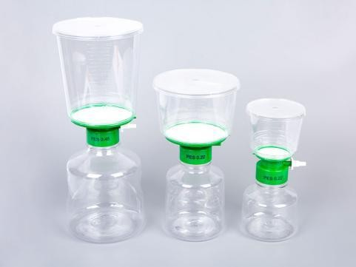
DARSUN
DARSUN™ Disposable vacuum filter/sterilizing filter
Self-contained filter system with filter funnel (top filter) receiving bottle and interface.
Pre-filtration is very convenient and is an ideal tool for removing bacteria or impurities from a large number of biological liquids in the laboratory
Polyether sulfone (PES), cellulose acetate (CA), polyvinylidene fluoride (PVDF) and other microporous filter membranes are provided
Different membrane pore sizes can be used for the treatment of different biological liquids.
Ergonomic design, the upper and lower containers are graduated, making the filtration more convenient and easy to operate
Filtration efficiency (0.22μm): LRV > 7 deficient Shortwave monomonas, ATCC19146, ASTM Bacterial Challenge test
Sterile, RNase/DNase-free,Non-pyrogenic,Non-cytotoxic, no surfactant, very low extraction
Biosafety testing, USP<87>, USP<88>
Single-use, pre-sterilized with gamma rays
Very low protein adsorption rate <1.5% (PES)
Ultra-high flow rates and fluxes filter liquids faster and more
The GL45 interface is suitable for conventional laboratory receiving containers.
A 0.1um aperture can be used for mycoplasma removal in liquids
The pore size of 0.22um can be used for debacterialization and filtration of liquid
The aperture of 0.45um can be used for liquid clarification and filtration
Order number | Description | Package
DARSUN™ Disposable vacuum filter/Sterilizing filter；Polyethersulfone membrane（PES)
PES50-S250 | 250ml; PES membrane; Diameter: 50mm; Aperture: 0.1um | 1/PK；12/CS
PES90-S500 | 500ml; PES membrane; Diameter: 90mm; Aperture: 0.1um | 1/PK；12/CS
PES90-S1000 | 1000ml; PES membrane; Diameter: 90mm; Aperture: 0.1um | 1/PK；12/CS
PES50-250 | 250ml; PES membrane; Diameter: 50mm; Aperture: 0.22um | 1/PK；12/CS
PES75-500 | 500ml; PES membrane; Diameter: 90mm; Aperture: 0.22um | 1/PK；12/CS
PES90-1000 | 1000ml; PES membrane; Diameter: 90mm; Aperture: 0.22um | 1/PK；12/CS
PES50-L250 | 250ml; PES membrane; Diameter: 50mm; Aperture: 0.45um | 1/PK；12/CS
PES90-L500 | 500ml; PES membrane; Diameter: 90mm; Aperture: 0.45um | 1/PK；12/CS
PES90-L1000 | 1000ml; PES membrane; Diameter: 90mm; Aperture: 0.45um | 1/PK；12/CS
DARSUN™ Disposable vacuum filter/Sterilizing filter；Polyvinylidene fluoride membrane (PVDF)
PVDF50-S250 | 250ml; PVDF membrane; Diameter: 50mm; Aperture: 0.1um | 1/PK；12/CS
PVDF90-S500 | 500ml; PVDF membrane; Diameter: 90mm; Aperture: 0.1um | 1/PK；12/CS
PVDF90-S1000 | 1000ml; PVDF membrane; Diameter: 90mm; Aperture: 0.1um | 1/PK；12/CS
PVDF50-250 | 250ml; PVDF membrane; Diameter: 50mm; Aperture: 0.22um | 1/PK；12/CS
PVDF75-500 | 500ml; PVDF membrane; Diameter: 90mm; Aperture: 0.22um | 1/PK；12/CS
PVDF90-1000 | 1000ml; PVDF membrane; Diameter: 90mm; Aperture: 0.22um | 1/PK；12/CS
PVDF50-L250 | 250ml; PVDF membrane; Diameter: 50mm; Aperture: 0.45um | 1/PK；12/CS
PVDF90-L500 | 500ml; PVDF membrane; Diameter: 90mm; Aperture: 0.45um | 1/PK；12/CS
PVDF90-L1000 | 1000ml; PVDF membrane; Diameter: 90mm; Aperture: 0.45um | 1/PK；12/CS
DARSUN™ Disposable vacuum filter/Sterilizing filter；Cellulose acetate membrane (CA)
CA50-250 | 250ml; CA membrane; Diameter: 50mm; Aperture: 0.22um | 1/PK；12/CS
CA75-500 | 500ml; CA membrane; Diameter: 90mm; Aperture: 0.22um | 1/PK；12/CS
CA90-1000 | 1000ml; CA membrane; Diameter: 90mm; Aperture: 0.22um | 1/PK；12/CS
CA50-L250 | 250ml; CA membrane; Diameter: 50mm; Aperture: 0.45um | 1/PK；12/CS
CA90-L500 | 500ml; CA membrane; Diameter: 90mm; Aperture: 0.45um | 1/PK；12/CS
CA90-L1000 | 1000ml; CA membrane; Diameter: 90mm; Aperture: 0.45um | 1/PK；12/CS
Note：DARSUN™ Disposable vacuum filter/sterilizing filter can provide more membrane materials, more aperture specifications, contact customer service staff.
20
DARSUN SCIENTIFIC

Slide 18
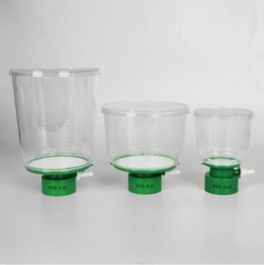
DARSUN
DARSUN™ Disposable Sterile Top Filter
It provides polyether sulfone (PES), cellulose acetate (CA), polyvinylidene fluoride (PVDF) and other microporous filter membranes, which can be used for the treatment of different biological liquids.
Single-use, pre-sterilized with gamma rays
Filtration efficiency (0.22μm): LRV > 7 deficient Shortwave monomonas,
ATCC19146, ASTM Bacterial Challenge test
Biosafety testing, USP<87>, USP<88>
Sterile, RNase/DNase-free,Non-pyrogenic,Non-cytotoxic, no surfactant, very low extraction
Very low protein adsorption rate <1.5% (PES)
Ultra-high flow rates and fluxes filter liquids faster and more
The GL45 interface is suitable for conventional laboratory receiving containers.
Ergonomic design, the upper and lower containers are graduated, making the filtration more convenient and easy to operate
Order number | Description | Package
DARSUN™Top Filter；Polyethersulfone membrane（PES)
PES50-S250N | 250ml; PES membrane; Diameter: 50mm; Aperture: 0.1um | 1/PK；24/CS
PES90-S500N | 500ml; PES membrane; Diameter: 90mm; Aperture: 0.1um | 1/PK；24/CS
PES90-S1000N | 1000ml; PES membrane; Diameter: 90mm; Aperture: 0.1um | 1/PK；24/CS
PES50-250N | 250ml; PES membrane; Diameter: 50mm; Aperture: 0.22um | 1/PK；24/CS
PES75-500N | 500ml; PES membrane; Diameter: 90mm; Aperture: 0.22um | 1/PK；24/CS
PES90-1000N | 1000ml; PES membrane; Diameter: 90mm; Aperture: 0.22um | 1/PK；24/CS
PES50-L250N | 250ml; PES membrane; Diameter: 50mm; Aperture: 0.45um | 1/PK；24/CS
PES90-L500N | 500ml; PES membrane; Diameter: 90mm; Aperture: 0.45um | 1/PK；24/CS
PES90-L1000N | 1000ml; PES membrane; Diameter: 90mm; Aperture: 0.45um | 1/PK；24/CS
DARSUN™Top Filter；Polyvinylidene fluoride membrane (PVDF)
PVDF50-250N | 250ml; PVDF membrane; Diameter: 50mm; Aperture: 0.22um | 1/PK；24/CS
PVDF75-500N | 500ml; PVDF membrane; Diameter: 90mm; Aperture: 0.22um | 1/PK；24/CS
PVDF90-1000N | 1000ml; PVDF membrane; Diameter: 90mm; Aperture: 0.22um | 1/PK；24/CS
PVDF50-L250N | 250ml; PVDF membrane; Diameter: 50mm; Aperture: 0.45um | 1/PK；24/CS
PVDF90-L500N | 500ml; PVDF membrane; Diameter: 90mm; Aperture: 0.45um | 1/PK；24/CS
PVDF90-L1000N | 1000ml; PVDF membrane; Diameter: 90mm; Aperture: 0.45um | 1/PK；24/CS
DARSUN™Top Filter；Cellulose acetate membrane (CA)
CA50-250N | 250ml; CA membrane; Diameter: 50mm; Aperture: 0.22um | 1/PK；24/CS
CA75-500N | 500ml; CA membrane; Diameter: 90mm; Aperture: 0.22um | 1/PK；24/CS
CA90-1000N | 1000ml; CA membrane; Diameter: 90mm; Aperture: 0.22um | 1/PK；24/CS
CA50-L250N | 250ml; CA membrane; Diameter: 50mm; Aperture: 0.45um | 1/PK；24/CS
CA90-L500N | 500ml; CA membrane; Diameter: 90mm; Aperture: 0.45um | 1/PK；24/CS
CA90-L1000N | 1000ml; CA membrane; Diameter: 90mm; Aperture: 0.45um | 1/PK；24/CS
Note：DARSUN™ Disposable vacuum filter/sterilizing filter can provide more membrane materials, more aperture specifications, contact customer service staff.
DARSUN SCIENTIFIC
21

Slide 19
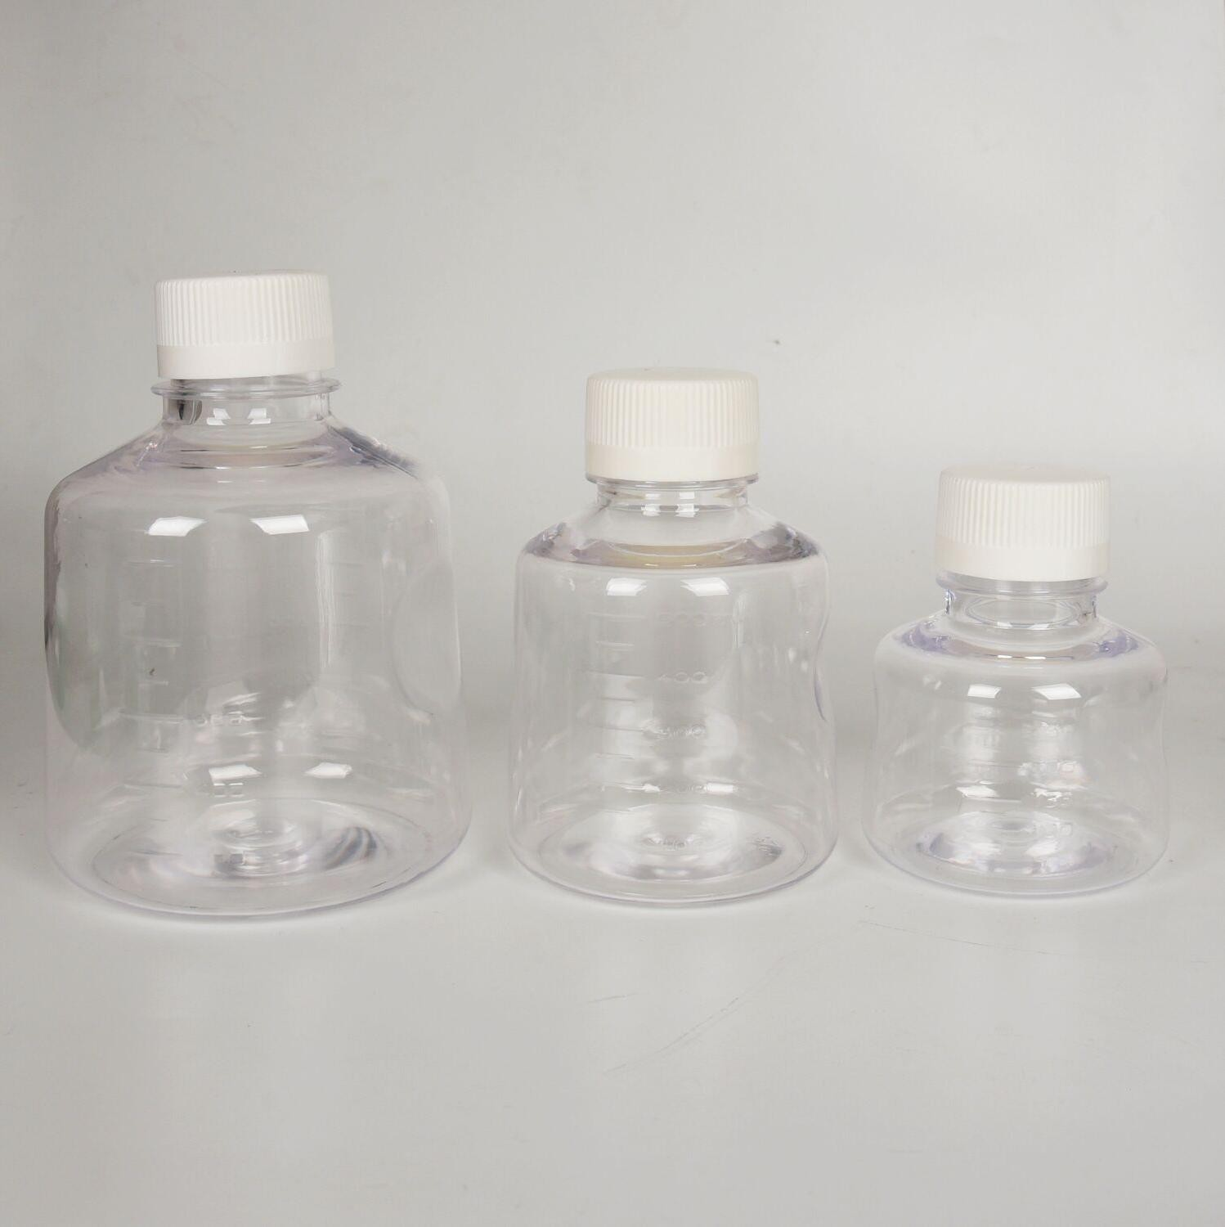
DARSUN
DARSUN™ Sterile filter Receiving Bottle/Storage Bottle
RNase/DNase-free
Human DNA-free
Non-pyrogenic
Non-cytotoxic
Sterile
The use of radiation sterilization can reduce the contamination of the sample.
Use with DARSUN™Top Filter or as a container to store media.
GL45 connector, screw cap, leak proof
Biosafety testing, USP<87>, USP<88>
Order number | Description | Package
GL06-250 | 250ml，Bottle body PS, Cap HDPE | 1/PK；24/CS
GL06-500 | 500ml，Bottle body PS, Cap HDPE | 1/PK；24/CS
GL06-1000 | 1000ml，Bottle body PS, Cap HDPE | 1/PK；24/CS
22
DARSUN SCIENTIFIC

Slide 20
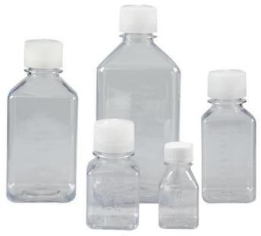
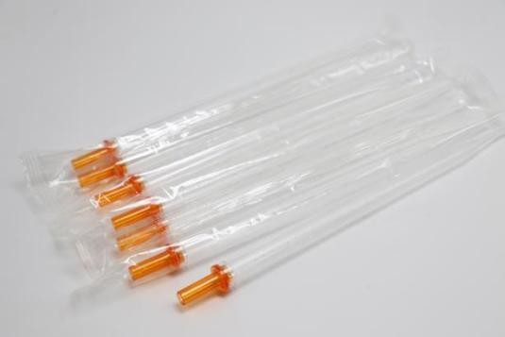
DARSUN
DARSUN™ PETG Biograde Frozen Bottle
Suitable for the preparation and storage of active drugs, intermediates, buffers, media and other laboratory liquids. The low permeability of CO2 and O2 in commonly used plastics PETG can be used as a storage for Ph-sensitive substances.
100,000 clean workshop production
PETG bottle body; HDPE bottle cap
Sterile, enzyme-free, pyrogen free, cytotoxic free
Bag packing
Square design for greater use of storage space
Leak-proof, graduated
Used for packaging and transporting liquid media, buffers and serums
Order number | Description | Package
MCB19-30 | PETG bottle body; Cap HDPE; 30ml; Natural lid | 6/PK；144/CS
MCB19-50 | PETG bottle body; Cap HDPE; 60ml; Natural lid | 6/PK；144/CS
MCB19-125 | PETG bottle body; Cap HDPE; 125ml; Natural lid | 5/PK；100/CS
MCB19-250 | PETG bottle body; Cap HDPE; 250ml; Natural lid | 5/PK；60/CS
MCB19-500 | PETG bottle body; Cap HDPE; 500ml; Natural lid | 4/PK；48/CS
MCB19-1000 | PETG bottle body; Cap HDPE; 1000ml; Natural lid | 4/PK；24/CS
DARSUN™ Biograde Serological Pipette
The unique scale design guarantees higher accuracy: ±1%
Ink-free printing to avoid contamination caused by ink shedding
The polyethylene sintered filter element ensures the ventilation flow while avoiding the pollution of fiber and wool
With the color of the joint, the specification is clear
Shorter than the conventional design, more convenient operation, narrow space operation more flexible
Plastic packaging, avoid paper scraps, hydrogel powder pollution
Class 100,000 clean workshop production, in line with ISO9001-2015,ISO13485-2016 quality management system certification
RNase/DNase-free
Human DNA-free
Non-pyrogenic
Non-cytotoxic
Sterile
Order number | Description | Package
PTB06-5 | 5ml, sterile individual packaging | 50/PK；200/CS
PTB06-10 | 10ml, sterile individual packaging | 50/PK；200/CS
PTB06-25 | 25ml, sterile individual packaging | 25/PK；200/CS
DARSUN SCIENTIFIC
23

Slide 21

DARSUN
24
DARSUN SCIENTIFIC

Slide 22
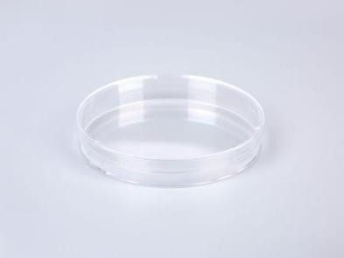
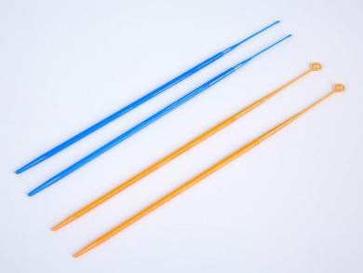
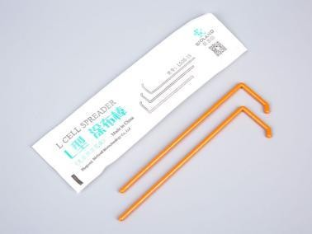
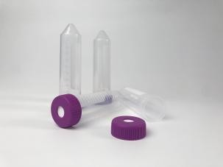
DARSUN
DARSUN™ Petri dish
Designed for microbiology to grow microorganisms on solid media
The shallow petri dish can improve the space utilization of the incubator as much as possible After mirror treatment, high optical quality of petri dishes can be ensured
Used for bacterial culture
RNase/DNase-free
Human DNA-free
Non-pyrogenic
Non-cytotoxic
Sterile
Order number | Description | Package
BCD06-060B | Diameter: 60, height: 15mm | 10/PK；500/CS
BCD06-090A | Diameter: 90, height: 15mm | 10/PK；500/CS
BCD06-090B | Diameter: 90, height: 20mm | 10/PK；300/CS
DARSUN™ Disposable Loop & Needle
Suitable for microbe inoculatio
Available in 1ul and 10ul sizes
Sterile, RNase/DNase free, pyrogen free
Made of polypropylene material, high temperature and high pressure sterilization
Order number | Description | Package
MIR05-01 | Blue; 1ul | 10/PK；500/CS
MIR05-10 | Orange; 10ul | 10/PK；500/CS
DARSUN™ L-shaped Spreader
Disposable spreader is used for spreading microorganisms which is sterilized before the release. suitable for spreading of microbes samples
Sterile, RNase/DNase free, pyrogen free
Made of polypropylene material, high temperature and high pressure sterilization
Individual packaging
Order number | Description | Package
LS05-1S | L-shaped Spreader ;orange；Individual packaging 10/PK；500/CS
DARSUN 15ml/50ml Membrane reaction tube/centrifuge tube/shaker tubes
It is especially suitable for suspension cell culture, clonal selection, bacterial solution/strain resuscitation, small volume suspension culture and low protein adsorption of serological research.
The external dimension is the same as that of the 15ml/50ml centrifuge tube, which is suitable for most 15ml/50ml centrifuge devices.
The tube body is made of USP Class VI medical grade polypropylene.The cap is made of USP ClassVI medical grade HDPE High transparency, easy observation, belt scale
0.22um PTFE membrane can provide high dissolved oxygen, bacteria resistance and air permeability
· Sterile, RNase/DNase-free, Human DNA-free, Non-pyrogenic, Non-cytotoxic.
15ml centrifugal force tolerance :13000xg; 50ml centrifugal force tolerance: 17000xg
Order NO. | Description | Package
ATS05-10-15 | 1 15ml，10mm，PTFE | 10Pcs/Pk;10Pk/Cs
ATS05-12-50 | 50ml，12mm，PTFE | 10Pcs/Pk;10Pk/Cs
DARSUN SCIENTIFIC
25

Slide 23
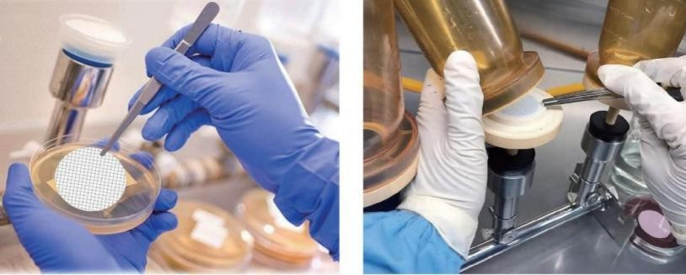
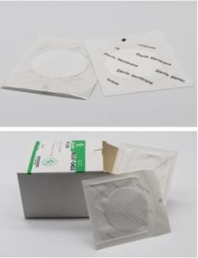
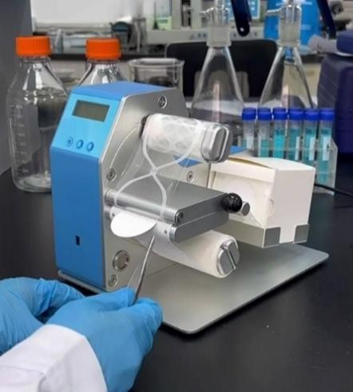
DARSUN
DARSUN™ Sterile microbial detection filter membrane
DARSUN™ Microbial detection membrane was selected as unsupported, natural hydrophilic mixed cellulose filter membrane, using different pore sizes to enrich designated bacteria for culture. It can be widely used in various microbial analysis and research。
Available in individual and continuous packaging, the continuous packaging grille film is suitable for DARSUN™ Membrane Dispenser Curve
In line with ISO7704, the most suitable for microbial retention and growth, microbial recovery >90%
Filtration efficiency: LRV&gt; 7(ATCC 19146 deficient Shortwave monas, ASTM Bacterial Challenge Test) High flow rate
The grid lines on the membrane facilitate colony identification and counting, and do not affect colony growth
Gamma rays pre-filtered, valid for 3 years
For "membrane filtration method" for solid, liquid, gas and other samples for microbial detection, especially for food hygiene industry or water monitoring in the total number of bacteria, fecal coliform, Escherichia coli, sterility testing, Pseudomonas aeruginosa, Staphylococcus aureus, etc., general microscopic inspection particle count or analysis.
Order NO. | Description | Package
MCE47-022S | Sterile microbial detection filter membrane；Diameter：47mm ；Aperture：0.22um | 200 pcs/Pk
MCE47-045S | Sterile microbial detection filter membrane；Diameter：47mm ；Aperture：0.45um | 200 pcs/Pk
MCE47-022SS | Sterile microbial detection filter membrane For Machine distribution；Diameter： | 200 pcs/Pk
 | 47mm ；Aperture：0.22um
MCE47-045SS | Sterile microbial detection filter membrane For Machine distribution；Diameter： | 200 pcs/Pk
 | 47mm ；Aperture：0.45um
DARSUN™ Membrane Dispenser Curve
General microbiological analysis; Beer; Bottled Water; Pharmaceutical Products Analysis; Environmental Analysis; Bioburden Testing; Water Monitoring，Extensive use of sterile filters is often required. The DARSUN™ automatic film extractor is
designed for this purpose, making the process of mass film extraction easy and fast. The film
extractor is lightweight, easy to install, and contactless, avoiding hand contact with the filter and reducing the risk of contamination.
Used for automatic membrane extraction of microbial detection membrane
Automatic infrared induction film collection
Filter membrane pre-sterilization, no contact to take the membrane, to avoid secondary pollution installation process is simple and fast
Indicates the number of membranes used and the number of membranes remaining
High speed film removal < 1 second
Lightweight appearance, easy to move and use
Can be used for AC power supply 110/220V or 18650 lithium battery
The detection efficiency is effectively improved
Order NO. | Description |  | Package
MCE47-01S | Membrane Dispenser Curve |  | 1 Set/Cs
 |  | 26 | DARSUN SCIENTIFIC

Slide 24
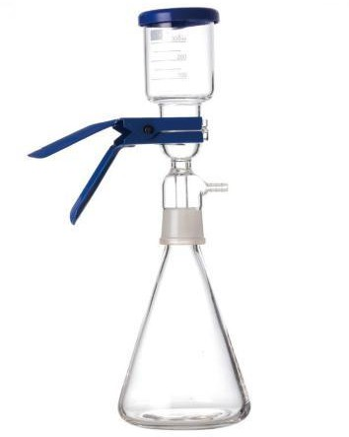
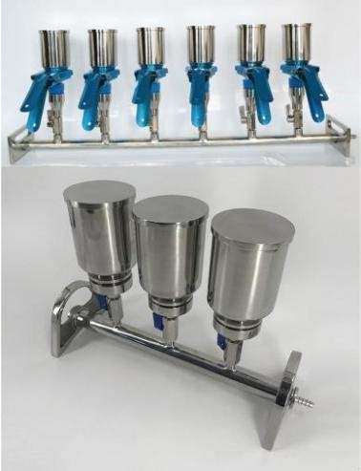
DARSUN
DARSUN™ High borosilicate solvent filter
High borosilicate glass material
42mm sand chips or 47mm and 50mm filters are available Resistant to most aqueous and organic solvents
Can be autoclaved
Order NO. | Description | Package
HG09-250 | High borosilicate solvent filter；250ml | 1 Set/Cs
HG09-500 | High borosilicate solvent filter；500ml | 1 Set/Cs
HG09-1000 | High borosilicate solvent filter；1000ml | 1 Set/Cs
HG09-2000 | High borosilicate solvent filter；2000ml | 1 Set/Cs
HG09-3000 | High borosilicate solvent filter；3000ml | 1 Set/Cs
HG09-5000 | High borosilicate solvent filter；5000ml | 1 Set/Cs
HG09-10000 | High borosilicate solvent filter；10000ml | 1 Set/Cs
DARSUN™ Stainless steel multiplex filter
The filter bracket is equipped with an independent control valve for each bracket, allowing for flexible and convenient disinfection with high efficiency.
It has the capability to simultaneously detect three or six samples with high sensitivity, low false positive rate, and simple operation. Constructed from 316L sanitary grade stainless steel material,
it is resistant to acid and alkali corrosion and can be easily disinfected at high temperatures, ensuring stable and reliable analysis results.
The aluminum clip's tight design facilitates easy combination of the filter cup with the middle filter head, ensuring a strict seal without any leakage.
Widely utilized in chemical analysis, biochemical pharmaceuticals, health inspection, environmental testing, water quality analysis, food and beverage industries as well as scientific research.
Order NO. | Description | Package
SSF3-300 | Stainless steel multiplex filter；3 Channels*300ml | 1Set/Cs
SSF3-500 | Stainless steel multiplex filter；3 Channels*500ml | 1Set/Cs
SSF6-300 | Stainless steel multiplex filter；6 Channels*300ml | 1Set/Cs
SSF6-500 | Stainless steel multiplex filter；6 Channels*500ml | 1Set/Cs
DARSUN SCIENTIFIC
27

Slide 25
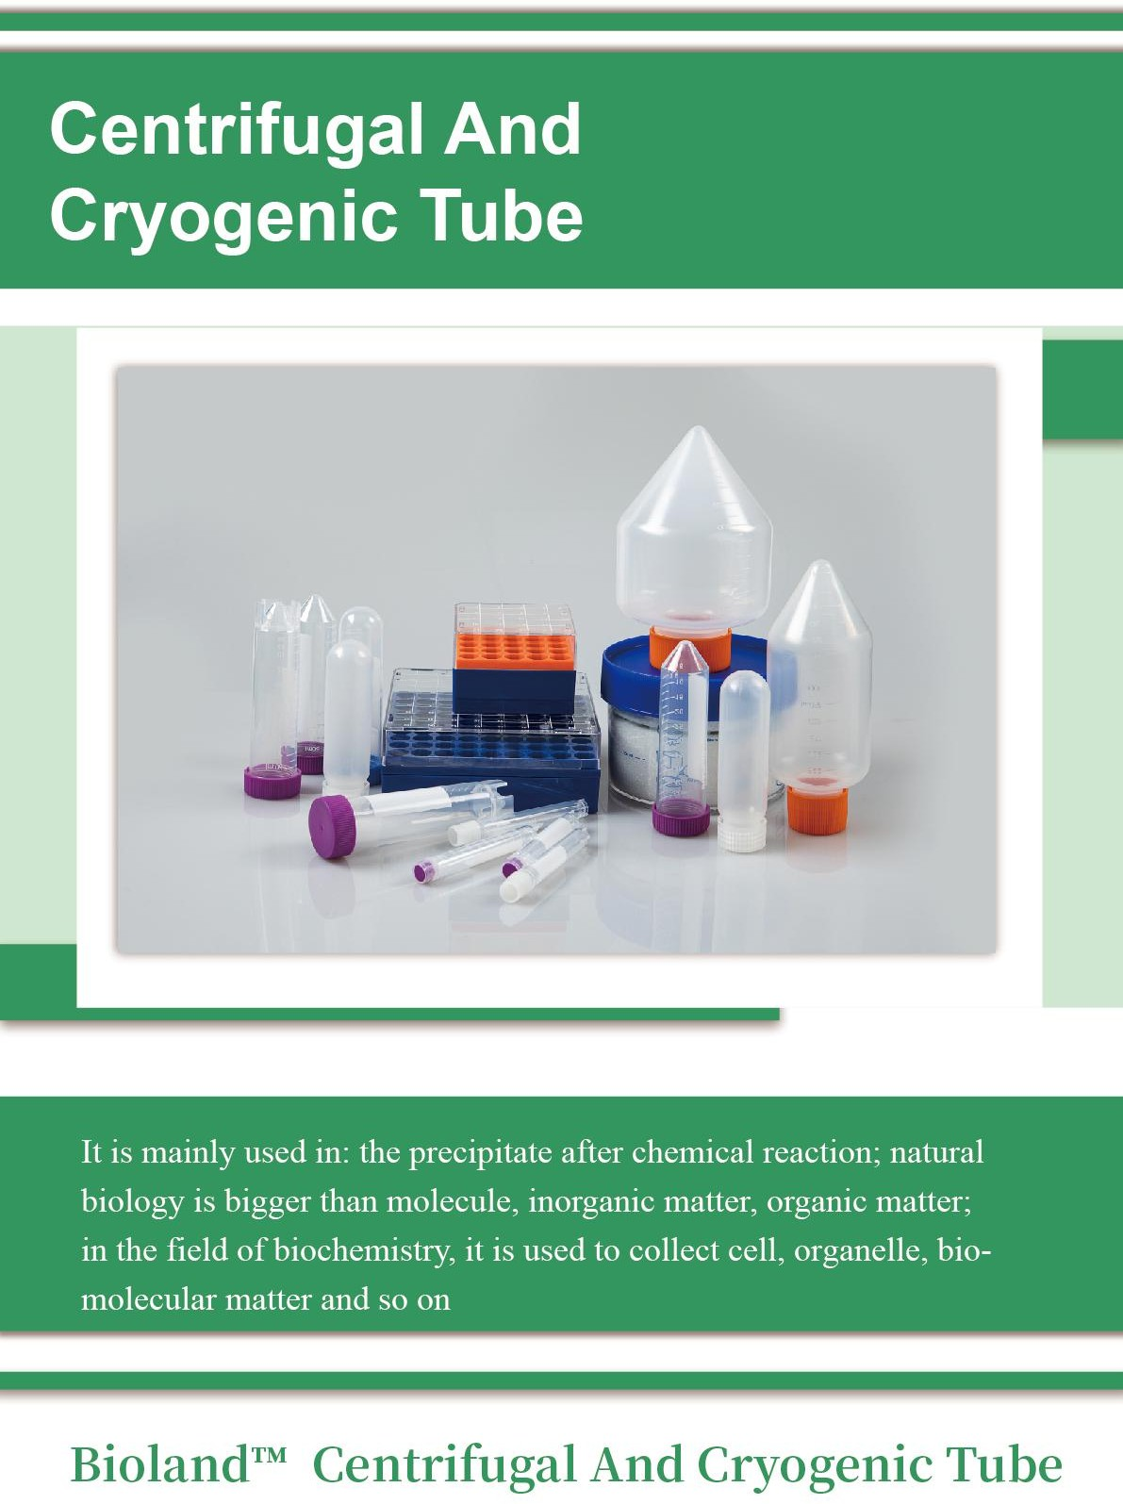
DARSUN
28
DARSUN SCIENTIFIC

Slide 26
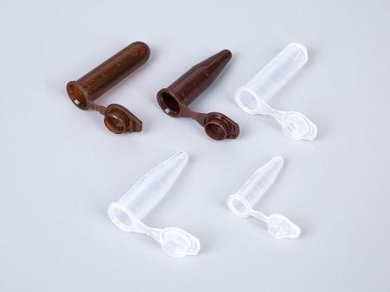
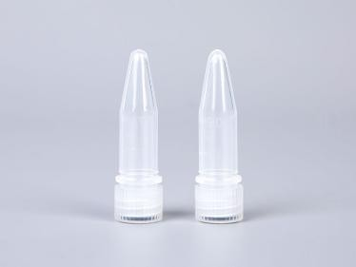
DARSUN
DARSUN™ Low Retention microcentrifuge tube
Microcentrifuge Tubes offer sample security while maintaining an easy to open cap. The larger round cap design assists in opening and the smooth surface reduces the possibility of ripped or torn gloves.
High clarity and clearly visible graduation marks allow for quick sample check.
Uniform tube concentricity aides in the robustness needed during centrifugation.
Tubes are available in amber to protect your light sensitive samples
Graduation marks on the microcentrifuge tube allow for effective sample reference
Frosted top and side writing pads
Uniform wall thickness improve durability
-80°C cold storage capable
Available in bulk bags
For stringent sterility requirements individually wrapped sterile tubes are available
Color options: Natural, Amber. Red. Blue, Green, Yellow and Violet and a mixed color packaging
virgin polypropylene ，ensure sample integrity during boiling, freezing and centrifugation
Sterile product is certified free of RNase, DNase, DNA, ATP, bioburden and endotoxins
Nonsterile product is certified free of RNase, DNase, DNA and pyrogens.
Max. RCF 20000xG
Can be autoclaved
Low adsorption microcentrifuge tube reduces liquid wall hanging and material adsorption
Order number | Description | Package
TP05-005 | 0.5ml; Not sterilized; Natural colour | 1000/PK；10000/CS
TP05-005-S | 0.5ml;Sterile; Natural colour | 100/PK；1000/Box,10000/Cs
TP05-015 | 1.5ml; Not sterilized; Natural colour | 500/PK；5000/Cs
TP05-015-S | 1.5ml;Sterile; Natural colour | 100/PK；500/Box,5000/Cs
TP05-020 | 2ml; Not sterilized; Natural colour | 500/PK；5000/Cs
TP05-020-S | 2ml;Sterile; Natural colour | 100/PK；500/Box,5000/Cs
TP05-050 | 5ml; Not sterilized; Natural colour | 200/PK；2000/CS
TP05-050-S | 5ml;Sterile; Natural colour | 100/PK；200/Box,2000/Cs
TP05-005B | 0.5ml;Non-sterilized; Amber | 1000/PK；10000/CS
TP05-005B-S | 0.5ml;Sterile; Amber | 100/PK；1000/Box,10000/Cs
TP05-015B | 1.5ml;Non-sterilized; Amber | 500/PK；5000/Cs
TP05-015B-S | 1.5ml;Sterile; Amber | 100/PK；500/Box,5000/Cs
TP05-020B | 2ml;Non-sterilized; Amber | 500/PK；5000/Cs
TP05-020B-S | 2ml;Sterile; Amber | 100/PK；500/Box,5000/Cs
Note：DARSUN™ Microcentrifuge tubes are available in a variety of color specifications. Contact DARSUN customer service for details.
DARSUN™ Screw Cap Microcentrifuge Tubes
Polypropylene material, durable, chemical resistance, natural color
Screw cap, leak proof
Can be high temperature autoclaved
RNase/DNase free, pyrogen free
The maximum centrifugal force：20000Xg
Order number | Description | Package
STP05-005 | 0.5 ml; Not sterilized; Natural colour | 500/PK；5000/CS
STP05-015 | 1.5 ml; Not sterilized; Natural colour | 500/PK；5000/CS
STP05-020 | 2ml; Not sterilized; Natural colour | 500/PK；5000/CS
DARSUN SCIENTIFIC
29

Slide 27
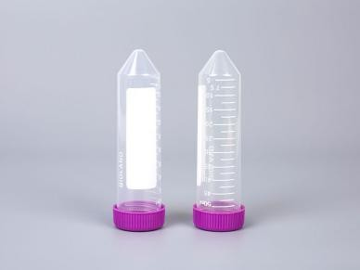
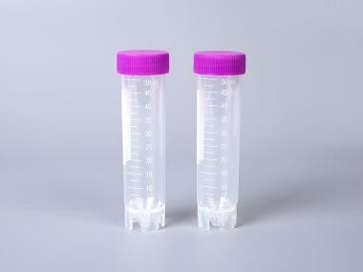
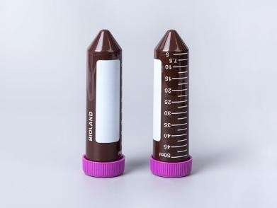
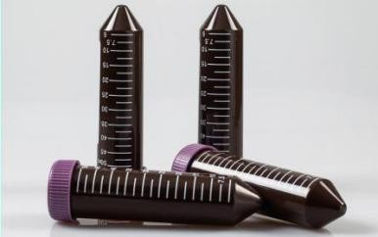
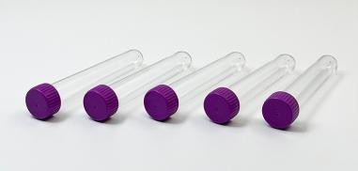
DARSUN
DARSUN™ 15mL and 50mL Conical Sterile Polypropylene Centrifuge Tubes
15mL & 50mL Conical Sterile Polypropylene Centrifuge Tubes are premium,
high-quality conical tubes that are environmentally friendly,
offer the highest cleanliness with a recyclable plastic rack； increased traceability with the large writing area.
Labware Products are made from high-purity resins and molded using our state-of-the-art processes.
Nonpyrogenic: Endotoxin tested (0.6 EU/mL)
Non-Cytotoxic
Biologically inert: USP biological reactivity class VI
High level of sterility: SAL 10-6
RNase/DNase-free
Leak proof
Made from virgin resins and molded using state-of-the-art processes;
50ml provides Skirted-bottom self-supporting type.
50ml maximum centrifugal force:17000xg.
15ml maximum centrifugal force: 13500xg.
Available in bag and rack styles
Available in polystyrene for blood research applications
Order number | Description | Package
ATS05-15 | Sterile; 15ml; Bulk | 25/PK；500/ Cs
ATS05-15L | Sterile; 15ml; Rack | 50/Rack；500/Cs
ATS05-50 | Sterile; 50ml; Bulk | 25/PK；500/ Cs
ATS05-50L | Sterile; 50ml; Rack | 25/Rack；500/Cs
ATS05-50A | Sterile;Skirted, 50ml; Rack | 25/PK；500/ Cs
DARSUN™ Amber Conical Centrifuge Tubes
Order number | Description | Package
ATSL05B-15 | Amber,Sterile; 15ml; Bulk | 25/PK；500/ Cs
ATSL05B-15L | Amber,Sterile; 15ml; Rack | 50/Rack；500/Cs
ATSL05B-50 | Amber,Sterile; 50ml; Bulk | 25/PK；500/ Cs
ATSL05B-50L | Amber,Sterile; 50ml; Rack | 25/Rack；500/Cs
DARSUN™ Low Retention Conical Centrifuge Tubes
Order number | Description | Package
ATSL05-LR-15 | Sterile; 15ml; Bulk | 25/PK；500/ Cs
ATSL05-LR-15L | Sterile; 15ml; Rack | 50/Rack；500/Cs
ATSL05-LR-50 | Sterile; 50ml; Bulk | 25/PK；500/ Cs
ATSL05-LR-50L | Sterile; 50ml; Rack | 25/Rack；500/Cs
DARSUN™ Round bottom centrifugal tube -high transparency
Made of polypropylene material
Reusable, high temperature autoclave sterilization
With scale;Writing area
Available in a variety of sizes from 2ml to 100ml, with two choices of button and screw
Order number | Description | Package
ATS06-15R | 15ml; Round bottom; ungraduated | 24/PK，960/Cs
ATS06-15RS | 15ml; Round bottom; Tape scale | 24/PK，960/Cs
30
DARSUN SCIENTIFIC

Slide 28
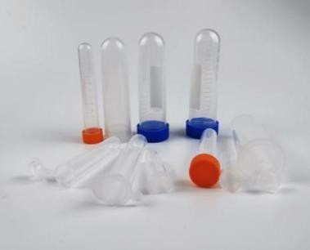
DARSUN
DARSUN™ Round bottom centrifuge tube
Made of polypropylene material
Reusable (high temperature autoclave)
With scale;Writing Area
Provide a variety of specifications from 2ml to 100ml, and provide two options: press cap and screw cap
Order NO. | Description | Package
CTL05-2P | 2mlRound bottom centrifuge tube;Press cap；10x42mm | 500/PK；5000/CS
CTL05-5P | 5mlRound bottom centrifuge tube; Press cap；13x54mm | 300/PK；3000/CS
CTL05-7P | 7mlRound bottom centrifuge tube;Press cap；14x81mm | 200/PK；2000/CS
CTL05-10P | 10mlRound bottom centrifuge tube; Press cap；14.5x82mm | 200/PK；2000/CS
CTL05-10S | 10mlRound bottom centrifuge tube; screw cap；16x102mm | 100/PK；1000/CS
CTL05-15P | 15mlRound bottom centrifuge tube; Press cap；18x98mm | 100/PK；1000/CS
CTL05-15S | 15mlRound bottom centrifuge tube; screw cap；16x115mm | 100/PK；1000/CS
CTL05-30S | 30mlRound bottom centrifuge tube;screw cap；27.5x107mm | 50/PK；500/CS
CTL05-50P | 50mlRound bottom centrifuge tube; Press cap；28x105mm | 50/PK；500/CS
CTL05-50S | 50mlRound bottom centrifuge tube; screw cap；28.5x115mm | 50/PK；500/CS
CTL05-100P | 100mlRound bottom centrifuge tube; Press cap；38x106mm | 30/PK；300/CS
CTL05-100S | 100mlRound bottom centrifuge tube; screw cap；38x116mm | 30/PK；300/CS
DARSUN SCIENTIFIC
31

Slide 29
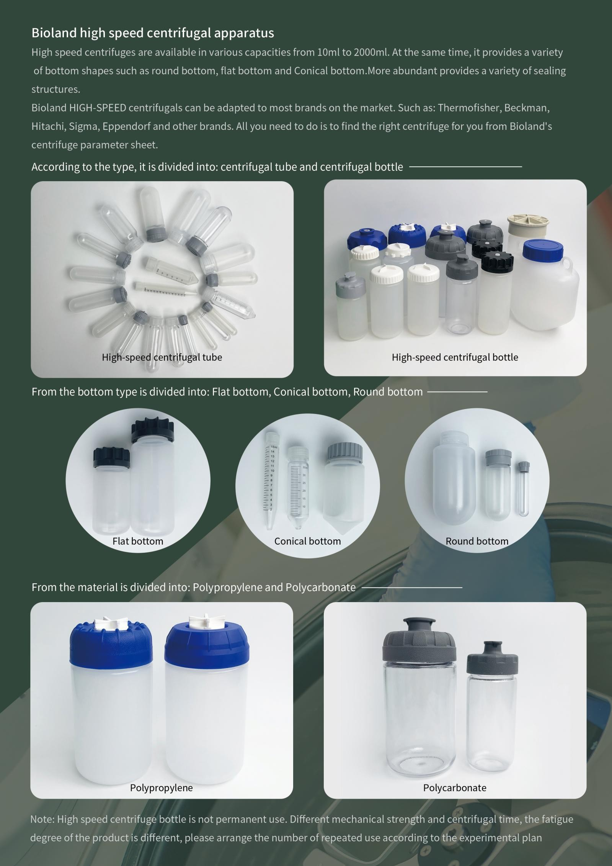
DARSUN
DARSUN SCIENTIFIC
32

Slide 30
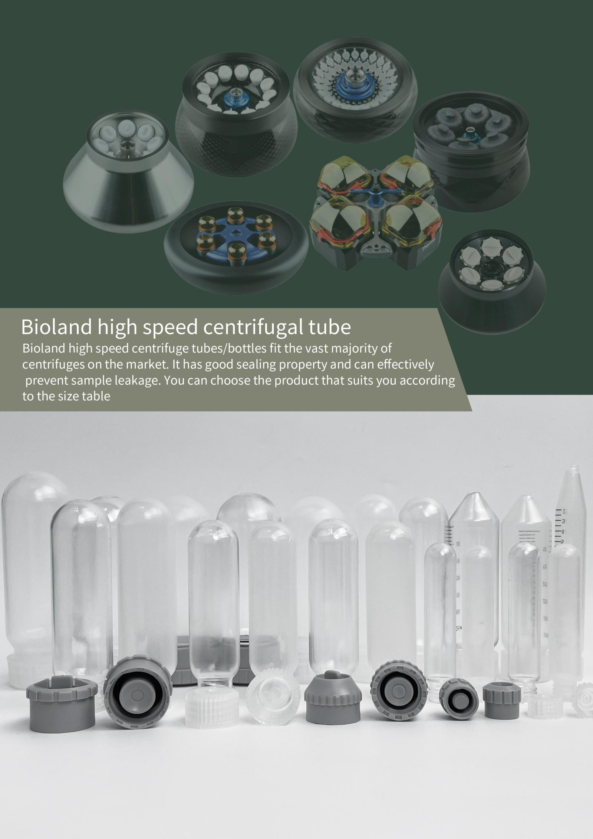
DARSUN
Darsun speed centrifugal tube
Darsun high speed centrifuge tube/
DARSUN SCIENTIFIC
33

Slide 31
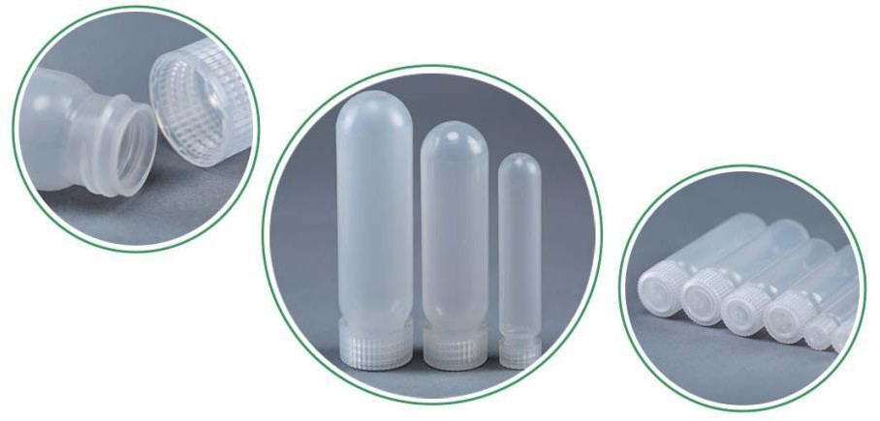
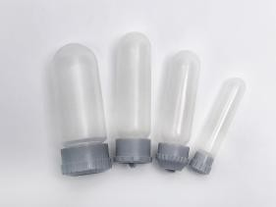
DARSUN
DARSUN™ High speed polypropylene centrifugal tube
High-Speed PP Centrifuge Tubes are chemically compatible with a wider variety of lab reagents and repeately autoclavable for extended performance.
It can be used in refrigerated centrifuges or non-refrigerated centrifuges with centrifugal force up to 5000xg
Suitable for ThermoFisher, Sigma, Beckman, Eppendorf, Tomy and other mainstream centrifugals
Comes with polypropylene linerless closures—easy to clean and provides leakproof protection under normal conditions up to 10,000 x g
Tubes must be filled to at least 80% capacity for proper performance
Great chemical resistance
Can be autoclaved repeatedly
Autoclavable
Leakproof
●
Note: During high temperature autoclave sterilization, please completely remove the cover and place it on the top of the container, remember not to rotate the screw seal
Order number | Description | Package
CTH05-10 | 10ml,Length * Diameter:81.4x16.0mm | 10/PK；100/CS
CTH05-30 | 30ml Length * Diameter:94.3x25.5mm | 10/PK；100/CS
CTH05-50 | 50ml, Length * Diameter: 106.7x28.8mm | 10/PK；100/CS
CTH05-100 | 100ml Length * Diameter:；105.7x38.2mm | 10/PK；100/CS
DARSUN™ High speed centrifugal tube
Suitable for most centrifuges on the market.
It has good sealing property and can effectively prevent sample leakage.
Provides flat bottom, conical bottom, round bottom three types of bottom. Various seal cap designs are available to reduce leakage of centrifugal bottles.
The combination seal cover is easier to open.
Centrifugal tubes made of either polypropylene or polycarbonate can be autoclaved at high temperature.
The centrifugal tube made of polypropylene has excellent chemical resistance, and the centrifugal tube made of polycarbonate has excellent light transmission and low temperature resistance.
You can choose the product that suits you according to the size table.
High speed centrifuge tube with gasket seal cap
Order number | Maximum capacity(ml) | Material | Size(mm) | Centrifugal force(Xg) | Packing Quantity
CTH05-S10 | 10ml | PP | 16x81.2 | 50000xg | 10Pcs/Pk；100Pcs/Cs
CTH05-S30 | 30ml | PP | 25x94 | 50000xg | 10Pcs/Pk；100Pcs/Cs
CTH05-S50 | 50ml | PP | 28.5x105 | 50000xg | 10Pcs/Pk；100Pcs/Cs
CTH05-S100 | 82ml | PP | 38x105 | 50000xg | 10Pcs/Pk；100Pcs/Cs
CTH07-S10 | 10ml | PC | 16x82.8 | 50000xg | 10Pcs/Pk；100Pcs/Cs
CTH07-S30 | 30ml | PC | 25.3x94.5 | 50000xg | 10Pcs/Pk；100Pcs/Cs
CTH07-S50 | 50ml | PC | 28.5x105 | 50000xg | 10Pcs/Pk；100Pcs/Cs
CTH07-S100 | 82ml | PC | 38x105 | 50000xg | 10Pcs/Pk；100Pcs/Cs
34
DARSUN SCIENTIFIC

Slide 32

DARSUN
Conical bottom High speed centrifuge tube with standard cap
Order number | Maximum capacity(ml) | Material | Size(mm) | Centrifugal force(Xg) | Packing Quantity
CTH05-C15 | 10ml | PP | 16x81.2 | 50000xg | 10Pcs/Pk；100Pcs/Cs
CTH05-C35 | 35ml | PP | 25x94 | 50000xg | 10Pcs/Pk；100Pcs/Cs
CTH05-C50 | 50ml | PP | 28.5x105 | 50000xg | 10Pcs/Pk；100Pcs/Cs
DARSUN SCIENTIFIC
35

Slide 33

DARSUN
Darsun High Speed centrifuge bottle with gasket sealing cap
36
DARSUN SCIENTIFIC

Slide 34

DARSUN
®
DARSUN High speed centrifugal bottle with combined seal lid can be adapted to mainstream centrifuges such as Thermo and
Beckman.
Order number | Maximum capacity(ml) | Material | Size(mm) | Centrifugal force(Xg) | Packing Quantity
CB05-C250 | 250ml | PP | 61.8x130 | 30000xg | 6Pcs/Pk；24Pcs/Cs
CB05-C250A | 250ml | PP | 61x141 | 30000xg | 6Pcs/Pk；24Pcs/Cs
CB05-C500S | 500ml | PP | 69x179 | 24500xg | 6Pcs/Pk；12Pcs/Cs
CB05-C500 | 500ml | PP | 73.5x177 | 24500xg | 6Pcs/Pk；12Pcs/Cs
CB05-C500A | 500ml | PP | 69x171 | 24500xg | 2Pcs/Pk；6Pcs/Cs
CB05-C1000 | 1000ml | PP | 97x202 | 20500xg | 2Pcs/Pk；6Pcs/Cs
CB05-C1000A | 1000ml | PP | 97x202 | 20500xg | 2Pcs/Pk；6Pcs/Cs
CB05-C1000B | 1000ml | PP | 97x194 | 20500xg | 2Pcs/Pk；6Pcs/Cs
CB05-C1000C | 1000ml | PP | 97x194 | 20500xg | 2Pcs/Pk；6Pcs/Cs
CB05-C1000P | 1000ml | PP | 95x220 | 20500xg | 2Pcs/Pk；6Pcs/Cs
CB07-C500A | 500ml | PC | 69x171 | 24500xg | 6Pcs/Pk；12Pcs/Cs
DARSUN SCIENTIFIC
37

Slide 35




DARSUN
CB07-C1000A | 1000ml | PC | 97x202 | 20500xg | 2Pcs/Pk；6Pcs/Cs
CB07-C1000B | 1000ml | PC | 97x194 | 20500xg | 2Pcs/Pk；6Pcs/Cs
CB07-C1000C | 1000ml | PC | 97x194 | 20500xg | 2Pcs/Pk；6Pcs/Cs
DARSUN® Rectangular centrifugal bottle
Order number | Maximum capacity(ml) | Material | Size(mm) | Centrifugal force(Xg) | Packing Quantity
CB02-D1500 | 1500ml | HDPE | 157x95x168 | 6800xg | 2Pcs/Pk；6Pcs/Cs
CB05-D1500 | 1500ml | PP | 157x95x168 | 6800xg | 2Pcs/Pk；6Pcs/Cs
CB05-D2000A | 2000ml | PP | 189x97.5x190 | 6800xg | 2Pcs/Pk；6Pcs/Cs
CB05-D2000B | 2000ml | PP | 175x111x210 | 6800xg | 2Pcs/Pk；6Pcs/Cs
CB05-D2400 | 2400ml | PP | 178x113x187 | 6800xg | 2Pcs/Pk；6Pcs/Cs
38
DARSUN SCIENTIFIC

Slide 36



DARSUN
DARSUN™ Centrifuge Bottles
Perform biopharmaceutical aseptic fluid transfer or sampling applications with the tri-clover flange of Centrifuge Bottles, molded of translucent polypropylene. Ideal for large-volume cell harvesting, pelleting and protein purification, translucent bottles are autoclavable and have excellent chemical resistance properties.
For low- to moderate-speed centrifugation of biological and chemical samples
leakproof assurance at higher speeds and fill volumes
For proper performance, bottle must be filled at least 80% of total capacity.
Suitable for ThermoFisher, Sigma, Beckman, Eppendorf, Tomy and other mainstream centrifugals
Alert: When autoclaving, remove cover completely and place on top of container, remember not to rotate seal by thread
Order number | Description | Package
CB05-250 | 250ml，Diameter * Height：61.8x127.7mm | 6/PK；60/CS
CB05-500S | 500ml，Diameter * Height：69.5x170mm | 6/PK；30/CS
CB05-500 | 500ml，Diameter * Height：74x170mm | 6/PK；30/CS
CB05-1000S | 1000ml，Diameter * Height：98x169mm | 6/PK；12/CS
CB05-1000 | 1000ml，Diameter * Height：97.5x167mm | 6/PK；12/CS
DARSUN™ PP Conical-Bottom Centrifuge Bottle
Process large batches more easily with centrifuge tubes, which are made from high-purity resins and can resist forces up to 7000 RCF.
Made of polypropylene material; sterility
Excellent chemical resistance
Available in 175ml, 250ml and 500ml sizes
The 175ml, 250ml and 500ml all have leak-proof sealing caps
Order number | Description | Package
PBC05-175 | Wide mouth Conical-Bottom；175ml；Diameter * Height：61x130mm | 1/PK；40/CS
PBC05-250 | Wide mouth Conical-Bottom；250ml；Diameter * Height：61x164mm | 1/PK；40/CS
PBC06-250 | Narrow mouth Conical-Bottom；250ml；Diameter * Height：60x164mm | 1/PK；102/CS
PBC06-500 | Narrow mouth Conical-Bottom；500ml；Diameter * Height：95x148mm | 1/PK；40/CS
DARSUN™ Microcentrifuge tube Rack
Made of polypropylene material
Excellent chemical resistance; Can be autoclaved at high temperature
Suitable for 1.5ml and 2.0ml microcentrifuge tubes
Order number | Description | Package
CF015-60 | 60-holes for 1.5ml and 2.0ml | 1/PK；50/CS
CF015-80 | 80-holes for 1.5ml and 2.0ml | 1/PK；50/CS
CF015-96 | 96-holes for 1.5ml and 2.0ml | 1/PK；50/CS
DARSUN SCIENTIFIC
39

Slide 37



DARSUN
DARSUN™ Conical Centrifuge Tube Rack
Made of polypropylene material
Excellent chemical resistance; Can be autoclaved at high temperature
Order number | Description | Package
CF05-15 | 15-holes for 5ml and 15ml | 1/PK；50/CS
CF15-25 | 25-holes for 15ml | 1/PK；50/CS
CF50-25 | 25-holes for 50ml | 1/PK；50/CS
DARSUN™ Conical-Bottom Centrifuge Bottle Rack
Made of stainless steel and ABS coating
Suitable for DARSUN™ tip bottomed bottles, Corning tip bottomed bottles, NUNC tip bottomed bottles
Order number | Description Package
SCF09-250 | Suitable for 225-250ml centrifugal bottles Individual package
SCF09-500 | Suitable for 450-500ml centrifugal bottles Individual package
DARSUN™ Plexiglass Aggreko centrifugal tube Rack
Made of transparent plexiglass
0.5ml, 1.5ml, 2.0ml, 5ml, 7ml, 10ml, 15ml, 50ml various specifications
Order number Description |  | Package
PTF-152-24 | 24-holes for 1.5ml and 2.0ml aperture ：11mm | Individual package
PTF-152-40 | 40-holes for 1.5ml and 2.0ml aperture ：11mm | Individual package
PTF-152-48 | 48-holes for 1.5ml and 2.0ml aperture ：11mm | Individual package
PTF-050-24 | 24-holes for 5ml aperture ：14mm | Individual package
PTF-050-40 | 40-holes for 5ml aperture ：14mm | Individual package
PTF-710-24 | 24-holes for 7ml and 10ml aperture ：16mm | Individual package
PTF-710-40 | 40-holes for 7ml and 10ml aperture ：16mm | Individual package
PTF-1015-24 | 24-holes for 10ml and 15ml aperture ：16mm | Individual package
PTF-1015-40 | 40-holes for 10ml and 15ml aperture ：16mm | Individual package
PTF-500-8 | 8-holes for 50ml aperture ：29mm | Individual package
PTF-500-10 | 10-holes for 50ml aperture ：29mm | Individual package
PTF-500-20 | 20-holes for 50ml aperture ：29mm | Individual package
40
DARSUN SCIENTIFIC

Slide 38



DARSUN
DARSUN™ Biobanking and Cell Culture Cryogenic Tubes
Store samples from general cold storage to the vapor phase of liquid nitrogen with Biobanking and Cell Culture Cryogenic Tubes, Non-cytotoxic,
non-mutagenic raw materials and pyrogen-free IVD compatible tubes for added sample security Certified SAL of 10-6 for the highest sterility assurance available
Suitable for storage from general cold storage refrigeration (+4°C) down to the vapor phase of liquid nitrogen Bulk
External rotating frozen storage tube flat bottom self - standing
The circular bottom of the inner rotating frozen storage tube has star support feet, which can also be self-supporting
The cryogenic tube is made of high quality polypropylene test tube, which is not deformed under high temperature and high pressure disinfection
Large bandwidth white writing area, scale in 0.5 mL increments
RNase/DNase-free
Human DNA-free
Non-pyrogenic
Non-cytotoxic
Sterile
Order number | Description | Package
External Cryogenic Tubes
AC05-10 | External screw cap, 1.0ml | 50/PK；500/CS
AC05-20 | External screw cap, 2.0ml | 50/PK；500/CS
AC05-50 | External screw cap, 5.0ml | 50/PK；500/CS
Internal Cryogenic Tubes
WC05-10 | Internal, 1.0ml, star standing | 50/PK；500/CS
WC05-20 | Internal, 2.0ml, star standing | 50/PK；500/CS
WC05-50 | Internal, 5.0ml, star standing | 50/PK；500/CS
DARSUN™ CryoBoxes
Plastic CryoBoxes designed to store cryogenic vials and tubes. Choose from a variety of durable plastic styles with keyed
lids and printed location grids, or select economical cardboard/chipboard CryoBoxes for short-term storage. Durable, all-plastic CryoBoxes for short- or long-term storage
Keyed lids on plastic CryoBoxes prevent misalignment
Plastic boxes are autoclavable for decontamination and usable at temperature range from -196°C to +121°C Printed grid on plastic lids for easy inventory management
Suitable for storing 25, 81, 100 frozen storage tubes
Suitable for 1-2ml frozen storage tube
Clear polycarbonate material
5X5, 9 x 9, 10 x 10
Order number | Description | Package
FB07-25 | 5X5；25-holes；Grid type | 1/PK；10/CS
FB07-81 | 9X9；81-holes；Grid type | 1/PK；10/CS
FB07-100 | 10X10；100-holes; Slot type | 1/PK；10/CS
DARSUN™ Freezing Container
Freeze cells in tubes from 1 to 5 mL using the Freezing Container. The simple-to-use system is designed to achieve a rate of cooling very close to
-1°C/minute, the optimal rate for cell preservation. It holds 12 to 18 tubes, and a screw top lid secures samples inside in the event of accidental container tipping.
Provides precise cooling rates for frozen cells (approx. -1℃/ min)
Appropriate amount of isopropyl alcohol should be injected when using
The top of the cover is designed for easy stacking
Order number | Description | Package
CB07-020 | 18-holes，Suitable for 1.5 ml and 2.0 ml cryopreserved tubes | 1/PK；50/CS
CB07-050 | 12-holes，Suitable for 5ml cryopreserved tubes | 1/PK；50/CS
DARSUN SCIENTIFIC
41

Slide 39


DARSUN
DARSUN™ Storage Canes
Store DARSUN cryostorage tubes in Storage Canes, available in standard or stepped format to accommodate a variety of vial sizes and designs.
Made of stainless steel compared to other brands of aluminum heavier, will not float, so there is no need for any fixed.
It can hold frozen storage tubes with a diameter of 10mm-12.5mm and a length of 25mm-50mm.
According to the size of the bucket, three models are designed: Type 3 (15cm long), Type 4 (20cm long), Type 5 (25cm long).
The use is very convenient and flexible, when using, the cell freezing tube or glass ampoule to be frozen on the freezing clip, according to the thickness of the freezing tube or glass ampoule clip adjust the tightness of the freezing clip, and then insert the bucket, and then the bucket can be stored in liquid nitrogen. Because the support strip is heavy, it does not float, so it does not need any fixing. To remove the cells, just push the hole in the corresponding frozen tube or ampoule with your finger to make it exit.
●
Order number | Description | Package
SS-315 | Length: 15cm; Can support 3 frozen storage tubes | 10/PK；100/CS
SS-420 | Length: 20cm; Can support 4 frozen storage tubes | 10/PK；100/CS
SS-525 | Length: 25cm; Can support 5 frozen storage tubes | 10/PK；100/CS
DARSUN™ Antifreeze gloves
Can tolerate - 240 ℃ low temperature
The surface of gloves is made of the first layer of cowhide, durable and frost proof
The inner layer is made of sponge velvet, which is warm, anti-freezing, moisture-absorbent, soft and comfortable
Available in 6 lengths
Order number Description |  | Package
AG05-25 | Length: 25cm | 1Pair/PK；120Pair/CS
AG05-30 | Length: 30cm | 1Pair/PK；120Pair/CS
AG05-35 | Length: 35cm | 1Pair/PK；120Pair/CS
AG05-40 | Length: 40cm | 1Pair/PK；120Pair/CS
AG05-45 | Length: 45cm | 1Pair/PK；120Pair/CS
AG05-60 | Length: 60cm | 1Pair/PK；120Pair/CS
42
DARSUN SCIENTIFIC

Slide 40

DARSUN
DARSUN All Suction Can Effectively Reduce Wall-hanging Liquid
Darsun introduced the stacked suction head effectivety solve the suction head and labor costs
DARSUN SCIENTIFIC
43

Slide 41

DARSUN
44
DARSUN SCIENTIFIC

Slide 42
DARSUN
DARSUN™ Micropipette tip(Non-Filtered)
Micropipette tips are made from 100% virgin polypropylene utilizing state of the art molds and molding methods. Micropipette tips are molded with high clarity resin and many include graduation marks and micro point design. Packaging options range from bags to aseptic boxes. DARSUN™ bagged suction bags are made of special composite materials for excellent puncture resistance. Can be autoclaved at high temperature.
RNase/DNase-free
Human DNA-free
Non- Pyrogen/Endotoxin
Non-cytotoxic
Sterile
Bioburden
PCR inhibitors
Endotoxin ATP
Order number Description
Package
AT-S10 AT-10 AT-200 AT-200Y AT-300 AT-1250
AT-1250B AT-5000 AT-N5000 AT-10000 AT-N10000
10ul standard tips, bulk, Clear
1000/PK,10000/CS
10ul Extended tips, bulk, Clear
1000/PK,10000/CS
200ul Extended tips, bulk, Clear
1000/PK,10000/CS
200ul standard tips, bulk, Yellow
1000/PK,10000/CS
300ul standard tips, bulk, Clear
1000/PK,10000/CS
1250ul standard tips, bulk, Clear
1000/PK,10000/CS
1250ul Extended tips, bulk, Blue
1000/PK,10000/CS
5ml standard tips, bulk, Clear
100/PK,1000/CS
5ml standard tips, bulk, Clear，Suitable for Eppendorf pipettes
100/PK,1000/CS
10ml standard tips, bulk, Clear
100/PK,1000/CS
DARSUN™ Tip in Rack；sterile
10ml standard tips, bulk, Clear，Suitable for Eppendorf pipettes
100/PK,1000/CS
AT-S10-S | 10ul Standard tips，Tip in Rack；sterile，Clear | 96/Rack，4800/Cs
AT-10-S | 10ul Extended tips，Tip in Rack；sterile，Clear | 96/Rack，4800/Cs
AT-200-S | 200ul Extended tips，Tip in Rack；sterile，Clear | 96/Rack，4800/Cs
AT-200Y-S | 200ul Standard tips，Tip in Rack；sterile，Yellow | 96/Rack，4800/Cs
AT-200X-S | 200ul Extra long tips，Tip in Rack；sterile，Clear | 96/Rack，4800/Cs
AT-300-S | 300ul Extended tips，Tip in Rack；sterile，Clear | 96/Rack，4800/Cs
AT-1250-S | 1250ul Extended tips，Tip in Rack；sterile，Clear | 96/Rack，2880/Cs
AT-1250B-S | 1250ul Extended tips，Tip in Rack；sterile，Blue | 96/Rack，2880/Cs
AT-5000-S | 5ml Standard tips，Tip in Rack；sterile，Clear | 40/Rack，600/Cs
AT-N5000-S | 5ml Standard tips，Tip in Rack；sterile，Clear, Suitable for Eppendorf pipettes | 24/Rack，360/Cs
AT-10000-S | 10ml standard tips, bulk, Clear | 24/Rack，360/Cs
AT-N10000-S | 10ml standard tips, bulk, Clear,Suitable for Eppendorf pipettes | 24/Rack，360/Cs
DARSUN SCIENTIFIC
45

Slide 43



DARSUN
DARSUN™ Refill Micropipette tip
Refill packing is more economical than boxed packing. More convenient than bulk, no need to insert the tip in the rack.
Still upset about being a sucker? Still worried about the price of a box of suckers? DARSUN introduced the stacked suction head effectively solves the suction head generation time and the labor cost aseptic stacked design cost may reduce to other brand bag price.
Order number Description DARSUN™ Refill tips；sterile |  | Package
AT-10-SS | 10ul Extended tips，Refill tip；sterile，Clear | 480/PK，4800/CS
AT-200-SS | 200ul Extended tips，Refill tip；sterile，Clear | 480/PK，4800/CS
AT-1250-SS | 1250ul Extended tips，Refill tip；sterile，Clear | 384/PK，3840/CS
DARSUN™ Filter pipette tip
The filter element is made of ultra-high molecular weight polyethylene and has good hydrophobicity. The filter element
effectively forms a protective structure between the pipette and the sample to ensure the safety of sampling; Reduce the harm of the gas residue in the gun body to the operator during the pipetting process and improve the repeatability of the experiment.
Provides low adsorption and ordinary filter element suction head, no coating design, will not contaminate the sample, low adsorption suction head surface is completely hydrophobic treatment. Can be autoclaved at high temperature. Available in sterile racks and ordinary bulks.
Order number Description DARSUN™ Filter pipette tip |  | Package
ATF-10-S | 10ul tips，Tip in Rack；sterile，Clear | 96/Rack，4800/Cs
ATF-20-S | 20ul tips，Tip in Rack；sterile，Clear | 96/Rack，4800/Cs
ATF-S20-S | 10ul tips，Tip in Rack；sterile，Clear, Suitable for micro connector pipettes | 96/Rack，4800/Cs
ATF-50-S | 50ul tips，Tip in Rack；sterile，Clear | 96/Rack，4800/Cs
ATF-100-S | 100ul tips，Tip in Rack；sterile，Clear | 96/Rack，4800/Cs
ATF-200-S | 200ul tips，Tip in Rack；sterile，Clear | 96/Rack，4800/Cs
ATF-300-S | 300ul tips，Tip in Rack；sterile，Clear | 96/Rack，4800/Cs
ATF-1250-S | 1250ul tips，Tip in Rack；sterile，Clear | 96/Rack，2880/Cs
46
DARSUN SCIENTIFIC

Slide 44




DARSUN
ATF-5000-S | 5ml tips，Tip in Rack；sterile，Clear | 40/Rack，600/Cs
ATF-N5000-S | 5ml tips，Tip in Rack；sterile，Clear, Suitable for Eppendorf pipettes | 24/Rack，360/Cs
ATF-N10000-S | 10ml tips，Tip in Rack；sterile，Clear, Suitable for Eppendorf pipettes | 24/Rack，360/Cs
ATF-10000-S | 10ml tips，Tip in Rack；sterile，Clear | 24/Rack，360/Cs
DARSUN™ Barrier Extended Length Pipette Tips
Barrier Extended Length Pipette Tips provides maximum protection against aerosols. The Barrier Extended Length Pipette
Tips greatly reduced the aerosol and liquid pollution, and more safely protected our experimental personnel and pipette. Sterile tips are DNase, RNase, DNA, ATP, PCR Inhibitor, and Endotoxin Free
Recommended for:
Liquid Handling
Molecular Biology
PCR
Biotechnology
Self-sealing filter element pipette tips
General filter Tips
No pollution
Pipette contamination
Order number DARSUN™ Barrier |  | Description Extended Length Pipette Tips，Sterile | Package
ATF-10-A-S | 10ul，Tip in Rack，Clear，Length:43.5mm |  | 96/Rack，4800/Cs
ATF-20-A-S | 20ul, Tip in Rack，Clear，Length:50.5mm |  | 96/Rack，4800/Cs
ATF-50-A-S | 50ul，Tip in Rack，Clear，Length:50.5mm |  | 96/Rack，4800/Cs
ATF-100-A-S | 100ul，Tip in Rack，Clear，Length:50.5mm |  | 96/Rack，4800/Cs
ATF-200-A-S | 200ul，Tip in Rack，Clear，Length: 59mm |  | 96/Rack，4800/Cs
ATF-200X-A-S | 200ul Extra long,Tip in Rack，Clear，Length:89mm |  | 96/Rack，2880/Cs
ATF-300-A-S | 300ul,Tip in Rack，Clear，Length:89mm |  | 96/Rack，2880/Cs
ATF-1250-A-S | 1250ul,Tip in Rack，Clear，Length:118mm |  | 96/Rack，2880/Cs
DARSUN™ Pipette Tip Racks
Order number | Description
TEB-10 TEB-200 TEB-1250 TEB-5000 TEB-N5000 TEB-10000 | Suitable for DARSUN 10ul Pipette Tip ; 96 holes | 50/CS
 | Suitable for DARSUN 200ul Pipette Tip ; 96 holes | 50/CS
 | Suitable for DARSUN 1250ul Pipette Tip ; 96 holes | 30/CS
 | Suitable for DARSUN 5ml Pipette Tip; 40 holes | 15/CS
 | Suitable for DARSUN 5ml Pipette Tip; 24 holes | 15/CS
 | Suitable for DARSUN 10ml Pipette Tip; 24 holes | 15/CS
DARSUN SCIENTIFIC
47

Slide 45

DARSUN
DARSUN column pipette Tips——Special Tips for RAININ brand
Pipette pipette Tips are disposable, adaptive pipette Tips for accurate, and consistent transfer of small amounts of liquid in a variety of research applications.
DARSUN column pipette heads are made of medical-grade polypropylene, high temperature sterilizable and chemically stable. The connector has a cylindrical design that perfectly matches pipettes designed with a light touch Tip LTS system.
For more effective prevention of cross contamination, pipette tips with filter elements are provided. The filter element is made of sintered high density polyethylene particles to block the mist and protect the pipette from contamination.
48
DARSUN SCIENTIFIC

Slide 46

DARSUN
In order to meet the needs of different customers, we provide four packaging methods: bag, box, filter cartridge box and stack.
Order NO. Description DARSUN™ pipette Tips；Bulk，RNase/DNase-free，Human DNA-free，Non-pyrogenic |  | Package
A-LTS-20 | 10ul、20ul；Bulk | 1000pcs/Pk；10Pk/Cs
A-LTS-200 | 200ul；Bulk | 1000pcs/Pk；10Pk/Cs
A-LTS-300 | 300ul；Bulk | 1000pcs/Pk；10Pk/Cs
A-LTS-1250 | 1000ul；Bulk | 1000pcs/Pk；10Pk/Cs
Order NO. Description Package DARSUN™pipette Tips；Rack；Sterile、RNase/DNase-free，Human DNA-free，Non-pyrogenic
A-LTS-20-S | 10ul、20ul；Sterile, Rack | 96pcs/Box；4880Pcs/Cs
A-LTS-200-S | 200ul；Sterile, Rack | 96pcs/Box；4880Pcs/Cs
A-LTS-300-S | 300ul；Sterile, Rack | 96pcs/Box；4880Pcs/Cs
A-LTS-1250-S | 1000ul；Sterile, Rack | 96pcs/Box；4880Pcs/Cs
Order NO. Description Package DARSUN™Filter Pipette Tips；Sterile、RNase/DNase-free，Human DNA-free，Non-pyrogenic
ATF-LTS-20 | 10ul、20ul；Bulk | 1000pcs/Pk；10Pk/Cs
ATF-LTS-200 | 200ul；Bulk | 1000pcs/Pk；10Pk/Cs
ATF-LTS-300 | 300ul；Bulk | 1000pcs/Pk；10Pk/Cs
ATF-LTS-1250 | 1000ul；Bulk | 1000pcs/Pk；10Pk/Cs
ATF-LTS-20-S | 10ul、20ul；Sterile, Rack | 96pcs/Box；4880Pcs/Cs
ATF-LTS-200-S | 200ul；Sterile, Rack | 96pcs/Box；4880Pcs/Cs
ATF-LTS-300-S | 300ul；Sterile, Rack | 96pcs/Box；4880Pcs/Cs
ATF-LTS-1250-S | 1000ul；Sterile, Rack | 96pcs/Box；2880Pcs/Cs
Order NO. Description Package DARSUN™ Refill Pipette Tips；Sterile、RNase/DNase-free，Human DNA-free，Non-pyrogenic
A-LTS-20-SS | 10ul、20ul；Sterile, Refill | 960Pcs/Rack；10Rack/Cs
A-LTS-200-SS | 200ul；Sterile, Refill | 960Pcs/Rack；10Rack/Cs
A-LTS-300-SS | 300ul；Sterile, Refill | 768Pcs/Rack；10Rack/Cs
A-LTS-1250-SS | 1000ul；Sterile, Refill | 768Pcs/Rack；10Rack/Cs
DARSUN™ Reagent Reservoirs
Suitable for 8-channel or 12-channel pipette or 8-channel, 12-channel, 96-hole, 384-hole automatic pipette station;
Low residue, low metal content, high temperature autoclave sterilization
Order number | Description | Package
SLG08-20 | 8 channel storage tanks; 20ml/ channel | 5/PK；50/CS
SLG08-20-S | 8 channel storage tanks; 20ml/ channel；Sterile | 5/PK；50/CS
SLG12-14 | 12 channel storage tanks; 14ml/ channel | 5/PK；50/CS
SLG12-14-S | 12 channel storage tanks; 14ml/ channel；Sterile | 5/PK；50/CS
SLG96-195 | 96 hole storage tank; 195ml | 5/PK；50/CS
SLG96-195-S | 96 hole storage tank; 195ml; Sterile | 5/PK；50/CS
SLG384-185 | 384 hole storage tank; 185ml | 5/PK；50/CS
SLG384-185-S | 384 hole storage tank; 185ml; Sterile | 5/PK；50/CS
DARSUN SCIENTIFIC
49

Slide 47
DARSUN
DARSUN™ Pipettor tip fitting table
Pipette brand | Gilson | Eppendorf | Thermo | Brand | Rainin | Be common | Sartorius | DragonLab
AT-10 | Yes | Yes | Yes | Yes | Yes |  | Yes | Yes
AT-200 | Yes | Yes | Yes | Yes | Yes |  | Yes | Yes
AT-300 | Yes | Yes | Yes | Yes | Yes |  | Yes | Yes
AT-1250 | Yes | Yes | Yes | Yes | Yes |  | Yes | Yes
AT-5000 | No | No | Yes | Yes | No |  | No | No
AT-N5000 | No | Yes | No | No | No |  | Yes | Yes
AT-10000 | Yes | No | Yes | No | Yes |  | To be verified | No
AT-N10000 | No | Yes | No | Yes | No |  | To be verified | Yes
AT-10-S | Yes | Yes | Yes | Yes | Yes |  | Yes | Yes
AT-200-S | Yes | Yes | Yes | Yes | Yes |  | Yes | Yes
AT-300-S | Yes | Yes | Yes | Yes | Yes |  | Yes | Yes
AT-1250-S | Yes | Yes | Yes | Yes | Yes |  | Yes | Yes
AT-5000-S | No | No | Yes | Yes | No |  | No | No
AT-N5000-S | No | Yes | No | No | No |  | Yes | Yes
AT-10000-S | Yes | No | Yes | No | Yes |  | To be verified | No
AT-N10000-S | No | Yes | No | Yes | No |  | To be verified | Yes
ATF-10 | Yes | Yes | Yes | Yes | Yes |  | Yes | Yes
ATF-20 | Yes | Yes | Yes | Yes | Yes |  | Yes | Yes
ATF-50 | Yes | Yes | Yes | Yes | Yes |  | Yes | Yes
ATF-100 | Yes | Yes | Yes | Yes | Yes |  | Yes | Yes
ATF-200 | Yes | Yes | Yes | Yes | Yes |  | Yes | Yes
ATF-1250 | Yes | Yes | Yes | Yes | Yes |  | Yes | Yes
ATF-10-S | Yes | Yes | Yes | Yes | Yes |  | Yes | Yes
ATF-20-S | Yes | Yes | Yes | Yes | Yes |  | Yes | Yes
ATF-50-S | Yes | Yes | Yes | Yes | Yes |  | Yes | Yes
ATF-100-S | Yes | Yes | Yes | Yes | Yes |  | Yes | Yes
ATF-200-S | Yes | Yes | Yes | Yes | Yes |  | Yes | Yes
ATF-1250-S | Yes | Yes | Yes | Yes | Yes |  | Yes | Yes
ATF-5000-S | No | No | Yes | Yes | No |  | No | No
ATF-N5000-S | No | Yes | No | No | No |  | Yes | Yes
ATF-10000-S | Yes | No | Yes | No | No |  | To be verified | No
ATF-N10000-S | No | Yes | No | Yes | Yes |  | To be verified | Yes
AT-10-SS | Yes | Yes | Yes | Yes | Yes |  | Yes | Yes
AT-200-SS | Yes | Yes | Yes | Yes | Yes |  | Yes | Yes
AT-1250-SS | Yes | Yes | Yes | Yes | Yes |  | Yes | Yes
50
DARSUN SCIENTIFIC

Slide 48

DARSUN
DARSUN SCIENTIFIC
51

Slide 49





DARSUN
DARSUN™ Elisa plate/ Clear Flat-Bottom Immuno 96-Well Plates
Clear plate is suitable for quantitative and qualitative solid-phase immunoassay and combination assay. Clear polystyrene
Choice of four surfaces for optimal binding Alphanumerically labeled rows and columns
The black plate is suitable for fluorescence immunoassay and combination assay.
The white plate is suitable for self-luminescence and chemiluminescence; Suitable for most standard equipment
DARSUN™ Elisa plate There are three levels of protein adsorption：
Low binding power: preferentially binding molecules containing significant hydrophobic regions (lipids, lipoproteins, large proteins) Intermediate binding power: Binding biomolecules with hydrophilic/hydrophobic properties (medium and large proteins, immunoglobulins, albumin)
High binding power: Preference for biomolecules with hydrophilic/hydrophobic properties (small to large proteins, immunoglobulins, albumin, LPS, proteins)
DARSUN™ Immunoplate Plate type(96well plate)
Order number | Description | Package
PT06-96I | Clear；Medium binding force; F-bottom 85.4*127.6*14.4 | 10/PK；100/CS
PT06-96S | Clear；High binding force; F-bottom, 85.4*127.6*14.4 | 10/PK；100/CS
PW06-96I | White；Medium binding force; F-bottom, 85.4*127.6*14.4 | 10/PK；100/CS
PW06-96S | White；High binding force; F-bottom, 85.4*127.6*14.4 | 10/PK；100/CS
PB06-96I | Black；Medium binding force; F-bottom, 85.4*127.6*14.4 | 10/PK；100/CS
PB06-96S | Black；High binding force; F-bottom, 85.4*127.6*14.4 | 10/PK；100/CS
DARSUN™ Immunoplate Strip Single Well
Order number | Description | Package
PT06-1ID | Clear；Medium binding force; C-bottom, 85.4*127.6*14.4 | 10/PK；100/CS
PT06-1SD | Clear；High binding force; C-bottom, 85.4*127.6*14.4 | 10/PK；100/CS
PW06-1ID | White；Medium binding force; C-bottom, 85.4*127.6*14.4 | 10/PK；100/CS
PW06-1SD | White；High binding force; C-bottom, 85.4*127.6*14.4 | 10/PK；100/CS
DARSUN™ Immunoplate Strip 8-Well
Order number | Description | Package
PT06-8ID | Clear；Medium binding force; F-bottom, 85.4*127.6*14.4 | 10/PK；100/CS
PT06-8SD | Clear；High binding force; F-bottom, 85.4*127.6*14.4 | 10/PK；100/CS
PW06-8ID | White；Medium binding force; F-bottom, 85.4*127.6*14.4 | 10/PK；100/CS
PW06-8SD | White；High binding force; F-bottom, 85.4*127.6*14.4 | 10/PK；100/CS
PB06-8ID | Black；Medium binding force; F-bottom, 85.4*127.6*14.4 | 10/PK；100/CS
PB06-8SD | Black；High binding force; F-bottom, 85.4*127.6*14.4 | 10/PK；100/CS
DARSUN™ Immunoplate Strip 12-Well
Order number | Description | Package
PT06-12ID | Clear；Medium binding force; F-bottom, 85.4*127.6*14.4 | 10/PK；100/CS
PT06-12SD | Clear；High binding force; F-bottom, 85.4*127.6*14.4 | 10/PK；100/CS
PW06-12ID | White；Medium binding force; F-bottom, 85.4*127.6*14.4 | 10/PK；100/CS
PW06-12SD | White；High binding force; F-bottom, 85.4*127.6*14.4 | 10/PK；100/CS
PB06-12ID | Black；Medium binding force; F-bottom, 85.4*127.6*14.4 | 10/PK；100/CS
PB06-12SD | Black；High binding force; F-bottom, 85.4*127.6*14.4 | 10/PK；100/CS
52
DARSUN SCIENTIFIC

Slide 50




DARSUN
DARSUN™ Deep Well Plate / storage plate
DARSUN also dedicated to developing and manufacturing various products for sample storage.
DARSUN Deep Well Plates are suitable for various experiments in the field of biology such as HTS applicable assay, sample storage,cellcultu re and more. Deep Well Plates which are made of high quality polypropylene display high chemical resistance to most polarorganic solvents, aci d and weak bases. Deep Well Plates are designed with numbers and alphabets on the top to allow for easysampling
Applicable to: KingFisher, Tianlong, Huada, Aikang, Kehua, Shengxiang, Da 'an, Capp, Zhijiang Biology, ABI, Roche, Beckman, Eppendorf, Bori, Qingdao Lubo, Hangzhou Youning and other models
Easy to transport and storage,layered (stacking)
For multi-channel pipette and automaticequipment
Numeric labeling
Available Storage at -80~121C
Non-pyrogenic
DNase/RNase-free
Human DNA-free
Autoclavable;
Little residue, low metal content;
Max. RCF: 4000g x g
Polypropylene material;
Good stability; Excellent chemical resistance, can withstand DMSO, phenols, chloroform, inert to water
96-well 2.2ml can be used for magnetic bead extraction kit, suitable for nucleic acid extraction instrument of multiple
manufacturers
Can choose self-adhesive sealing plate film, silicone sealing pad, heat sealing film three sealing plate sealing methods
DARSUN™ Square-well storage plate/deep-well plate
Order number | Description | Package
SBS24-10-V | Square-well；24-well；10ml；V-bottom | 5/PK；50/CS
SBS24-10-V-S | Square-well；24-well；10ml；Sterile, V-bottom | 5/PK；50/CS
SBS48-46-U | Square-well；48-well；4.6ml；U-bottom | 5/PK；50/CS
SBS48-46-U-S | Square-well；48-well；4.6ml；U-bottom, Sterile | 5/PK；50/CS
SBS96-G22-U | I-shaped ,Square-well；96-well；2.2ml；U-bottom | 5/PK；50/CS
SBS96-G22-U-S | I-shaped ,Square-well；96-well；2.2ml；U-bottom, Sterile | 5/PK；50/CS
SBS96-22-U | Square-well；96-well；2.2ml；U-bottom | 5/PK；50/CS
SBS96-22-U-S | Square-well；96-well；2.2ml；U-bottom, Sterile | 5/PK；50/CS
SBS96-22-V | Square-well；96-well；2.2ml；V-bottom | 5/PK；50/CS
SBS96-22-V-S | Square-well；96-well；2.2ml；V-bottom, Sterile | 5/PK；50/CS
SBS96-22-C | Square-well；96-well；2.2ml；Conical bottom | 5/PK；50/CS
SBS96-22-C-S | Square-well；96-well；2.2ml；Conical bottom, Sterile | 5/PK；50/CS
SBS96-16-U | Square-well；96-well；1.6ml；U-bottom | 5/PK；50/CS
SBS96-16-U-S | Square-well；96-well；1.6ml；U-bottom, Sterile | 5/PK；50/CS
SBS96-16-V | Square-well；96-well；1.6ml；V-bottom | 5/PK；50/CS
SBS96-16-V-S | Square-well；96-well；1.6ml；V-bottom, Sterile | 5/PK；50/CS
SBS96-13-U | Square-well；96-well；1.0ml/1.3ml；U-bottom | 10/PK；100/CS
SBS96-13-U-S | Square-well；96-well；1.0ml/1.3ml；U-bottom, Sterile | 10/PK；100/CS
SBS96-500-C | Square-well；96-well；500ul；Conical bottom | 10/PK；100/CS
SBS96-500-C-S | Square-well；96-well；500ul；Conical bottom, Sterile | 10/PK；100/CS
SBS384-240-V | Square-well；384-well；240ul；Conical bottom | 5/PK；50/CS
SBS384-240-V-S | Square-well；384-well；240ul；Conical bottom, Sterile | 5/PK；50/CS
DARSUN SCIENTIFIC
53

Slide 51






DARSUN
DARSUN™ Round-well storage plate/deep-well plate
Order number | Description | Package
SBC48-35-U | Round-well；48-well；3.5ml；U-bottom | 5/PK；50/CS
SBC48-35-U-S | Round-well；48-well；3.5ml；U-bottom, Sterile | 5/PK；50/CS
SBC96-20-U | Round-well；96-well；2.0ml；U-bottom | 5/PK；50/CS
SBC96-20-U-S | Round-well；96-well；2.0ml；U-bottom, Sterile | 5/PK；50/CS
SBC96-12-U | Round-well；96-well；1.3ml；U-bottom | 5/PK；50/CS
SBC96-12-U-S | Round-well；96-well；1.3ml；U-bottom, Sterile | 5/PK；50/CS
SBC96-10-U | Round-well；96-well；1.0ml；U-bottom | 5/PK；50/CS
SBC96-10-U-S | Round-well；96-well；1.0ml；U-bottom, Sterile | 5/PK；50/CS
SBC96-10-V | Round-well；96-well；1.0ml；V-bottom | 5/PK；50/CS
SBC96-10-V-S | Round-well；96-well；1.0ml；V-bottom, Sterile | 5/PK；50/CS
SBC96-400-U | Round-well；96-well；400ul；U-bottom | 10/PK；100/CS
SBC96-400-U-S | Round-well；96-well；400ul；U-bottom, Sterile | 10/PK；100/CS
SBC96-360-V | Round-well；96-well；360ul；V-bottom | 10/PK；100/CS
SBC96-360-V-S | Round-well；96-well；360ul；V-bottom, Sterile | 10/PK；100/CS
DARSUN™ Seals, Tapes, and Foils
Provide three kinds of sealing plate products: silicone sealing pad, self-adhesive sealing plate film, heat sealing plate film
Silicone sealing pad can be pierced
DARSUN™ 96-Well Cap Mats
Order number | Description | Package
SBS01-24 | 24-well；Square well；17.2x17.2mm，Autoclavable | 10/PK；50/Box
SBS01-48 | 48-well；rectangle-well；8.4x17.2mm，Autoclavable | 10/PK；50/Box
SBS01-96 | 96-well；Square well；8.4x8.4mm，Autoclavable | 10/PK；50/Box
SBC01-96X | 96-well；Round well；Φ8.3mm，Autoclavable | 10/PK；50/Box
SBC01-96 | 96-well；Round well；Φ7.3mm，Autoclavable | 10/PK；50/Box
SBC01-96PCR | PCR 96-well；Round well；Φ5.7mm，Autoclavable | 10/PK；50/Box
SBS01-384 | 96-well；Square well；3.4x3.4mm，Autoclavable | 10/PK；50/Box
DARSUN™ Self-adhesive aluminum film
SF125-841
130mm*78.3mm
100/Box
DARSUN™ Heat sealing film
SF125-842 | Length * Width:125x82mm；Smooth; piercable 100/Box
SF125-843 | Length * Width:125x82mm；Smooth; Thicken;impenetrable | 100/Box
SF125-844 | Length * Width:125x82mm；Pitted surface; Thicken; piercable | 100/Box
SF125-845 | Length * Width:125x82mm；Pitted surface; Thicken; impenetrable | 100/Box
54
DARSUN SCIENTIFIC

Slide 52




DARSUN
DARSUN™ 8 Strip Tip Comb
Used with DARSUN™ nucleic acid extraction square well deep well plate
DARSUN™ magnetic sleeve are available in 8, 12, 24 and 96 sizes
Suitable for 2.0ml/2.2ml deep well plate
Suitable for most nucleic acid extractors
Order number | Description | Package
SBS08-96 | 8 Strip Tip Comb；Standard type | 2 PCS/bag；100 PCS/CS
SBS08-96S | 8 Strip Tip Comb；Standard type；Sterile | 2 PCS/bag；100 PCS/CS
SBS08S-96 | 8 Strip Tip Comb；No handle model | 2 PCS/bag；100 PCS/CS
SBS08S-96S | 8 Strip Tip Comb；Without handle; Sterile | 2 PCS/bag；100 PCS/CS
SBS08J-96 | 8 Strip Tip Comb；Wide back style | 2 PCS/bag；100 PCS/CS
SBS08J-96S | 8 Strip Tip Comb；Wide back style；Sterile | 2 PCS/bag；100 PCS/CS
SBS08C-96 | 8 Strip Tip Comb；With buckle; Cone bottom | 2 PCS/bag；100 PCS/CS
SBS08C-96S | 8 Strip Tip Comb；With buckle; Cone bottom；Sterile | 2 PCS/bag；100 PCS/CS
SBS08N-96 | 8 Strip Tip Comb；With buckle; Round bottom | 2 PCS/bag；100 PCS/CS
SBS08N-96S | 8 Strip Tip Comb；With buckle; Round bottom；Sterile | 2 PCS/bag；100 PCS/CS
SBS12-96 | 12 Strip Tip Comb | 2 PCS/bag；100 PCS/CS
SBS12-96S | 12 Strip Tip Comb；Sterile | 2 PCS/bag；100 PCS/CS
SBS24S-96 | 24 Strip Tip Comb；Thin sleeve； | 2 PCS/bag；30 PCS/CS
SBS24S-96S | 24 Strip Tip Comb；Thin sleeve；Sterile | 2 PCS/bag；30 PCS/CS
SBS24-96 | 24 Strip Tip Comb；Large capacity standard model | 1 PCS/bag；30 PCS/CS
SBS24-96S | 24 Strip Tip Comb；Large capacity standard model；Sterile | 1 PCS/bag；30 PCS/CS
SBS24L-96 | 24 Strip Tip Comb；Large capacity standard model | 1 PCS/bag；30 PCS/CS
SBS24L-96S | 24 Strip Tip Comb；Large capacity standard model；Sterile | 1 PCS/bag；30 PCS/CS
SBS96-96 | Magnetic sleeve 96 tip column | 2 PCS/bag；30 PCS/CS
SBS96-96S | Magnetic sleeve 96 tip column；Sterile | 2 PCS/bag；30 PCS/CS
DARSUN SCIENTIFIC
55

Slide 53

DARSUN
Darsun
56
DARSUN SCIENTIFIC

Slide 54


DARSUN
DARSUN™ Micro Tubes
Screw Cap Micro Tubes robust design and material selection are well suited for work with biologics and offer rich features, including ultra-clear
externally threaded tubes and UV protective amber tubes. Packaged in bulk bags and non-sterile clean claims are; RNase/DNase, DNA, pyrogen and endotoxin free.
Screw Cap micro tube volume range of 0.5, 1.5 and 2.0ml and are ideal for sample preparation, storage and transportation Conical bottom or self standing offered with knurls in ultra clear natural or UV protective amber color
Tether caps and standard non tether caps are available in a rainbow of color options
Autoclavable and can be frozen and thawed repeatedly
RNase/DNase-free
Human DNA-free
Non- Pyrogen/Endotoxin
Non-cytotoxic
Sterile packaging is also available in small package sizes of 100 PCS/pallet
Cap colors available: red, orange, yellow, green, blue, pink, purple, white, brown, natural colors
DARSUN™ Natural Screw Cap Micro Tubes
Order number | Description | Package
ST05-005 | 0.5ml; Skirted; | 500/PK；5000/CS
ST05-005-S | 0.5ml; Skirted; Sterile | 500/PK；5000/CS
ST05-015 | 1.5ml; Skirted; | 500/PK；5000/CS
ST05-015-S | 1.5ml; Skirted;Sterile | 500/PK；5000/CS
ST05-015N | 1.5ml; No-Skirted; | 500/PK；5000/CS
ST05-015N-S | 1.5ml; No-Skirted; Sterile | 500/PK；5000/CS
ST05-020 | 2.0ml; Skirted; | 500/PK；5000/CS
ST05-020-S | 2.0ml; Skirted; Sterile | 500/PK；5000/CS
DARSUN™ Amber Screw Cap Micro Tubes
Order number | Description | Package
STA05-005 | 0.5ml; Not Clear Amber, Skirted; | 500/PK；5000/CS
STA05-005-S | 0.5ml; Not Clear Amber, Skirted; Sterile | 500/PK；5000/CS
STA05-015 | 1.5ml; Not Clear Amber, Skirted; | 500/PK；5000/CS
STA05-015-S | 1.5ml; Not Clear Amber, Skirted; Sterile | 500/PK；5000/CS
STA05-020 | 2.0ml; Not Clear Amber, Skirted; | 500/PK；5000/CS
STA05-020-S | 2.0ml; Not Clear Amber, Skirted; Sterile | 500/PK；5000/CS
STB05-005 | 0.5ml; Semi-clear Amber；Skirted; | 500/PK；5000/CS
STB05-005-S | 0.5ml; Semi-clear Amber；Skirted; Sterile | 500/PK；5000/CS
STB05-015 | 1.5ml; Semi-clear Amber；Skirted; | 500/PK；5000/CS
STB05-015-S | 1.5ml; Semi-clear Amber；Skirted; Sterile | 500/PK；5000/CS
STB05-020 | 2.0ml; Semi-clear Amber；Skirted; | 500/PK；5000/CS
STB05-020-S | 2.0ml; Semi-clear Amber；Skirted; Sterile | 500/PK；5000/CS
STX05-005 | 0.5ml; Not Clear Brownish yellow, Skirted; | 500/PK；5000/CS
STX05-005-S | 0.5ml; Not Clear Brownish yellow, Skirted; Sterile | 500/PK；5000/CS
STX05-015 | 1.5ml; Not Clear Brownish yellow, Skirted; | 500/PK；5000/CS
STX05-015-S | 1.5ml; Not Clear Brownish yellow, Skirted; Sterile | 500/PK；5000/CS
STX05-020 | 2.0ml; Not Clear Brownish yellow, Skirted; | 500/PK；5000/CS
STX05-020-S | 2.0ml; Not Clear Brownish yellow, Skirted; Sterile | 500/PK；5000/CS
DARSUN SCIENTIFIC
57

Slide 55


DARSUN
DARSUN™ Tether Screw Cap Micro Tubes
Order number | Description | Package
ST05-005-C | 0.5ml；Tether caps；White mark; Skirted; | 500/PK；5000/CS
ST05-005-C-S | 0.5ml；Tether caps；White mark; Skirted; Sterile | 500/PK；5000/CS
ST05-015-C | 1.5ml；Tether caps；White mark; Skirted; | 500/PK；5000/CS
ST05-015-C-S | 1.5ml；Tether caps；White mark; Skirted; Sterile | 500/PK；5000/CS
ST05-015N-C | 1.5ml; Tether caps, Skirted; | 500/PK；5000/CS
ST05-015N-C-S | 1.5ml; Tether caps, Skirted; Sterile | 500/PK；5000/CS
ST05-020-C | 1.5ml；Tether caps；White mark; Skirted; | 500/PK；5000/CS
ST05-020-C-S | 1.5ml；Tether caps；White mark; Skirted; Sterile | 500/PK；5000/CS
STB05-005-C | 0.5ml；Tether caps；Semi-clear amber ; Skirted; | 500/PK；5000/CS
STB05-005-C-S | 0.5ml；Tether caps；Semi-clear amber; Skirted; Sterile | 500/PK；5000/CS
STB05-015-C | 1.5ml；Tether caps；Semi-clear amber ; Skirted; | 500/PK；5000/CS
STB05-015-C-S | 1.5ml；Tether caps；Semi-clear amber; Skirted; Sterile | 500/PK；5000/CS
STB05-015N-C | 1.5ml；Tether caps；Semi-clear amber ; No-Skirted; | 500/PK；5000/CS
STB05-015N-C-S | 1.5ml；Tether caps；Semi-clear amber; No-Skirted; Sterile | 500/PK；5000/CS
STB05-020-C | 2.0ml；Tether caps；Semi-clear amber ; Skirted; | 500/PK；5000/CS
STB05-020-C-S | 2.0ml；Tether caps；Semi-clear amber; Skirted; Sterile | 500/PK；5000/CS
DARSUN™ 5ml Screw Cap Micro Tubes, Skirted
There is a risk of leakage of 5-7ml pressed sample tubes under high and low negative pressures
The 5-7ml sample tube can be selected with screw cap and snap cap
Order number | Description | Package
ST05-050 | 5ml; Screw cap; With washer; With scale; |  | 300/PK；3000/CS
ST05-050-S | 5ml; Screw cap; With washer; With scale; Sterile |  | 300/PK；3000/CS
ST05-S50 | 5ml; Screw cap; With washer; With scale; |  | 300/PK；3000/CS
ST05-S50-S | 5ml; Screw cap; With washer; With scale; Sterile |  | 300/PK；3000/CS
ST05-507 | 5-7ml；Screw cap |  | 200/PK；2000/CS
ST05-507-S | 5-7ml；Screw cap, Sterile |  | 200/PK；2000/CS
STP05-507 | 5-7ml；Snap cap |  | 200/PK；2000/CS
STP05-507-S | 5-7ml；Snap cap, Sterile |  | 200/PK；2000/CS
58
DARSUN SCIENTIFIC

Slide 56



DARSUN
DARSUN™ 13mm Sample tube color cap
Color caps help customers distinguish between samples and reagents
13mm sample tube color cap can be adapted to 0.5ml, 1.5ml, 2.0ml
And 1.5ml non-selfstand sample tubes
RNase/DNase-free
Human DNA-free
Non- Pyrogen/Endotoxin
Non-cytotoxic
Sterile packaging was also provided
Order number | Description | Package
DARSUN™13mm Sample tube color cap
ST05-2R | 13mm Sample tube color cap; Red | 500/PK；10PK/CS
ST05-2O | 13mm Sample tube color cap;Orange | 500/PK；10PK/CS
ST05-2Y | 13mm Sample tube color cap;Yellow | 500/PK；10PK/CS
ST05-2G | 13mm Sample tube color cap;Green | 500/PK；10PK/CS
ST05-2B | 13mm Sample tube color cap;Blue | 500/PK；10PK/CS
ST05-2P | 13mm Sample tube color cap;Pink | 500/PK；10PK/CS
ST05-2V | 13mm Sample tube color cap;Violet | 500/PK；10PK/CS
ST05-2W | 13mm Sample tube color cap;White | 500/PK；10PK/CS
ST05-2A | 13mm Sample tube color cap;Amber | 500/PK；10PK/CS
ST05-2N | 13mm Sample tube color cap; Natural | 500/PK；10PK/CS
DARSUN™ 18mm Sample tube color cap
Color caps help customers distinguish between samples and reagents
18mm sample tube color cap can be adapted to 5ml tubes
RNase/DNase-free
Human DNA-free
Non- Pyrogen/Endotoxin
Non-cytotoxic
Sterile packaging was also provided
Order NO. | Description | Package
ST05-5R | 18mm Sample tube color cap; Red | 300/PK；10PK//CS
ST05-5O | 18mm Sample tube color cap;Orange | 300/PK；10PK//CS
ST05-5Y | 18mm Sample tube color cap;Yellow | 300/PK；10PK//CS
ST05-5G | 18mm Sample tube color cap;Green | 300/PK；10PK//CS
ST05-5B | 18mm Sample tube color cap;Blue | 300/PK；10PK//CS
ST05-5P | 18mm Sample tube color cap;Pink | 300/PK；10PK//CS
ST05-5V | 18mm Sample tube color cap;Violet | 300/PK；10PK//CS
ST05-5W | 18mm Sample tube color cap;White | 300/PK；10PK//CS
ST05-5A | 18mm Sample tube color cap;Amber | 300/PK；10PK//CS
ST05-5N | 18mm Sample tube color cap; Natural | 300/PK；10PK//CS
DARSUN SCIENTIFIC
59

Slide 57

DARSUN
Resin |  | LDPE | HDPE | PP | PC | PET
Maximum Service Temperature ℃ |  | 80 | 120 | 135 | 135 | 70
HDT Temperature℃ |  | 45 | 65 | 107 | 138 | 70
Embrittlement Temperature℃ |  | -100 | -100 | 0 | -135 | -40
Clear |  | Half Clear | Half Clear | Half Clear | Half Clear | Half Clear
High temperature and pressure sterilization |  | No | No | Yes | Yes | No
Gas |  | Yes | Yes | Yes | Yes | Yes
Dry Heat |  | No | No | No | No | No
Sterilization | Radiation | Yes | Yes | No | Yes | Yes
 | Disinfectant | Yes | Yes | Yes | Yes | Part
Specific gravity |  | 0.92 | 0.95 | 0.9 | 1.2 | 1.27
Flexibility |  | Excellent | Rigid | Rigid | Rigid | Medium
Permeability | N2 | 180 | 42 | 48 | 50 | 10
cc.-mil/100in2-24 | O2 | 500 | 185 | 240 | 300 | 25
hr.-atm) | CO2 | 2700 | 580 | 800 | 1075 | 125
Notes：
Autoclaving is recommended at 121 ° C, 15 PSIG (1 bar) for 20 minutes.
For best results, use a low exhaust cycle.
Please unscrew or place the cap on the bottle, do not screw the seal before the operation of the DARSUN® product
60
DARSUN SCIENTIFIC

Slide 58


DARSUN
DARSUN™ Narrow-Mouth PP Bottles with Closure: Autoclavable
Perform lab applications requiring excellent chemical resistance and autoclaving
Polypropylene copolymer bottles are translucent, providing good clarity for viewing contents.
Made from high-quality, laboratory-grade plastic materials for dependably low leachables and extractables.
Linerless caps provide the ultimate in leakproof protection without the use of a liner that can wrinkle, cause leaks, or contaminate your reagents
Autoclavable
Leakproof design
Manufactured from non-toxic materials
RNase/DNase-free
Ideal for storing, sampling, transporting and packaging products
Note:Completely disengage threads or remove cap before autoclaving.
Order number | Description | Package
DARSUN™ Narrow-Mouth PP Bottles with Closure: Autoclavable；RNase/DNase-free
NB05-4 | 4ml; PP bottle body; PP bottle cap | 50/PK；500/CS
NB05-8 | 8ml; PP bottle body; PP bottle cap | 50 PCS/tray; 500 PCS/CS
NB05-15 | 15ml; PP bottle body; PP bottle cap | 50 PCS/tray; 500 PCS/CS
NB05-30 | 30ml; PP bottle body; PP bottle cap | 50 PCS/tray; 500 PCS/CS
NB05-60 | 60ml; PP bottle body; PP bottle cap | 50 PCS/tray; 500 PCS/CS
NB05-125 | 125ml; PP bottle body; PP bottle cap | 50 PCS/tray; 250 PCS/CS
NB05-250 | 250ml; PP bottle body; PP bottle cap | 25 PCS/tray; 125 PCS/CS
NB05-500 | 500ml; PP bottle body; PP bottle cap | 10/PK；100/CS
NB05-1000 | 1000ml; PP bottle body; PP bottle cap | 6/PK；48/CS
NB05-2000 | 2000ml; PP bottle body; PP bottle cap | Individual packaging；25/CS
DARSUN™ Narrow-Mouth PP Bottles with Closure: Autoclavable；RNase/DNase-free；Sterile
NB05-4-S | 4ml; PP bottle body; PP bottle cap；Sterile | 50/PK；500/CS
NB05-8-S | 8ml; PP bottle body; PP bottle cap；Sterile | 50 PCS/tray; 500 PCS/CS
NB05-15-S | 15ml; PP bottle body; PP bottle cap；Sterile | 50 PCS/tray; 500 PCS/CS
NB05-30-S | 30ml; PP bottle body; PP bottle cap；Sterile | 50 PCS/tray; 500 PCS/CS
NB05-60-S | 60ml; PP bottle body; PP bottle cap；Sterile | 50 PCS/tray; 500 PCS/CS
NB05-125-S | 125ml; PP bottle body; PP bottle cap；Sterile | 50 PCS/tray; 250 PCS/CS
NB05-250-S | 250ml; PP bottle body; PP bottle cap；Sterile | 25 PCS/tray; 125 PCS/CS
NB05-500-S | 500ml; PP bottle body; PP bottle cap；Sterile | 10/PK；100/CS
NB05-1000-S | 1000ml; PP bottle body; PP bottle cap；Sterile | 6/PK；48/CS
NB05-2000-S | 2000ml; PP bottle body; PP bottle cap；Sterile | Individual packaging；25/CS
DARSUN™ Narrow-Mouth PP Bottles with Closure: Autoclavable；RNase/DNase-free；Bulk Pack
NBG05-4 | 4ml; PP bottle body; PP bottle cap | 500/CS
NBG05-8 | 8ml; PP bottle body; PP bottle cap | 500/CS
NBG05-15 | 15ml; PP bottle body; PP bottle cap | 500/CS
NBG05-30 | 30ml; PP bottle body; PP bottle cap | 500/CS
NBG05-60 | 60ml; PP bottle body; PP bottle cap | 500/CS
NBG05-125 | 125ml; PP bottle body; PP bottle cap | 250/CS
NBG05-250 | 250ml; PP bottle body; PP bottle cap | 125/CS
NBG05-500 | 500ml; PP bottle body; PP bottle cap | 100/CS
NBG05-1000 | 1000ml; PP bottle body; PP bottle cap | 48/CS
DARSUN SCIENTIFIC
61

Slide 59

DARSUN
DARSUN™ Round Narrow-Mouth HDPE Bottles
Ideal for packaging and shipping liquids, Boston Round Narrow-Mouth HDPE Bottles are highly reliable and durable for long-term use, and offer excellent chemical resistance.
These semi-rigid, translucent, all-purpose bottles are specifically designed for long-term, demanding lab use and offer excellent chemical resistance.
Linerless polypropylene closures ensure leakproof† protection without the use of liner that can wrinkle, cause leaks or contaminate your reagents
Made only from high quality, laboratory-grade plastic materials for dependably low leachables and extractables.
Uniform walls provide durability and resistance to splitting or punctures
Leakproof
Can be used in a freezer up to -100°C (-149°F)
Versatile and indispensable in the lab
Manufactured from non-toxic materials
RNase/DNase-free
Sterile and non-sterile are provided
Order number | Description | Package
DARSUN™ Narrow-Mouth HDPE Lab Quality Bottles with Closure
NB02-4 | 4ml; HDPE bottle body; PP bottle cap | 50/PK；500/CS
NB02-8 | 8ml; HDPE bottle body; PP bottle cap | 50 PCS/tray; 500 PCS/CS
NB02-15 | 15ml; HDPE bottle body; PP bottle cap | 50 PCS/tray; 500 PCS/CS
NB02-30 | 30ml; HDPE bottle body; PP bottle cap | 50 PCS/tray; 500 PCS/CS
NB02-60 | 60ml; HDPE bottle body; PP bottle cap | 50 PCS/tray; 500 PCS/CS
NB02-125 | 125ml; HDPE bottle body; PP bottle cap | 50 PCS/tray; 250 PCS/CS
NB02-250 | 250ml; HDPE bottle body; PP bottle cap | 25 PCS/tray; 125 PCS/CS
NB02-500 | 500ml; HDPE bottle body; PP bottle cap | 10/PK；100/CS
NB02-1000 | 1000ml; HDPE bottle body; PP bottle cap | 6/PK；48/CS
NB02-2000 | 2000ml; HDPE bottle body; PP bottle cap | Individual packaging；25/CS
DARSUN™ Narrow-Mouth HDPE Lab Quality Bottles with Closure；Sterile
NB02-4-S | 4ml; HDPE bottle body; PP bottle cap；Sterile | 50/PK；500/CS
NB02-8-S | 8ml; HDPE bottle body; PP bottle cap；Sterile | 50 PCS/tray; 500 PCS/CS
NB02-15-S | 15ml; HDPE bottle body; PP bottle cap；Sterile | 50 PCS/tray; 500 PCS/CS
NB02-30-S | 30ml; HDPE bottle body; PP bottle cap；Sterile | 50 PCS/tray; 500 PCS/CS
NB02-60-S | 60ml; HDPE bottle body; PP bottle cap；Sterile | 50 PCS/tray; 500 PCS/CS
NB02-125-S | 125ml; HDPE bottle body; PP bottle cap；Sterile | 50 PCS/tray; 250 PCS/CS
NB02-250-S | 250ml; HDPE bottle body; PP bottle cap；Sterile | 25 PCS/tray; 125 PCS/CS
NB02-500-S | 500ml; HDPE bottle body; PP bottle cap；Sterile | 10/PK；100/CS
NB02-1000-S | 1000ml; HDPE bottle body; PP bottle cap；Sterile | 6/PK；48/CS
NB02-2000-S | 2000ml; HDPE bottle body; PP bottle cap；Sterile | Individual packaging；25/CS
DARSUN™ Narrow-Mouth HDPE Lab Quality Bottles with Closure；Bulk Pack
NBG02-4 | 4ml; HDPE bottle body; PP bottle cap | 500/CS
NBG02-8 | 8ml; HDPE bottle body; PP bottle cap | 500/CS
NBG02-15 | 15ml; HDPE bottle body; PP bottle cap | 500/CS
NBG02-30 | 30ml; HDPE bottle body; PP bottle cap | 500/CS
NBG02-60 | 60ml; HDPE bottle body; PP bottle cap | 500/CS
NBG02-125 | 125ml; HDPE bottle body; PP bottle cap | 250/CS
NBG02-250 | 250ml; HDPE bottle body; PP bottle cap | 125/CS
NBG02-500 | 500ml; HDPE bottle body; PP bottle cap | 100/CS
NBG02-1000 | 1000ml; HDPE bottle body; PP bottle cap | 48/CS
DARSUN SCIENTIFIC
62

Slide 60


DARSUN
DARSUN™ Round Narrow-Mouth Amber HDPE Bottles
Order number | Capacity | Package
DARSUN™ Narrow-Mouth Amber HDPE Lab Quality Bottles with Closure
ANB02-4 | 4ml; HDPE bottle body; PP bottle cap；Amber | 50/PK；500/CS
ANB02-8 | 8ml; HDPE bottle body; PP bottle cap；Amber | 50 PCS/tray; 500 PCS/CS
ANB02-15 | 15ml; HDPE bottle body; PP bottle cap；Amber | 50 PCS/tray; 500 PCS/CS
ANB02-30 | 30ml; HDPE bottle body; PP bottle cap；Amber | 50 PCS/tray; 500 PCS/CS
ANB02-60 | 60ml; HDPE bottle body; PP bottle cap；Amber | 50 PCS/tray; 500 PCS/CS
ANB02-125 | 125ml; HDPE bottle body; PP bottle cap；Amber | 50 PCS/tray; 250 PCS/CS
ANB02-250 | 250ml; HDPE bottle body; PP bottle cap；Amber | 25 PCS/tray; 125 PCS/CS
ANB02-500 | 500ml; HDPE bottle body; PP bottle cap；Amber | 10/PK；100/CS
ANB02-1000 | 1000ml; HDPE bottle body; PP bottle cap；Amber | 6/PK；48/CS
ANB02-2000 | 2000ml; HDPE bottle body; PP bottle cap；Amber | Individual packaging；25/CS
DARSUN™ Narrow-Mouth Amber HDPE Lab Quality Bottles with Closure；Sterile
ANB02-4-S | 4ml; HDPE bottle body; PP bottle cap；Sterile；Amber | 50/PK；500/CS
ANB02-8-S | 8ml; HDPE bottle body; PP bottle cap；Sterile；Amber | 50 PCS/tray; 500 PCS/CS
ANB02-15-S | 15ml; HDPE bottle body; PP bottle cap；Sterile；Amber | 50 PCS/tray; 500 PCS/CS
ANB02-30-S | 30ml; HDPE bottle body; PP bottle cap；Sterile；Amber | 50 PCS/tray; 500 PCS/CS
ANB02-60-S | 60ml; HDPE bottle body; PP bottle cap；Sterile；Amber | 50 PCS/tray; 500 PCS/CS
ANB02-125-S | 125ml; HDPE bottle body; PP bottle cap；Sterile；Amber | 50 PCS/tray; 250 PCS/CS
ANB02-250-S | 250ml; HDPE bottle body; PP bottle cap；Sterile；Amber | 25 PCS/tray; 125 PCS/CS
ANB02-500-S | 500ml; HDPE bottle body; PP bottle cap；Sterile；Amber | 10/PK；100/CS
ANB02-1000-S | 1000ml; HDPE bottle body; PP bottle cap；Sterile；Amber | 6/PK；48/CS
ANB02-2000-S | 2000ml; HDPE bottle body; PP bottle cap；Sterile；Amber | Individual packaging；25/CS
DARSUN™ Narrow-Mouth Amber HDPE Lab Quality Bottles with Closure；Bulk Pack
ANBG02-4 | 4ml; HDPE bottle body; PP bottle cap；Amber | 500/CS
ANBG02-8 | 8ml; HDPE bottle body; PP bottle cap；Amber | 500/CS
ANBG02-15 | 15ml; HDPE bottle body; PP bottle cap；Amber | 500/CS
ANBG02-30 | 30ml; HDPE bottle body; PP bottle cap；Amber | 500/CS
ANBG02-60 | 60ml; HDPE bottle body; PP bottle cap；Amber | 500/CS
ANBG02-125 | 125ml; HDPE bottle body; PP bottle cap；Amber | 250/CS
ANBG02-250 | 250ml; HDPE bottle body; PP bottle cap；Amber | 125/CS
ANBG02-500 | 500ml; HDPE bottle body; PP bottle cap；Amber | 100/CS
ANBG02-1000 | 1000ml; HDPE bottle body; PP bottle cap；Amber | 48/CS
DARSUN SCIENTIFIC
63

Slide 61

DARSUN
DARSUN™ Wide-Mouth PP Bottles with Closure, Autoclavable
Store specimens where autoclaving is required with Made from high-quality, laboratory-grade plastic materials for reliably low leachables and extractables.
Excellent chemical resistance to most acids, bases and alcohol
Translucent for easy viewing of liquid levels
Wide mouth for easy filling
Linerless polypropylene closures ensure leakproof† protection without the use of liner that can wrinkle, cause leaks or contaminate your reagents
Autoclavable
Leakproof design
RNase/DNase-free
Manufactured from non-toxic materials
Sterile and non-sterile are provided
Note: Completely disengage threads or remove cap before autoclaving.
Order number | Description | Package
DARSUN™ Wide-Mouth Lab Quality PP Bottles with Closure；RNase/DNase-free
WB05-30 | 30ml；PP bottle body; PP bottle cap | 50/Tray；500/CS
WB05-60 | 60ml；PP bottle body; PP bottle cap | 50/Tray；500/CS
WB05-125 | 125ml；PP bottle body; PP bottle cap | 50/Tray；250/CS
WB05-250 | 250ml；PP bottle body; PP bottle cap | 25/Tray；125/CS
WB05-500 | 500ml；PP bottle body; PP bottle cap | 10/PK；100/CS
WB05-1000 | 1000ml；PP bottle body; PP bottle cap | 6/Pk；48/CS
WB05-2000S | 2000ml；PP bottle body; PP bottle cap；caliber 63mm | Individual packaging；25/CS
WB05-2000 | 2000ml；PP bottle body; PP bottle cap | Individual packaging；25/CS
WB05-4000S | 4000ml；PP bottle body; PP bottle cap；caliber 63mm | Individual packaging；6/CS
WB05-4000 | 4000ml；PP bottle body; PP bottle cap | Individual packaging；6/CS
DARSUN™ Wide-Mouth PP Bottles with Closure；RNase/DNase-free; Sterile
WB05-30-S | 30ml；PP bottle body; PP bottle cap；Sterile | 50/Tray；500/CS
WB05-60-S | 60ml；PP bottle body; PP bottle cap；Sterile | 50/Tray；500/CS
WB05-125-S | 125ml；PP bottle body; PP bottle cap；Sterile | 50/Tray；250/CS
WB05-250-S | 250ml；PP bottle body; PP bottle cap；Sterile | 25/Tray；125/CS
WB05-500-S | 500ml；PP bottle body; PP bottle cap；Sterile | 10/PK；100/CS
WB05-1000-S | 1000ml；PP bottle body; PP bottle cap；Sterile | 6/Pk；48/CS
WB05-2000S-S | 2000ml；PP bottle body; PP bottle cap；caliber 63mm；Sterile | Individual packaging；25/CS
WB05-2000-S | 2000ml；PP bottle body; PP bottle cap；Sterile | Individual packaging；25/CS
WB05-4000S-S | 4000ml；PP bottle body; PP bottle cap；caliber 63mm；Sterile | Individual packaging；6/CS
WB05-4000-S | 4000ml；PP bottle body; PP bottle cap；Sterile | Individual packaging；6/CS
DARSUN™ Wide-Mouth PP Bottles with Closure；RNase/DNase-free; Bulk Pack
WBG05-30 | 30ml；PP bottle body; PP bottle cap | 500/CS
WBG05-60 | 60ml；PP bottle body; PP bottle cap | 500/CS
WBG05-125 | 125ml；PP bottle body; PP bottle cap | 250/CS
WBG05-250 | 250ml；PP bottle body; PP bottle cap | 125/CS
WBG05-500 | 500ml；PP bottle body; PP bottle cap | 100/CS
WBG05-1000 | 1000ml；PP bottle body; PP bottle cap | 48/CS
DARSUN SCIENTIFIC
64

Slide 62

DARSUN
DARSUN™ Wide-Mouth HDPE Bottles with Closure
Wide-Mouth HDPE Bottles Ideal for storing, sampling, transporting and packaging products. excellent chemical resistance to most acids, bases and alcohols and are suitable for freezer use to −100°C .Leakproof design.
Made only from high-quality, laboratory-grade plastic materials for dependably low leachables and extractables.
uniform walls provide durability and resistance to splitting or punctures
Linerless caps provide the ultimate in leakproof† protection without the use ofa liner that can wrinkle, cause leaks, or contaminate your reagents
RNase/DNase-free
Manufactured from non-toxic materials
Sterile and non-sterile are provided
Order number | Description | Package
DARSUN™ Wide-Mouth Lab Quality HDPE Bottles；RNase/DNase-free
WB02-30 | 30ml；HDPE bottle body; PP bottle cap | 50/Tray；500/CS
WB02-60 | 60ml；HDPE bottle body; PP bottle cap | 50/Tray；500/CS
WB02-125 | 125ml；HDPE bottle body; PP bottle cap | 50/Tray；250/CS
WB02-250 | 250ml；HDPE bottle body; PP bottle cap | 25/Tray；125/CS
WB02-500 | 500ml；HDPE bottle body; PP bottle cap | 10/PK；100/CS
WB02-1000 | 1000ml；HDPE bottle body; PP bottle cap | 6/Pk；48/CS
WB02-2000S | 2000ml；HDPE bottle body; PP bottle cap；Caliber:63mm | Individual packaging；25/CS
WB02-2000 | 2000ml；HDPE bottle body; PP bottle cap | Individual packaging；25/CS
WB02-4000S | 4000ml；HDPE bottle body; PP bottle cap；Caliber:63mm | Individual packaging；6/CS
WB02-4000 | 4000ml；HDPE bottle body; PP bottle cap | Individual packaging；6/CS
DARSUN™ Wide-Mouth Lab Quality HDPE Bottles；RNase/DNase-free;Sterile
WB02-30-S | 30ml；HDPE bottle body; PP bottle cap | 50/Tray；500/CS
WB02-60-S | 60ml；HDPE bottle body; PP bottle cap | 50/Tray；500/CS
WB02-125-S | 125ml；HDPE bottle body; PP bottle cap | 50/Tray；250/CS
WB02-250-S | 250ml；HDPE bottle body; PP bottle cap | 25/Tray；125/CS
WB02-500-S | 500ml；HDPE bottle body; PP bottle cap | 10/PK；100/CS
WB02-1000-S | 1000ml；HDPE bottle body; PP bottle cap | 6/Pk；48/CS
WB02-2000S-S | 2000ml；HDPE bottle body; PP bottle cap；Caliber:63mm | Individual packaging；25/CS
WB02-2000-S | 2000ml；HDPE bottle body; PP bottle cap | Individual packaging；25/CS
WB02-4000S-S | 4000ml；HDPE bottle body; PP bottle cap；Caliber:63mm | Individual packaging；6/CS
WB02-4000-S | 4000ml；HDPE bottle body; PP bottle cap | Individual packaging；6/CS
DARSUN™ Wide-Mouth HDPE Bottles；RNase/DNase-free; Bulk Pack
WBG02-30 | 30ml；HDPE bottle body; PP bottle cap | 500/CS
WBG02-60 | 60ml；HDPE bottle body; PP bottle cap | 500/CS
WBG02-125 | 125ml；HDPE bottle body; PP bottle cap | 250/CS
WBG02-250 | 250ml；HDPE bottle body; PP bottle cap | 125/CS
WBG02-500 | 500ml；HDPE bottle body; PP bottle cap | 100/CS
WBG02-1000 | 1000ml；HDPE bottle body; PP bottle cap | 48/CS
DARSUN SCIENTIFIC
65

Slide 63

DARSUN
DARSUN™ Wide-Mouth Amber HDPE Bottles with Closure
For light sensitive materials
Order number | Description | Package
DARSUN™ Wide-Mouth Lab Quality Amber HDPE Bottles；RNase/DNase-free
AWB02-30 | 30ml；HDPE bottle body; PP bottle cap；Amber | 50/Tray；500/CS
AWB02-60 | 60ml；HDPE bottle body; PP bottle cap；Amber | 50/Tray；500/CS
AWB02-125 | 125ml；HDPE bottle body; PP bottle cap；Amber | 50/Tray；250/CS
AWB02-250 | 250ml；HDPE bottle body; PP bottle cap；Amber | 25/Tray；125/CS
AWB02-500 | 500ml；HDPE bottle body; PP bottle cap；Amber | 10/PK；100/CS
AWB02-1000 | 1000ml；HDPE bottle body; PP bottle cap；Amber | 6/Pk；48/CS
AWB02-2000S | 2000ml；HDPE bottle body; PP bottle cap；Caliber:63mm；Amber | Individual packaging；25/CS
AWB02-2000 | 2000ml；HDPE bottle body; PP bottle cap；Amber | Individual packaging；25/CS
AWB02-4000S | 4000ml；HDPE bottle body; PP bottle cap；Caliber:63mm；Amber | Individual packaging；6/CS
AWB02-4000 | 4000ml；HDPE bottle body; PP bottle cap；Amber | Individual packaging；6/CS
DARSUN™ Wide-Mouth Lab Quality Amber HDPE Bottles；RNase/DNase-free；Sterile
AWB02-30-S | 30ml；HDPE bottle body; PP bottle cap；Amber；Sterile | 50/Tray；500/CS
AWB02-60-S | 60ml；HDPE bottle body; PP bottle cap；Amber；Sterile | 50/Tray；500/CS
AWB02-125-S | 125ml；HDPE bottle body; PP bottle cap；Amber；Sterile | 50/Tray；250/CS
AWB02-250-S | 250ml；HDPE bottle body; PP bottle cap；Amber；Sterile | 25/Tray；125/CS
AWB02-500-S | 500ml；HDPE bottle body; PP bottle cap；Amber；Sterile | 10/PK；100/CS
AWB02-1000-S | 1000ml；HDPE bottle body; PP bottle cap；Amber；Sterile | 6/Pk；48/CS
AWB02-2000S-S | 2000ml；HDPE bottle body; PP bottle cap；Caliber:63mm；Amber； Sterile | Individual packaging；25/CS
AWB02-2000-S | 2000ml；HDPE bottle body; PP bottle cap；Amber；Sterile | Individual packaging；25/CS
AWB02-4000S-S | 4000ml；HDPE bottle body; PP bottle cap；Caliber:63mm；Amber； Sterile | Individual packaging；6/CS
AWB02-4000-S | 4000ml；HDPE bottle body; PP bottle cap；Amber；Sterile | Individual packaging；6/CS
DARSUN™ Wide-Mouth Lab Quality Amber HDPE Bottles；RNase/DNase-free；大 Package
AWBG02-30 | 30ml；HDPE bottle body; PP bottle cap；Amber | 500/CS
AWBG02-60 | 60ml；HDPE bottle body; PP bottle cap；Amber | 500/CS
AWBG02-125 | 125ml；HDPE bottle body; PP bottle cap；Amber | 250/CS
AWBG02-250 | 250ml；HDPE bottle body; PP bottle cap；Amber | 125/CS
AWBG02-500 | 500ml；HDPE bottle body; PP bottle cap；Amber | 100/CS
AWBG02-1000 | 1000ml；HDPE bottle body; PP bottle cap；Amber | 48/CS
DARSUN SCIENTIFIC
66

Slide 64



DARSUN
DARSUN™ Heavy-Duty Vacuum Bottles with Closure
Hold full vacuum for up to 24 hours with Heavy-Duty PP Vacuum Bottles.
Ideal for heavy-duty biotechnology lab use,
these thick-walled bottles can withstand repeated room-temperature vacuum applications.
Use as a waste aspirator bottle or as an autoclavable vessel for scaleup activities
in cell culture applications.
The bottle cap is designed to withstand wear and tear, and the wide diameter thick
and durable vacuum bottle has ultra-high strength
Reinforced polypropylene white cap design with gasket for complete leak proof
DARSUN™ vacuum bottles are available in polypropylene, HDPE and amber HDPE
For the storage and transportation of liquids and dry materials, as well as storage tanks and waste containers for automated instruments. Each bottle can be equipped with a three-way cap.
For liquid dispenser or rehydration device
Order number | Capacity | Height | Outside diameter | Inner diameter of bottle mouth | Package
DARSUN™ Heavy-Duty PP Vacuum Bottles with Closure；leakproof
PB05-1000 | 1000ml | 228mm | 88mm | 39mm | 25/CS
PB05-2000 | 2000ml | 260mm | 119mm | 39mm | 20/CS
PB05-4000 | 4000ml | 335mm | 154mm | 64mm | 6/CS
DARSUN™ Heavy-Duty HDPE Vacuum Bottles with Closure；leakproof
PB02-1000 | 1000ml | 228mm | 88mm | 39mm | 25/CS
PB02-2000 | 2000ml | 260mm | 119mm | 39mm | 20/CS
PB02-4000 | 4000ml | 335mm | 154mm | 64mm | 6/CS
DARSUN™ Polypropylene, Carboy with Handle
Autoclavable Carboys for large batches of culture media, vaccine product production, bulk media and chemical storage. These carboys feature a large mouth for easy filling/dispensing, and are made of natural polypropylene with white 83B polypropylene closure and TPE (thermoplastic elastomer) gasket.
Round design, graduated, leak-proof, excellent chemical resistance, wide shoulders with handles for easy handling and dumping
Storage vats with drain taps are ideal for storing and distributing solutions, media, distilled water, reagents, etc.Polypropylene storage VAT can be high temperature autoclave sterilization, used to store solvents, media, reagents, vaccines, etc. Compared with HDPE, LDPE uses fewer catalysts and is more suitable for containing reagents sensitive to polymerization catalysts
DARSUN SCIENTIFIC
67

Slide 65


DARSUN
Amber HDPE storage vats are the best choice for storing and mixing photosensitive chemicals, reagents, buffers and standards
There are options with and without a Spigot
Note: Completely disengage threads or remove cap before autoclaving.
Order number | Capacity | Height | Outside diameter | Inner diameter of bottle mouth | Package
DARSUN™ Polypropylene, Carboy with Handle；leak-proof
B05-10L | 10L | 389mm | 250mm | 64mm | 1/PK
B05-20L | 20L | 528mm | 286mm | 64mm | 1/PK
B05-50L | 50L | 678mm | 379mm | 64mm | 1/PK
DARSUN™ Polypropylene, Carboy with Handle；with Spigot ；leak-proof
FB05-10L | 10L | 389mm | 250mm | 64mm | 1/PK
FB05-20L | 20L | 528mm | 286mm | 64mm | 1/PK
FB05-50L | 50L | 678mm | 379mm | 64mm | 1/PK
DARSUN™ Brown polypropylene, Carboy brown Handle；leak-proof
B05-10L-B | 10L | 389mm | 250mm | 64mm | 1/PK
DARSUN™ Filling/Venting Closures
Made of white polypropylene with a white gold silicone hose, the SC05-3-64 series is available in two diameters
DARSUN™ special three-way cover can be used for solvent dispensing, waste liquid collection, rehydration and more
Order number | Description | Package
SC05-3-39 | Three-way cover; Cover size 53mm tube diameter 6.35mm; Suitable for DARSUN™ 1000ml, 2000ml vacuum bottles | 1/PK
SC05-3-64A | Three-way cover; Cover size 83mm tube diameter 6.35mm; Suitable for DARSUN™ 4000ml, 5000ml vacuum bottles and vats | 1/PK
SC05-3-64B | Three-way cover; Cover size 83mm Tube diameter 12.7mm; Suitable for DARSUN™ 4000ml, 5000ml vacuum bottles and vats | 1/PK
SC05-53B | Standard cover; DARSUN 1 liter, 2 liter vacuum pressure bottles | 1/PK
SC05-83B | Standard cover; Suitable for DARSUN 4 L, 10 L, 20 L, 50 L vats | 1/PK
DARSUN™ Special Spigot
Made of white/blue polypropylene material; The connector is made of high density polyethylene
DARSUN™ special faucet can be connected to 16mm hose
Equipped with 6-8mm hose connector
Suitable for DARSUN™ storage vats with drain spout
Order number | Description | Package
WT05-10 | Suitable for FB05-10L, FB05-20L, FB05-50L, FB04-10L, FB04-20L, FB04-50L 1/PK
68
DARSUN SCIENTIFIC

Slide 66



DARSUN
DARSUN™ Powder free latex gloves
Easy to access, easy to wear
Thickened treatment, excellent flexibility
The original Asian hand-shaped design, both hands can be used, can not be divided into left and right hands
Pure natural latex, glove surface powder free
Order NO. | Description | Package
DARSUN™ Powder free latex gloves
B02-120-A | 6-7cm；XS | 100Pcs/PK；10Pk/Cs
B02-120-B | 7-8cm；S | 100Pcs/PK；10Pk/Cs
B02-120-C | 8-9cm；M | 100Pcs/PK；10Pk/Cs
B02-120-D | 9-10cm；L | 100Pcs/PK；10Pk/Cs
DARSUN™Powder free latex gloves；Sterile
B03-120-B | 6-7cm；XS | 30Pairs/PK；10Pk/Cs
B03-120-C | 7-8cm；S | 30Pairs/PK；10Pk/Cs
B03-120-D | 8-9cm；M | 30Pairs/PK；10Pk/Cs
DARSUN™ Nitrile gloves
Excellent high-density material, tensile resistance and durability
Fingertip pitting increases friction and improves sensitivity and handling
Anti-skid, anti-oil, excellent grip strength
Excellent puncture resistance, enhanced plasticity, strong gloves puncture resistance
Order NO. | Description | Package
DARSUN™ Nitrile gloves
B04-120-B | 7-8cm；S | 100Pcs/PK；10Pk/Cs
B04-120-C | 8-9cm；M | 100Pcs/PK；10Pk/Cs
B04-120-D | 9-10cm；L | 100Pcs/PK；10Pk/Cs
DARSUN™ Disposable masks
Moisture-proof layer - non-woven fabric: using ultra-soft fine fiber, good skin affinity, excellent comfort
Ultra-soft fine fiber layer - non-woven fabric: with acid, alkali, moisture resistance and other properties
Filter layer - filter cloth: The use of anti-bacterial filter paper can effectively hinder bacterial dust, thereby reducing bacterial invasion
Order NO. | Description | Package
M2007-B | Blue；17x9.5cm 50Pcs/Box；10Box/Cs
DARSUN SCIENTIFIC
69

Slide 67




DARSUN
DARSUN™ Goggles
Widen the flanks: effectively prevent splashing into the eyes, more comprehensive protection, more secure
PC lens: polycarbonate reinforced lens anti-impact, anti-scratch, anti-strong UV
Comfortable nose support: ergonomic design, comfortable to wear, not easy to fall off, reduce the burden of the nose
Telescopic mirror legs: four adjustable telescopic mirror legs, with personal face shape, can be adjusted at will
Order NO. | Description | Package
G2007-N | Dark blue frame; The mirror leg is 1Pair/Pk；12Pairs/Box adjustable; PC lens
DARSUN™ Anti-fog goggles
PC material: High transparency, impact resistance, effective protection of eyes
Nose bridge design: Special nose bridge design, more soft, more fit
Vent design: effectively prevent lens fog obstructing vision
Effective blocking 99% UV
Order NO. | Description | Package
AG2007-T | PC material: High transparency 1Pair/Pk；12Pairs/Box
DARSUN™A nti-splash face screen
Made of plexiglass material
New style, strong protective performance, comfortable to wear
Impact resistance, high temperature resistance, acid and alkali resistance, anti-splash
Headwear: light and durable, flexible structure, comfortable to wear
Order NO. | Description | Package
F2007-T | plexiglass material 1Pair/Pk；12Pairs/Box
DARSUN™ uvex™ Customized myopia goggles
Perfect for Asian face shape and optimal protection
The polycarbonate lenses together with the transparent flanks provide comprehensive protection
Optical Level 1 panorama is a lens that gives a wide field of view
Wrap the legs to ensure a perfect fit to the head
Weighs only 26g
Best wear comfort
Compliant with European Standard (EN), National Standard (GB), American standard (ANSI)
Available in three leg colors: dark blue, sky blue, black
Order NO. | Description | Package
MG2007-N | measured degree | 1 glasses/Box
70
DARSUN SCIENTIFIC

Slide 68



DARSUN
DARSUN™ Lab emergency eye wash device
Fixed dust protection for outdoor operation Function: eye wash, dust
Working pressure: 0.20-0.40Mpa
Flow rate: Spray :2.0-3.0/ Eye wash :0.2-0.3
Laboratory emergency eye wash device is a safe eye wash protection device for special working occasions such as universities, chemical, pharmaceutical, and petroleum
Order NO. | Description | Package
EW2007-P | Lab emergency eye wash device 1Set/Cs
DARSUN™ Vertical eye wash device
Easy to operate, high strength, firm structure
Bright yellow nano ABS coating, coating thickness is 250-300 microns
Good oil resistance, acid resistance, alkali resistance, salt solution and other properties
Luminous safety signage may also be added
Can be equipped with pedals, hands and feet linkage, more convenient and fast
Widely used in petroleum, chemical industry, electronics, electric power, electroplating, paper making, semiconductor, environmental protection, printing and dyeing textile, construction, food, new energy, machinery manufacturing, automobile and ship repair, casting, painting, and other fields。
Order NO. | Description | Package
EW2007-V | Vertical eye wash device 1 Set/Cs
DARSUN™ Multi-functional eye washing device
Anti-corrosion treatment, stainless steel and ABS coating.
Bright yellow ABS coating, coating thickness of 250-300 microns
Shower head 120-180 L/min Eye washer nozzle 12 L/min
Has good resistance to oil, acid, alkali, salt solution performance.
Pedal can be added, hand and foot linkage control, more convenient and fast.
Lighting device can be added
Can be added anti - freezing evacuation device, electric heating device
Widely used in petroleum, chemical industry, electronics, electric power, electroplating, paper making, semiconductor, environmental protection, printing and dyeing textile, construction, food, new energy, machinery manufacturing, automobile and ship repair, casting, spray paint, and other fields。
Order NO. | Description | Package
EW2007-C | 1 Set/Cs
DARSUN SCIENTIFIC
71

Slide 69

DARSUN
Darsun
72
DARSUN SCIENTIFIC

Slide 70


DARSUN
DARSUN™ Microporous filtration membrane
Available microporous filtration membranes include: polyether sulfone membrane (PES), mixed cellulose membrane (MCE), Nylon (Nylon), polyvinylidene fluoride membrane (PVDF), polytetrafluoroethylene membrane (PTFE), polypropylene membrane (PP), glass fiber membrane (GF), cellulose acetate membrane (CA), cellulose nitrate membrane (NC), etc. Diameter 13mm ~ 293mm, aperture 0.1μm ~ 10μm, etc., at the same time can be customized according to user needs of other specifications of the disc film.
In particular, 0.7μm/1.0μm/1.2μm/1.6μm/2.7μm glass fiber membrane has a wide range of applications in kit production, DNA adsorption and purification, food industry and protein precipitation.。
High porosity High flow rate High purity High strength
Diversification of membrane size
DARSUN™ Cellulose acetate filter membrane (CA filter membrane)
Made of pure cellulose acetate, it is ideal for biological sample preparation, clinical analysis, sterility testing and scintillation count testing.
The protein adsorption of cellulose acetate is extremely low
Naturally hydrophilic, suitable for aqueous solution and alcohol medium
Compared with ordinary vinegar fiber membrane, it has higher solvent resistance, especially to low molecular alcohols
Improved thermal stability and physical strength, can withstand 180℃ high temperature
Suitable for all sterilization methods without damaging the integrity of the membrane
Order NO. | Description | Package
CA13-022 | Diameter 13mm;Pore size 0.22um | 200Pcs/PK
CA13-045 | Diameter 13mm;Pore size 0.45um | 200Pcs/PK
CA25-022 | Diameter 25mm;Pore size 0.22um | 50Pcs/PK；100Pcs/Box
CA25-045 | Diameter 25mm;Pore size 0.45um | 50Pcs/PK；100Pcs/Box
CA47-022 | Diameter 47mm;Pore size 0.22um | 50Pcs/PK；100Pcs/Box
CA47-045 | Diameter 47mm;Pore size 0.45um | 50Pcs/PK；100Pcs/Box
CA50-022 | Diameter 50mm;Pore size 0.22um | 50Pcs/PK；100Pcs/Box
CA50-045 | Diameter 50mm;Pore size 0.45um | 50Pcs/PK；100Pcs/Box
CA90-022 | Diameter 90mm;Pore size 0.22um | 50Pcs/PK
DARSUN SCIENTIFIC
73

Slide 71


DARSUN
CA90-045 | Diameter 90mm;Pore size 0.45um | 50Pcs/PK
CA142-022 | Diameter 142mm;Pore size 0.22um | 50Pcs/PK
CA142-045 | Diameter 142mm;Pore size 0.45um | 50Pcs/PK
DARSUN™ Nitrocellulose filter membrane (NC filter membrane)
Nitrocellulose membranes (NC membranes) are used in most everyday applications and are produced under strictly controlled conditions. DARSUN™ nitrocellulose membranes ensure a very narrow pore size distribution and extremely low extraction dissolution levels, with excellent biocompatibility, increased strength and flexibility, all of which can benefit the end user.
The nitrocellulose membrane is more robust and can maintain the integrity of the membrane itself during the whole process of picking, loading and sterilization
Maintained good integrity after sterilization at 121℃ Fold shrinkage is low
Accurate aperture distribution improves surface capture and analysis Low level of dissolution ensures sample integrity
Sample preparation, water quality analysis, food and beverage quality control, aqueous filtration, bactericidal filtration, mycoplasma removal
Order NO. | Description | Package
NC13-022 | Diameter 13mm;Pore size 0.22um | 200Pcs/PK
NC13-045 | Diameter 13mm;Pore size 0.45um | 200Pcs/PK
NC25-022 | Diameter 25mm;Pore size 0.22um | 50Pcs/PK；100Pcs/Box
NC25-045 | Diameter 25mm;Pore size 0.45um | 50Pcs/PK；100Pcs/Box
NC47-022 | Diameter 47mm;Pore size 0.22um | 50Pcs/PK；100Pcs/Box
NC47-045 | Diameter 47mm;Pore size 0.45um | 50Pcs/PK；100Pcs/Box
NC50-022 | Diameter 50mm;Pore size 0.22um | 50Pcs/PK；100Pcs/Box
NC50-045 | Diameter 50mm;Pore size 0.45um | 50Pcs/PK；100Pcs/Box
NC90-022 | Diameter 90mm;Pore size 0.22um | 50Pcs/PK
NC90-045 | Diameter 90mm;Pore size 0.45um | 50Pcs/PK
NC142-022 | Diameter 142mm;Pore size 0.22um | 50Pcs/PK
NC142-045 | Diameter 142mm;Pore size 0.45um | 50Pcs/PK
DARSUN™ Mixed cellulose ester filter membrane (MCE filter membrane)
The mixed cellulose ester film was made of cellulose nitrate (NC) and cellulose acetate (CA). Compared with the purer nitrate cellulose film, the mixed cellulose film has better flatness and uniformity, providing better contrast for the detection of particles and microorganisms, and reducing eye fatigue. Mixed cellulose membranes are very effective in applications that require higher flow rates and larger filtration capacities.。
Strong contrast, easy particle detection
The filter membrane provides a high internal surface area and is suitable for products with higher adsorption power
Higher load capacity, good thermal stability
Biological inertia, good thermal stability
No surfactant, will not contaminate the sample
The uniform membrane microporous structure increases the flow rate
It is used in cytology, sample preparation, bacterial biology research, particle counting, yeast/mold and E.coli counting
74
DARSUN SCIENTIFIC

Slide 72

DARSUN
Order NO. | Description | Package
MCE13-022 | Diameter 13mm;Pore size 0.22um | 200Pcs/PK
MCE13-045 | Diameter 13mm;Pore size 0.45um | 200Pcs/PK
MCE25-022 | Diameter 25mm;Pore size 0.22um | 50Pcs/PK；100Pcs/Box
MCE25-045 | Diameter 25mm;Pore size 0.45um | 50Pcs/PK；100Pcs/Box
MCE47-022 | Diameter 47mm;Pore size 0.22um | 50Pcs/PK；100Pcs/Box
MCE47-045 | Diameter 47mm;Pore size 0.45um | 50Pcs/PK；100Pcs/Box
MCE50-022 | Diameter 50mm;Pore size 0.22um | 50Pcs/PK；100Pcs/Box
MCE50-045 | Diameter 50mm;Pore size 0.45um | 50Pcs/PK；100Pcs/Box
MCE90-022 | Diameter 90mm;Pore size 0.22um | 50Pcs/PK
MCE90-045 | Diameter 90mm;Pore size 0.45um | 50Pcs/PK
MCE142-022 | Diameter 142mm;Pore size 0.22um | 50Pcs/PK
MCE142-045 | Diameter 142mm;Pore size 0.45um | 50Pcs/PK
DARSUN™ Polyethersulfone membrane (PES membrane)
Polyether sulfone membrane (PES membrane) has natural hydrophilicity. Compared with other membrane varieties, PES membrane has very good water wetness, so polyether sulfone membrane (PES membrane) has high water flux. PES membrane showed very low protein adsorption capacity and was widely used in food, medicine and other fields.
Asymmetric membrane pore structure, with higher water flux
High strength, high flow rate, pH: 2-12
Low eluate and low protein adsorption
Particle retention rate: >99.99%
Can be autoclaved at high temperature
Can have good high temperature resistance and acid-proof alkaline
Order NO. | Description | Package
PES13-022 | Diameter 13mm;Pore size 0.22um | 200Pcs/PK
PES13-045 | Diameter 13mm;Pore size 0.45um | 200Pcs/PK
PES25-022 | Diameter 25mm;Pore size 0.22um | 50Pcs/PK；100Pcs/Box
PES25-045 | Diameter 25mm;Pore size 0.45um | 50Pcs/PK；100Pcs/Box
PES47-022 | Diameter 47mm;Pore size 0.22um | 50Pcs/PK；100Pcs/Box
PES47-045 | Diameter 47mm;Pore size 0.45um | 50Pcs/PK；100Pcs/Box
PES50-022 | Diameter 50mm;Pore size 0.22um | 50Pcs/PK；100Pcs/Box
PES50-045 | Diameter 50mm;Pore size 0.45um | 50Pcs/PK；100Pcs/Box
PES90-022 | Diameter 90mm;Pore size 0.22um | 50Pcs/PK
PES90-045 | Diameter 90mm;Pore size 0.45um | 50Pcs/PK
PES142-022 | Diameter 142mm;Pore size 0.22um | 50Pcs/PK
PES142-045 | Diameter 142mm;Pore size 0.45um | 50Pcs/PK
DARSUN SCIENTIFIC
75

Slide 73

DARSUN
DARSUN™ Nylon membrane (Nylon membrane)
High quality Nylon membrane (Nylon membrane) is suitable for filtering aqueous solutions and most organic solutions, widely used in biological sample preparation and filtration of other membranes are not suitable or difficult to use. Nylon film (Nylon film) has good hydrophilicity and no wetting agent, because any microporous filter film containing wetting agent will be extracted in the filtration of aqueous solution or organic solvent and pollute the sample
Good flexibility, durability, tear resistance
It can be sterilized at 135℃
High protein binding, suitable for protein-free aqueous solution and organic solution, alcohol and DMSO resistance, pH: 2-13
For filtration of aqueous and organic mobile phases, vacuum pump degassing, tissue media, microbial media, buffer solution and solution filtration
Order NO. | Description | Package
NY6613-022 | Diameter 13mm;Pore size 0.22um | 200Pcs/PK
NY6613-045 | Diameter 13mm;Pore size 0.45um | 200Pcs/PK
NY6625-022 | Diameter 25mm;Pore size 0.22um | 50Pcs/PK；100Pcs/Box
NY6625-045 | Diameter 25mm;Pore size 0.45um | 50Pcs/PK；100Pcs/Box
NY6647-022 | Diameter 47mm;Pore size 0.22um | 50Pcs/PK；100Pcs/Box
NY6647-045 | Diameter 47mm;Pore size 0.45um | 50Pcs/PK；100Pcs/Box
NY6650-022 | Diameter 50mm;Pore size 0.22um | 50Pcs/PK；100Pcs/Box
NY6650-045 | Diameter 50mm;Pore size 0.45um | 50Pcs/PK；100Pcs/Box
NY6690-022 | Diameter 90mm;Pore size 0.22um | 50Pcs/PK
NY6690-045 | Diameter 90mm;Pore size 0.45um | 50Pcs/PK
NY66142-022 | Diameter 142mm;Pore size 0.22um | 50Pcs/PK
NY66142-045 | Diameter 142mm;Pore size 0.45um | 50Pcs/PK
DARSUN™ Polyteflon filter membrane (PTFE filter membrane)
The main application of PTFE filter membrane is to clarify those corrosive agents, organic solvents and strong oxidizing solutions. Including the preparation of liquid samples before the HPLC machine, to avoid the entry of foreign particles and damage to the chromatographic column, generally using 0.45um aperture.Air and gas sterilization using polytetrafluorethylene membrane (PTFE film) hydrophobic, blocking gaseous water, usually use 0.2um and 0.45um pore size, online sterilization application must use 0.2um pore size. The use of 0.2um polytetrafluoroethylene membrane (PTFE membrane) is required for multi-head vacuuming units, fermenters and sterile respirators for sterile filtration tubes and containers.
The chemical stability and inertness of polytetrafluorylene filter membrane (PTFE filter membrane) make it suitable for highly corrosive organic solvents, strong acids and strong bases
Polytetrafluoroethylene (PTFE) filter membrane is also very suitable for HPLC sample preparation
Its natural hydrophobicity is also ideal for air and gas sterilization
Can be used at temperatures up to 120ºC
76
DARSUN SCIENTIFIC

Slide 74

DARSUN
The hydrophobic polytetrafluoroethylene filter membrane (PTFE filter membrane) can effectively block gaseous water and
aerosol
Suitable for the filtration of strong corrosive solutions, organic solutions and gases, pH:1-14
Order NO. | Description | Package
PTFE13-022 | Diameter 13mm;Pore size 0.22um；hydrophilic | 200Pcs/PK
PTFE13-045 | Diameter 13mm;Pore size 0.45um；hydrophilic | 200Pcs/PK
PTFE25-022 | Diameter 25mm;Pore size 0.22um；hydrophilic | 50Pcs/PK；100Pcs/Box
PTFE25-045 | Diameter 25mm;Pore size 0.45um；hydrophilic | 50Pcs/PK；100Pcs/Box
PTFE47-022 | Diameter 47mm;Pore size 0.22um；hydrophilic | 50Pcs/PK；100Pcs/Box
PTFE47-045 | Diameter 47mm;Pore size 0.45um；hydrophilic | 50Pcs/PK；100Pcs/Box
PTFE50-022 | Diameter 50mm;Pore size 0.22um；hydrophilic | 50Pcs/PK；100Pcs/Box
PTFE50-045 | Diameter 50mm;Pore size 0.45um；hydrophilic | 50Pcs/PK；100Pcs/Box
PTFE90-022 | Diameter 90mm;Pore size 0.22um；hydrophilic | 50Pcs/PK
PTFE90-045 | Diameter 90mm;Pore size 0.45um；hydrophilic | 50Pcs/PK
PTFE142-022 | Diameter 142mm;Pore size 0.22um；hydrophilic | 50Pcs/PK
PTFE142-045 | Diameter 142mm;Pore size 0.45um；hydrophilic | 50Pcs/PK
PTFE13-022W | Diameter 13mm;Pore size 0.22um；hydrophobic | 200Pcs/PK
PTFE13-045W | Diameter 13mm;Pore size 0.45um；hydrophobic | 200Pcs/PK
PTFE25-022W | Diameter 25mm;Pore size 0.22um；hydrophobic | 50Pcs/PK；100Pcs/Box
PTFE25-045W | Diameter 25mm;Pore size 0.45um；hydrophobic | 50Pcs/PK；100Pcs/Box
PTFE47-022W | Diameter 47mm;Pore size 0.22um；hydrophobic | 50Pcs/PK；100Pcs/Box
PTFE47-045W | Diameter 47mm;Pore size 0.45um；hydrophobic | 50Pcs/PK；100Pcs/Box
PTFE50-022W | Diameter 50mm;Pore size 0.22um；hydrophobic | 50Pcs/PK；100Pcs/Box
PTFE50-045W | Diameter 50mm;Pore size 0.45um；hydrophobic | 50Pcs/PK；100Pcs/Box
PTFE90-022W | Diameter 90mm;Pore size 0.22um；hydrophobic | 50Pcs/PK
PTFE90-045W | Diameter 90mm;Pore size 0.45um；hydrophobic | 50Pcs/PK
PTFE142-022W | Diameter 142mm;Pore size 0.22um；hydrophobic | 50Pcs/PK
PTFE142-045W | Diameter 142mm;Pore size 0.45um；hydrophobic | 50Pcs/PK
DARSUN SCIENTIFIC
77

Slide 75

DARSUN
DARSUN™ Poly (vinylidene fluoride Filter membrane (PVDF filter membrane)
Low protein binding, suitable for general biological filtration, not suitable for filtration of strong corrosive liquids, can not tolerate acetone, DMSO, THF, DMF, dichloromethane, chloroform, etc
High mechanical strength and tenacity
High wear resistance
High permeability resistance to gases and liquids
Thermal stability is good
High wear resistance
Having both rigid and flexible forms
Resistance to UV and nuclear radiation
Impact resistance, high weather resistance
Both hydrophilic and hydrophobic filter membranes are provided
Resistant to most chemicals and solvents pH:2-12
Order NO. | Description | Package
PVDF13-022 | Diameter 13mm;Pore size 0.22um；hydrophilic | 200Pcs/PK
PVDF13-045 | Diameter 13mm;Pore size 0.45um；hydrophilic | 200Pcs/PK
PVDF25-022 | Diameter 25mm;Pore size 0.22um；hydrophilic | 50Pcs/PK；100Pcs/Box
PVDF25-045 | Diameter 25mm;Pore size 0.45um；hydrophilic | 50Pcs/PK；100Pcs/Box
PVDF47-022 | Diameter 47mm;Pore size 0.22um；hydrophilic | 50Pcs/PK；100Pcs/Box
PVDF47-045 | Diameter 47mm;Pore size 0.45um；hydrophilic | 50Pcs/PK；100Pcs/Box
PVDF50-022 | Diameter 50mm;Pore size 0.22um；hydrophilic | 50Pcs/PK；100Pcs/Box
PVDF50-045 | Diameter 50mm;Pore size 0.45um；hydrophilic | 50Pcs/PK；100Pcs/Box
PVDF90-022 | Diameter 90mm;Pore size 0.22um；hydrophilic | 50Pcs/PK
PVDF90-045 | Diameter 90mm;Pore size 0.45um；hydrophilic | 50Pcs/PK
PVDF142-022 | Diameter 142mm;Pore size 0.22um；hydrophilic | 50Pcs/PK
PVDF142-045 | Diameter 142mm;Pore size 0.45um；hydrophilic | 50Pcs/PK
PVDF13-022W | Diameter 13mm;Pore size 0.22um；hydrophobic | 200Pcs/PK
PVDF13-045W | Diameter 13mm;Pore size 0.45um；hydrophobic | 200Pcs/PK
PVDF25-022W | Diameter 25mm;Pore size 0.22um；hydrophobic | 50Pcs/PK；100Pcs/Box
PVDF25-045W | Diameter 25mm;Pore size 0.45um；hydrophobic | 50Pcs/PK；100Pcs/Box
PVDF47-022W | Diameter 47mm;Pore size 0.22um；hydrophobic | 50Pcs/PK；100Pcs/Box
PVDF47-045W | Diameter 47mm;Pore size 0.45um；hydrophobic | 50Pcs/PK；100Pcs/Box
PVDF50-022W | Diameter 50mm;Pore size 0.22um；hydrophobic | 50Pcs/PK；100Pcs/Box
PVDF50-045W | Diameter 50mm;Pore size 0.45um；hydrophobic | 50Pcs/PK；100Pcs/Box
PVDF90-022W | Diameter 90mm;Pore size 0.22um；hydrophobic | 50Pcs/PK
PVDF90-045W | Diameter 90mm;Pore size 0.45um；hydrophobic | 50Pcs/PK
PVDF142-022 W | Diameter 142mm;Pore size 0.22um；hydrophobic | 50Pcs/PK
PVDF142-045 W | Diameter 142mm;Pore size 0.45um；hydrophobic | 50Pcs/PK
78
DARSUN SCIENTIFIC

Slide 76


DARSUN
DARSUN™ Polypropylene filter membrane (PP filter membrane)
Polypropylene filter membrane is made of polypropylene microfiber hot melt adhesion together, is a kind of membrane material belonging to deep filtration.
Non-toxic, can be widely used in medicine, chemical, food, beverage and other fields
Excellent chemical resistance, it can resist acid, alkali, solvent, including polar solvent (except benzene xylene)
High temperature resistance, can be 121°C, 30 minutes hot pressing disinfection, working temperature below 100°C
Good strength, no deformation, no media fall off, no re-pollution
Low resistance, fast flow
Polypropylene filter membrane is hydrophobic, especially for gas filtration
Order NO. | Description | Package
PP13-022 | Diameter 13mm;Pore size 0.22um | 200Pcs/PK
PP13-045 | Diameter 13mm;Pore size 0.45um | 200Pcs/PK
PP25-022 | Diameter 25mm;Pore size 0.22um | 50Pcs/PK；100Pcs/Box
PP25-045 | Diameter 25mm;Pore size 0.45um | 50Pcs/PK；100Pcs/Box
PP47-022 | Diameter 47mm;Pore size 0.22um | 50Pcs/PK；100Pcs/Box
PP47-045 | Diameter 47mm;Pore size 0.45um | 50Pcs/PK；100Pcs/Box
PP50-022 | Diameter 50mm;Pore size 0.22um | 50Pcs/PK；100Pcs/Box
PP50-045 | Diameter 50mm;Pore size 0.45um | 50Pcs/PK；100Pcs/Box
PP90-022 | Diameter 90mm;Pore size 0.22um | 50Pcs/PK
PP90-045 | Diameter 90mm;Pore size 0.45um | 50Pcs/PK
PP142-022 | Diameter 142mm;Pore size 0.22um | 50Pcs/PK
PP142-045 | Diameter 142mm;Pore size 0.45um | 50Pcs/PK
DARSUN™ Polycarbonate filter membrane (PC filter membrane)
Polycarbonate membrane is hydrophilic, high chemical cleanliness, no impurities, low water adsorption performance, non-specific protein binding level is low.。
It does not adhere to the stain and has a large optical contrast, which is conducive to the observation under the microscope
True surface interception allows easy sample determination and shorter analysis time
There are completely transparent track etched films to choose from
Low adsorption, filtrate adsorption amount is negligible, no moisture absorption
No crumbs, filtrate cleanliness is high
Biological inertia
Order NO. | Description | Package
PC25-001 | Diameter 25mm;Pore size 0.1um | 50Pcs/PK；100Pcs/Box
PC25-002 | Diameter 25mm;Pore size 0.2um | 50Pcs/PK；100Pcs/Box
PC25-004 | Diameter 25mm;Pore size 0.4um | 50Pcs/PK；100Pcs/Box
PC25-010 | Diameter 25mm;Pore size 1um | 50Pcs/PK；100Pcs/Box
PC25-020 | Diameter 25mm;Pore size 2um | 50Pcs/PK；100Pcs/Box
PC25-030 | Diameter 25mm;Pore size 3um | 50Pcs/PK；100Pcs/Box
PC25-050 | Diameter 25mm;Pore size 5um | 50Pcs/PK；100Pcs/Box
PC25-080 | Diameter 25mm;Pore size 8um | 50Pcs/PK；100Pcs/Box
DARSUN SCIENTIFIC
79

Slide 77
DARSUN
PC47-001 | Diameter 47mm;Pore size 0.1um | 50Pcs/PK；100Pcs/Box
PC47-002 | Diameter 47mm;Pore size 0.2um | 50Pcs/PK；100Pcs/Box
PC47-004 | Diameter 47mm;Pore size 0.4um | 50Pcs/PK；100Pcs/Box
PC47-010 | Diameter 47mm;Pore size 1um | 50Pcs/PK；100Pcs/Box
PC47-020 | Diameter 47mm;Pore size 2um | 50Pcs/PK；100Pcs/Box
PC47-030 | Diameter 47mm;Pore size 3um | 50Pcs/PK；100Pcs/Box
PC47-050 | Diameter 47mm;Pore size 5um | 50Pcs/PK；100Pcs/Box
PC47-080 | Diameter 47mm;Pore size 8um | 50Pcs/PK；100Pcs/Box
80
DARSUN SCIENTIFIC

Slide 78


DARSUN
DARSUN™ Glass fiber filter membrane (GF filter membrane)
Glass microfiber filter paper is made of 100% borosilicate glass and is divided into two types: adhesive and non-adhesive. Fast flow rate and high load. Very fine particles can be trapped down to the submicron range. Can withstand high temperature up to 550℃. Ideal for air filtration and gravimetric analysis of volatile substances after burning. Glass microfiber filter paper has a capillary structure, which can absorb more liquid than the equivalent cellulose filter paper, making it suitable for spot testing and liquid flash counting methods. The filter paper can be made completely transparent for subsequent microscopic observation.
GF/F: 0.7um Non-adhesive glass microfiber filter membrane
Can intercept 0.7 um particles. It has very fast flow rate and very high load capacity. It meets the strict requirements of EPA for the filter particle retention size of 0.6-0.8um and the structure of pure borosilicate glass. It is also used for DNA binding and purification. Very effective in filtering protein precipitation, GF/F is used in combination with GF/D to clarify biochemical solutions and nucleic acids that are extremely difficult to filter.
GF/B: 1.0um Non-adhesive glass microfiber filter membrane
With high wet strength and high load characteristics. Good retention of small particles, fast flow rate. Suitable for liquid clarification or solid quantitative analysis of turbid particle suspensions. It can be used as a fine interception membrane prefiltration membrane, and can also be used in liquid scintillation counting (LSC) technology.
GF/C: 1.2um Non-adhesive glass microfiber filter membrane
Fine particulate matter has good retention and fast flow rate. Standard glass fiber filter paper for the detection of total suspended solids in drinking water, natural and industrial wastewater. It can quickly and efficiently clarify small particulate water liquids.
Detection of total suspended solids (TSS) and total dissolved solids (TDS) in water. It is also used in the field of cell harvesting, LSC and affinity analysis with high load requirements on the filter membrane.
GF/A: 1.6um Non-adhesive glass microfiber filter membrane
Fine particles have good retention, fast flow speed and high load capacity. It can be used for efficient filtration in the laboratory, such as wastewater filtration in industrial wastewater monitoring, algal and bacterial cultures, food analysis, protein filtration, and radioimmunoassays for weak beta rays. Recommended for gravimetric determination of airborne particles, smoke sampling and adsorption monitoring of atmospheric pollution.
GF/D: 2.7um Non-adhesive glass microfiber filter membrane Faster flow rate and overall filtration speed. The filter paper is very thick and has a high load capacity. As a filter membrane pre-filter membrane, it can effectively extend the service life of the filter membrane with small aperture. When combined with GF/F, GF/B,
GF/C, GF/A, efficient gradient prefiltration membranes can be formed. GF/10 Glass microfiber filter membrane with adhesive
Used for infrared weighing and automatic air filtration device in the roller filter membrane.
Grade | Pore size | Thinkness | Resistance temperature | Velocity of flow
GF/F | 0.7um | 420um | 550℃ | 41 ml/min
GF/B | 1.0um | 675um | 550℃ | 81 ml/min
GF/C | 1.2um | 260um | 550℃ | 105 ml/min
GF/A | 1.6um | 260um | 550℃ | 143 ml/min
GF/D | 2.7um | 675um | 550℃ | 681 ml/min
GF/10 | —— | 350um | 180℃ | Medium speed
DARSUN SCIENTIFIC
81

Slide 79
DARSUN
Order NO. | Description | Package
GF25-007 | Diameter 25mm;Pore size 0.7um | 50Pcs/PK；100Pcs/Box
GF25-010 | Diameter 25mm;Pore size 1um | 50Pcs/PK；100Pcs/Box
GF25-012 | Diameter 25mm;Pore size 1.2um | 50Pcs/PK；100Pcs/Box
GF25-016 | Diameter 25mm;Pore size 1.6um | 50Pcs/PK；100Pcs/Box
GF25-027 | Diameter 25mm;Pore size 2.7um | 50Pcs/PK；100Pcs/Box
GF25-100 | GF/10 Diameter 25mm | 50Pcs/PK；100Pcs/Box
GF47-007 | GF/F Diameter 47mm;Pore size 0.7um | 50Pcs/PK；100Pcs/Box
GF47-010 | GF/B Diameter 47mm;Pore size 1um | 50Pcs/PK；100Pcs/Box
GF47-012 | GF/C Diameter 47mm;Pore size 1.2um | 50Pcs/PK；100Pcs/Box
GF47-016 | GF/A Diameter 47mm;Pore size 1.6um | 50Pcs/PK；100Pcs/Box
GF47-027 | GF/D Diameter 47mm;Pore size 2.7um | 50Pcs/PK；100Pcs/Box
GF47-100 | GF/10 Diameter 47mm | 50Pcs/PK；100Pcs/Box
GF90-007 | GF/F Diameter 90mm;Pore size 0.7um | 50Pcs/PK
GF90-010 | GF/B Diameter 90mm;Pore size 1um | 50Pcs/PK
GF90-012 | GF/C Diameter 90mm;Pore size 1.2um | 50Pcs/PK
GF90-016 | GF/A Diameter 90mm;Pore size 1.6um | 50Pcs/PK
GF90-027 | GF/D Diameter 90mm;Pore size 2.7um | 50Pcs/PK
GF90-100 | GF/10 Diameter 90mm | 50Pcs/PK
GF110-007 | GF/F Diameter 110mm;Pore size 0.7um | 50Pcs/PK
GF110-010 | GF/B Diameter 110mm;Pore size 1um | 50Pcs/PK
GF110-012 | GF/C Diameter 110mm;Pore size 1.2um | 50Pcs/PK
GF110-016 | GF/A Diameter 110mm;Pore size 1.6um | 50Pcs/PK
GF110-027 | GF/D Diameter 110mm;Pore size 2.7um | 50Pcs/PK
GF110-100 | GF/10 Diameter 110mm | 50Pcs/PK
GF125-007 | GF/F Diameter 125mm;Pore size 0.7um | 50Pcs/PK
GF125-010 | GF/B Diameter 125mm;Pore size 1um | 50Pcs/PK
GF125-012 | GF/C Diameter 125mm;Pore size 1.2um | 50Pcs/PK
GF125-016 | GF/A Diameter 125mm;Pore size 1.6um | 50Pcs/PK
GF125-027 | GF/D Diameter 125mm;Pore size 2.7um | 50Pcs/PK
GF125-100 | GF/10 Diameter 125mm | 50Pcs/PK
GF142-007 | GF/F Diameter 142mm;Pore size 0.7um | 50Pcs/PK
GF142-010 | GF/B Diameter 142mm;Pore size 1um | 50Pcs/PK
GF142-012 | GF/C Diameter 142mm;Pore size 1.2um | 50Pcs/PK
GF142-016 | GF/A Diameter 142mm;Pore size 1.6um | 50Pcs/PK
GF142-027 | GF/D Diameter 142mm;Pore size 2.7um | 50Pcs/PK
GF142-100 | GF/10 Diameter 142mm | 50Pcs/PK
GF150-007 | GF/F Diameter 150mm;Pore size 0.7um | 50Pcs/PK
GF150-010 | GF/B Diameter 150mm;Pore size 1um | 50Pcs/PK
GF150-012 | GF/C Diameter 150mm;Pore size 1.2um | 50Pcs/PK
GF150-016 | GF/A Diameter 150mm;Pore size 1.6um | 50Pcs/PK
GF150-027 | GF/D Diameter 150mm;Pore size 2.7um | 50Pcs/PK
GF150-100 | GF/10 Diameter 150mm | 50Pcs/PK
82
DARSUN SCIENTIFIC

Slide 80

DARSUN
DARSUN™ Non-Sterile Syringe Filter
The Syringe Filter produced by the clean workshop has good consistency between batches, which ensures the quality and use value of the product to the greatest extent from the raw materials and production process, and the filtration effect is first-class. Can provide a variety of filter membrane materials and specifications, can also be developed according to customer needs. At present, the commonly used filter materials are: Nylon (Nylon), polyvinylidene fluoride (PVDF), polytetrafluoroethylene (PTFE), mixed cellulose (MCE), cellulose acetate (CA), polypropylene (PP), polyether sulfone (PES) and so on. Widely used in HPLC, GC and other sample preparation and industrial production laboratory quality detection.
Features:
Low dissolution
The particle retention rate is higher than 99% Fast speed
High flux
Threaded interface design Strong pressure resistance
Optional glass fiber pre-filter for increased throughput
Typical applications:
Food industry: alcohol, beverage and other terminal filtration Chromatographic analysis: HPLC/GC sample pretreatment Ultra pure water terminal filtration
Environmental water sample detection and analysis
Purification of airborne particulates and air sterilization in the fermentation industry
NY(nylon) : widely used, water phase, organic phase can be used, alkali and acid resistance, protein binding ability is strong, not recommended for protein containing liquid filtration
PES(polyether sulfone) : suitable for aqueous phase, low protein adsorption, suitable for biological medium or serum filtration, filtration speed
CA(cellulose acetate) and MCE(mixed cellulose) : Suitable for aqueous phase with narrow pH tolerance range RC(regenerated cellulose) : strong chemical compatibility, but not resistant to strong acids and bases, low protein adsorption PVDF(polyvinylidene fluoride) : strong chemical compatibility, low protein adsorption, but can not filter DMSO
PTFE(polytetrafluoroethylene) : hydrophobic membrane filter organic phase, hydrophilic membrane can be used for aqueous phase and organic phase, chemical compatibility is the strongest, almost universal
DARSUN SCIENTIFIC
83

Slide 81


DARSUN
DARSUN™ Non-Sterile Syringe Filter
Widely used in gravimetric analysis, microanalysis, colloid separation and sterility test. Also suitable for HPLC,MS,LC-MS and other analytical instruments sample preparation, purification, pre-treatment, preparation of biological products, tissue culture medium, buffer solution and other liquid sample filtration, aggressive solution purification, clarification, filtration of a small number of samples, remove impurities in the sample, precipitation.
The needle filter is made of polypropylene and can be connected to the syringe
Fast, convenient and reliable filtration treatment device for small volume samples
Five filter membrane materials: PTFE, PVDF, PES, NYLON, MCE
Three diameter specifications
Three pore sizes: 0.1um, 0.22um, 0.45um
Filter membrane diameter | Filter area | Residual volumeul(ul) | Filtration volume | Withstand pressure
4mm | 0.125cm2 | 5ul | 1ml | 87PSI
13mm | 0.92cm2 | 10ul | 10ml | 87PSI
25mm | 2.98cm2 | 50ul | 100ml | 87PSI
DARSUN™ 4mm Non-Sterile Syringe Filter
Order NO. | Description | Package
PT04-N022 | PTFE Filter membrane；4mm；0.22um | 100Pcs/Pk;1000Pcs /Cs
PT04-N045 | PTFE Filter membrane；4mm；0.45um | 100Pcs/Pk;1000Pcs /Cs
PE04-N022 | PES Filter membrane；4mm；0.22um | 100Pcs/Pk;1000Pcs /Cs
PE04-N045 | PES Filter membrane；4mm；0.45um | 100Pcs/Pk;1000Pcs /Cs
NY04-N022 | NYLON Filter membrane；4mm；0.22um | 100Pcs/Pk;1000Pcs /Cs
NY04-N045 | NYLON Filter membrane；4mm；0.45um | 100Pcs/Pk;1000Pcs /Cs
DARSUN™ 13mm Non-Sterile Syringe Filter
Order NO. | Description | Package
PT13-N022 | PTFE Filter membrane；13mm；0.22um | 100Pcs/Pk;1000Pcs /Cs
PT13-N045 | PTFE Filter membrane；13mm；0.45um | 100Pcs/Pk;1000Pcs /Cs
PV13-N010 | PVDF Filter membrane；13mm；0.1um | 100Pcs/Pk;1000Pcs /Cs
PV13-N022 | PVDF Filter membrane；13mm；0.22um | 100Pcs/Pk;1000Pcs /Cs
PV13-N045 | PVDF Filter membrane；13mm；0.45um | 100Pcs/Pk;1000Pcs /Cs
PE13-N022 | PES Filter membrane；13mm；0.22um | 100Pcs/Pk;1000Pcs /Cs
PE13-N045 | PES Filter membrane；13mm；0.45um | 100Pcs/Pk;1000Pcs /Cs
MC13-N022 | MCE Filter membrane；13mm；0.22um | 100Pcs/Pk;1000Pcs /Cs
MC13-N045 | MCE Filter membrane；13mm；0.45um | 100Pcs/Pk;1000Pcs /Cs
NY13-N022 | NYLON Filter membrane；13mm；0.22um | 100Pcs/Pk;1000Pcs /Cs
NY13-N045 | NYLON Filter membrane；13mm；0.45um | 100Pcs/Pk;1000Pcs /Cs
84
DARSUN SCIENTIFIC

Slide 82

DARSUN
DARSUN™ 25mm Non-Sterile Syringe Filter
Order NO. | Description | Package
PT30-N022 | PTFE Filter membrane；25mm；0.22um | 100Pcs/Pk;1000Pcs /Cs
PT30-N045 | PTFE Filter membrane；25mm；0.45um | 100Pcs/Pk;1000Pcs /Cs
PV30-N010 | PVDF Filter membrane；25mm；0.1um | 100Pcs/Pk;1000Pcs /Cs
PV30-N022 | PVDF Filter membrane；25mm；0.22um | 100Pcs/Pk;1000Pcs /Cs
PV30-N045 | PVDF Filter membrane；25mm；0.45um | 100Pcs/Pk;1000Pcs /Cs
PE30-N022 | PES Filter membrane；25mm；0.22um | 100Pcs/Pk;1000Pcs /Cs
PE30-N045 | PES Filter membrane；25mm；0.45um | 100Pcs/Pk;1000Pcs /Cs
MC30-N022 | MCE Filter membrane；25mm；0.22um | 100Pcs/Pk;1000Pcs /Cs
MC30-N045 | MCE Filter membrane；25mm；0.45um | 100Pcs/Pk;1000Pcs /Cs
NY30-N022 | NYLON Filter membrane；25mm；0.22um | 100Pcs/Pk;1000Pcs /Cs
NY30-N045 | NYLON Filter membrane；25mm；0.45um | 100Pcs/Pk;1000Pcs /Cs
DARSUN SCIENTIFIC
85

Slide 83

DARSUN
DARSUN™ Sterile Syringe Filter
Filtration is one of the fastest methods of liquid sterilization and can reduce the impact of the sterilization process on the active ingredients of the liquid. Sterile needle filters are widely used in all areas of the life sciences to debacteria a variety of biological liquids in small volumes, such as proteins, media, additives, buffers, reagents or pharmaceuticals. Sterile needle filters are ideal sterilizing consumables for life science applications in pharmaceutical, environmental, biotechnology, food & beverage, agriculture and more.
0.1 um filter is used to remove mycoplasma 0.22um filter is used to remove all bacteria
0.45um filter is used to remove particles from the liquid. Applications:
Sterilization or clarification of biological liquids Tissue culture medium preparation
Protein or enzyme product filtration Hybridization buffer
Gas aqueous solution
86
www.sci-DARSUN.com
DARSUN SCIENTIFIC

Slide 84


DARSUN
DARSUN™ Sterile Syringe Filter
Used for various biological liquid filtration sterilization or clarification. DARSUN™PES membranes, in particular, have excellent flow rates, fluxes, and extremely low protein binding rates, making them ideal for handling a wide range of bioaqueous liquids.
Single-use, γ-ray pre-sterilization, bactericidal filtration efficiency (0.22μm): LRV > 7 deficient Shortwave monomonas, ATCC19146, ASTM Bacterial Challenge test
No pyrogen, no surfactant, very low extract, very low protein binding <1.5% (PES) Ultra-high flow rates and fluxes filter liquids faster and more!
DARSUN™ 13mm Sterile Syringe Filter
Order NO. | Description | Package
PT13-022 | PTFE Filter membrane；13mm；0.22um hydrophilic | 100Pcs/Pk;1000Pcs /Cs
PT13-045 | PTFE Filter membrane；13mm；0.45um hydrophilic | 100Pcs/Pk;1000Pcs /Cs
PV13-010 | PVDF Filter membrane；13mm；0.1um hydrophilic | 100Pcs/Pk;1000Pcs /Cs
PV13-022 | PVDF Filter membrane；13mm；0.22um hydrophilic | 100Pcs/Pk;1000Pcs /Cs
PV13-045 | PVDF Filter membrane；13mm；0.45um hydrophilic | 100Pcs/Pk;1000Pcs /Cs
PT13-022W | PTFE Filter membrane；13mm；0.22um hydrophobic | 100Pcs/Pk;1000Pcs /Cs
PT13-045W | PTFE Filter membrane；13mm；0.45um hydrophobic | 100Pcs/Pk;1000Pcs /Cs
PV13-010W | PVDF Filter membrane；13mm；0.1um hydrophobic | 100Pcs/Pk;1000Pcs /Cs
PV13-022W | PVDF Filter membrane；13mm；0.22um hydrophobic | 100Pcs/Pk;1000Pcs /Cs
PV13-045W | PVDF Filter membrane；13mm；0.45um hydrophobic | 100Pcs/Pk;1000Pcs /Cs
PE13-022 | PES Filter membrane；13mm；0.22um | 100Pcs/Pk;1000Pcs /Cs
PE13-045 | PES Filter membrane；13mm；0.45um | 100Pcs/Pk;1000Pcs /Cs
MC13-022 | MCE Filter membrane；13mm；0.22um | 100Pcs/Pk;1000Pcs /Cs
MC13-045 | MCE Filter membrane；13mm；0.45um | 100Pcs/Pk;1000Pcs /Cs
NY13-022 | NYLON Filter membrane；13mm；0.22um | 100Pcs/Pk;1000Pcs /Cs
NY13-045 | NYLON Filter membrane；13mm；0.45um | 100Pcs/Pk;1000Pcs /Cs
DARSUN™ 25mm Sterile Syringe Filter
Order NO. | Description | Package
PT30-022 | PTFE Filter membrane；25mm；0.22um hydrophilic | 50Pcs/Pk;500Pcs /Cs
PT30-045 | PTFE Filter membrane；25mm；0.45um hydrophilic | 50Pcs/Pk;500Pcs /Cs
PV30-010 | PVDF Filter membrane；25mm；0.1um hydrophilic | 50Pcs/Pk;500Pcs /Cs
PV30-022 | PVDF Filter membrane；25mm；0.22um hydrophilic | 50Pcs/Pk;500Pcs /Cs
PV30-045 | PVDF Filter membrane；25mm；0.45um hydrophilic | 50Pcs/Pk;500Pcs /Cs
PT30-022W | PTFE Filter membrane；25mm；0.22um hydrophobic | 50Pcs/Pk;500Pcs /Cs
PT30-045W | PTFE Filter membrane；25mm；0.45um hydrophobic | 50Pcs/Pk;500Pcs /Cs
PV30-010W | PVDF Filter membrane；25mm；0.1um hydrophobic | 50Pcs/Pk;500Pcs /Cs
PV30-022W | PVDF Filter membrane；25mm；0.22um hydrophobic | 50Pcs/Pk;500Pcs /Cs
PV30-045W | PVDF Filter membrane；25mm；0.45um hydrophobic | 50Pcs/Pk;500Pcs /Cs
PE30-022 | PES Filter membrane；25mm；0.22um | 50Pcs/Pk;500Pcs /Cs
PE30-045 | PES Filter membrane；25mm；0.45um | 50Pcs/Pk;500Pcs /Cs
MC30-022 | MCE Filter membrane；25mm；0.22um | 50Pcs/Pk;500Pcs /Cs
MC30-045 | MCE Filter membrane；25mm；0.45um | 50Pcs/Pk;500Pcs /Cs
NY30-022 | NYLON Filter membrane；25mm；0.22um | 50Pcs/Pk;500Pcs /Cs
DARSUN SCIENTIFIC
87

Slide 85


DARSUN
NY30-045 | NYLON Filter membrane；25mm；0.45um | 50Pcs/Pk;500Pcs /Cs
PP30-022 | PTFE Filter membrane；25mm；0.22um hydrophilic | 50Pcs/Pk;500Pcs /Cs
PP30-045 | PTFE Filter membrane；25mm；0.45um hydrophilic | 50Pcs/Pk;500Pcs /Cs
DARSUN™ 33mm Sterile Syringe Filter
Order NO. | Description | Package
PT33-022 | PTFE Filter membrane；33mm；0.22um hydrophilic | 50Pcs/Pk;500Pcs /Cs
PT33-045 | PTFE Filter membrane；33mm；0.45um hydrophilic | 50Pcs/Pk;500Pcs /Cs
PV33-010 | PVDF Filter membrane；33mm；0.1um hydrophilic | 50Pcs/Pk;500Pcs /Cs
PV33-022 | PVDF Filter membrane；33mm；0.22um hydrophilic | 50Pcs/Pk;500Pcs /Cs
PV33-045 | PVDF Filter membrane；33mm；0.45um hydrophilic | 50Pcs/Pk;500Pcs /Cs
PT33-022W | PTFE Filter membrane；33mm；0.22um hydrophobic | 50Pcs/Pk;500Pcs /Cs
PT33-045W | PTFE Filter membrane；33mm；0.45um hydrophobic | 50Pcs/Pk;500Pcs /Cs
PV33-010W | PVDF Filter membrane；33mm；0.1um hydrophobic | 50Pcs/Pk;500Pcs /Cs
PV33-022W | PVDF Filter membrane；33mm；0.22um hydrophobic | 50Pcs/Pk;500Pcs /Cs
PV33-045W | PVDF Filter membrane；33mm；0.45um hydrophobic | 50Pcs/Pk;500Pcs /Cs
PE33-022 | PES Filter membrane；33mm；0.22um | 50Pcs/Pk;500Pcs /Cs
PE33-045 | PES Filter membrane；33mm；0.45um | 50Pcs/Pk;500Pcs /Cs
MC33-022 | MCE Filter membrane；33mm；0.22um | 50Pcs/Pk;500Pcs /Cs
MC33-045 | MCE Filter membrane；33mm；0.45um | 50Pcs/Pk;500Pcs /Cs
NY33-022 | NYLON Filter membrane；33mm；0.22um | 50Pcs/Pk;500Pcs /Cs
NY33-045 | NYLON Filter membrane；33mm；0.45um | 50Pcs/Pk;500Pcs /Cs
DARSUN™ Fermenter vent filter
PTFE filter membrane, polypropylene reinforced mesh and shell, high temperature autoclave
Bubble point: 0.2µm> 140kPa
Ladder hose connector (6-12mm)
Application field Small fermenter type air purification equipment
Standard flow rate of 0.2µm membrane filtered air: Δp=0.2kPa 1.1 L/min
Δp=0.5kPa 2.9 L/min
Δp=10kPa 5.0 L/min
Order NO. | Description | Package
MAF60-022 | Diameter: 60mm;Pore size: 0.22um | 10Pcs/Pk
MAF60-022S | Diameter: 60mm;Pore size: 0.22um，sterile | 1Pcs/Pk；10Pcs/Box
MAF60-022SS | Sterile; Certification; Diameter: 60mm; Aperture: 0.22um | 1Pcs/Pk；10Pcs/Box
88
DARSUN SCIENTIFIC

Slide 86
DARSUN
DARSUN™ Membrane Chemical Tolerance table
Solvent | CA | CN | PC | GMF | NYL | PP | PES | PTFE | PVDF
Acetic acid 5% | M | S | S | S | S | S | S | S | S
Glacial acetic acid | U | U |  | S | M | S | S | S | S
Acetone | U | U | U | S | S | S | U | S | U
acetonitrile | U | U |  | S | S | S | S | S | S
Ammonia, 6N |  | U | U | M | S | S | S | S | M
Amyl acetate | U | U | S | S | S | S | M | S | M
Pentleaven | S | S |  | S | S | S | U | S | S
Benzene * | S | S | M | S | M | M | S | S | S
Benzo-leaven * | M | M | M | S | M | M | U | S | S
Boric acid | S | S | S | S | M | S |  | S | S
Tezah | S | S | S | S | S | S | S | S | S
Butyryl chloride * |  |  |  | S | U | U |  | S | S
Carbon tetrachloride * | U | S | M | S | M | M | S | S | S
Chlorobenzene * |  | S |  | S |  |  | U | S | S
Chloroform * | U | S | U | S | U | M | U | S | S
Citric acid |  |  |  | S | M |  | S | S | S
cresol | U | S |  | S | U | S | U | S | U
cyclohexane | S | S | S | S | S | S | S | S | S
cyclohexanone | U | U |  | S | U | S | U | S | S
Diethylacetamide | S | U |  | S | S | S |  | S | U
Dimethylformamide | U | U |  | S | S | S | U | S | U
dioxane | U | U | U | S | S | S | M | S | M
Dimethyl inkstone | U | U | S | S | S | S | U | S | M
Ethanol | U | U | S | S | S | S | S | S | S
ether | M | M | S | S | S | S | S | S | M
Ethyl acetate | U | U | M | S | S | S | U | S | M
Glycol | M | M | S | S | S | S | S | S | S
Methanol | M | S | S | S | S | S | S | S | S
Formic acid | M | M |  | S | U | S | S | S | S
Freon TF | S | S | S | S | S | S | S | S | S
hexane | S | S | S | S | S | S | S | S | S
Hydrochloric acid (concentrated) | U | U | S | S | U | M | S | S | S
Hydrochloric acid | U | U |  | U | U | M |  | S | S
isobutanol | S | M | S | S | S | S |  | S | S
Isopropyl alcohol | S | M |  | S | S | S |  | S | S
DARSUN SCIENTIFIC
89

Slide 87
DARSUN
S - indicates satisfaction M - indicates not satisfied
U - indicates that it is not satisfied
Note: This chemical tolerance table is for general guidance only. For uncertain factors such as temperature and exposure time, please refer to your actual conditions for testing.
90
DARSUN SCIENTIFIC

Slide 88


DARSUN
DARSUN™ Stainless steel disc filter
DARSUN™ stainless steel disc filters are available in both single and double layer types
Four sizes available: 100mm, 150mm, 200mm, 300mm
Made of 316L stainless steel material, acid and alkali resistant
It has the characteristics of fast filter speed, long service life, reasonable structure and easy to use
The filter can withstand a maximum pressure of 0.6MPa
Widely used in colleges and universities, scientific research units, pharmaceutical factories, hospitals and other media, blood products, liquid sterilization or clarification filtration
Note: For flow test, the selected pressure is 0.2MPa, and the pore size of the microporous filter membrane is 0.8μm
Order NO. | membrane diameter | inlet diameter | Outlet diameter | Flow rate | height
DARSUN™ Single-layer stainless steel disc filter
SSF-100 | 100mm | 7mm | 7mm | 80 L/h | 250mm
SSF-150 | 150mm | 9mm | 9mm | 150 L/h | 250mm
SSF-200 | 200mm | 9mm | 9mm | 270 L/h | 260mm
SSF-300 | 300mm | 12mm | 12mm | 600 L/h | 260mm
DARSUN™Double layer stainless steel disc filter
SSF-100D | 100mm | 7mm | 7mm | 80 L/h | 270mm
SSF-150D | 150mm | 9mm | 9mm | 150 L/h | 270mm
SSF-200D | 200mm | 9mm | 9mm | 250 L/h | 280mm
SSF-300D | 300mm | 12mm | 12mm | 500 L/h | 280mm
DARSUN™ Stainless steel cylinder filter
Reasonable structure, beautiful appearance of pressurized sterilization filter Made of 316L stainless steel
Acid and alkali resistance, high surface finish, easy to clean, fast filter speed, durable, easy to use and so on
The filter can withstand a maximum pressure of 0.6MPa
Widely used in colleges and universities, scientific research units, pharmaceutical factories, hospitals and other media, blood products, liquid sterilization or clarification filtration Note: For flow test, the selected pressure is 0.2MPa, and the pore size of the microporous Filter membrane is 0.22μm
Order NO. | capacity | membrane diameter | inlet diameter | Outlet diameter | Flow rate
SSF-500C | 500ml | 100mm | 6mm | 7.8mm | 0.7 L/m
SSF-1000C | 1000ml | 100mm | 6mm | 7.8mm | 0.7 L/m
SSF-2000C | 2000ml | 150mm | 6mm | 9mm | 2.2 L/m
SSF-5000C | 5000ml | 200mm | 6mm | 9mm | 4 L/m
SSF-10000C | 10000ml | 300mm | 6mm | 12mm | 10 L/m 钟
DARSUN SCIENTIFIC
91

Slide 89



DARSUN
DARSUN™ MCX (Mixed-Mode Cation SPE Column) Mixed cationic solid phase extraction column
A mixed adsorbent with strong cation exchange and reverse retention. Highly selective for alkaline analytes, stable in organic solvents. Equivalent to Waters Oasis MCX
Typical applications are: beta-receptor agonists; Sulfamide, trimethoprim, Ulotropine, malachite green; Crystal violet, melamine; And aconitine limit inspection in Chinese medicine
Average particle size: 50um; Average diameter: 300A; Specific surface area: 600m²/g
Order NO. | Gram weight of stuffing | Column specifications | Package
MCX-01-30mg | 30mg | 1mL | 50 per box
MCX-01-60mg | 60mg | 1mL | 50 per box
MCX-03-30mg | 30mg | 3mL | 50 per box
MCX-03-60mg | 60mg | 3mL | 50 per box
MCX-06-150mg | 150mg | 6mL | 30 per box
MCX-06-200mg | 200mg | 6mL | 30 per box
MCX-06-500mg | 500mg | 6mL | 30 per box
MCX-12-500mg | 500mg | 12mL | 30 per box
MCX-12-1000mg | 1000mg | 12mL | 20 per box
DARSUN™ WCX weak cationic solid phase extraction column
Order NO. | Gram weight of stuffing | Column specifications | Package
WCX-01-30mg | 30mg | 1mL | 50 per box
WCX-01-60mg | 60mg | 1mL | 50 per box
WCX-03-30mg | 30mg | 3mL | 50 per box
WCX-03-60mg | 60mg | 3mL | 50 PCS/box
WCX-06-150mg | 150mg | 6mL | 30 per box
WCX-06-200mg | 200mg | 6mL | 30 per box
WCX-06-500mg | 500mg | 6mL | 30 per box
WCX-12-500mg | 500mg | 12mL | 30 PCS/box
WCX-12-1000mg | 1000mg | 12mL | 20 per box
DARSUN™ Florisil Solid phase Extraction column (Florean silica, magnesium
silicate)
Florisil is a highly selective adsorbent. It is composed of silica, magnesium oxide and sodium sulfide.
Similar to silica gel, this adsorbent is strongly polar and can extract polar compounds from non-polar solutions. In addition to the separation of organochlorine pesticides, Florisil is also used for the extraction separation of PCBs, PAHs, etc., and is also mostly used in AOAC and EPA methods. The particle size of Florisil is 100-200 mesh.
Typical applications are: purification of pesticide residues, separation, separation of internal secretions and oil removal. PCBs,PAHs, separation of nitrogen-containing compounds in hydrocarbons and antibiotic substances are essential sample pretreatment columns for NY761 analysis
Average particle size: 45-74μm; Average diameter: 120A; Specific surface area: 700m²/g
92
DARSUN SCIENTIFIC

Slide 90


DARSUN
Order NO. | Gram weight of stuffing | Column specifications | Package
Florisil-01-100mg | 100mg | 1mL | 50 PCS/box
Florisil-03-200mg | 200mg | 3mL | 50 per box
Florisil-03-500mg | 500mg | 3mL | 50 per box
Florisil-06-500mg | 500mg | 6mL | 30 per box
Florisil-06-1000mg | 1000mg | 6mL | 30 PCS/box
Florisil-12-1000mg | 1000mg | 12mL | 30 per box
Florisil-12-2000mg | 2000mg | 12mL | 20 per box
DARSUN™ MAX Solid phase extraction column (mixed anionic extraction column)
An extraction column based on a water-wettable polymer with anion exchange mixing mechanism. Dual retention modes are provided: ion exchange and reverse phase retention, and the fillers are stable in the PH0-14 range. Exchange strength: 0.9meg/g. PH application range 2-8.
Suitable for rapid essence enrichment of anions, organic acids, nucleic acids, nucleotides, surfactants, etc.
Typical applications are: acid drugs; Oxytetracycline, aureomycin, doxycycline, carboxy, quinoline and their metabolites; Sudan red Average particle size: 50-60μm; Average aperture: 300A; Specific surface area: 600m²/g
Order NO. | Gram weight of stuffing | Column size | Package
MAX-01-30mg | 30mg | 1mL | 50 per box
MAX-01-60mg | 60mg | 1mL | 50 per box
MAX-03-30mg | 30mg | 3mL | 50 per box
MAX-03-60mg | 60mg | 3mL | 50 per box
MAX-06-150mg | 150mg | 6mL | 30 per box
MAX-06-200mg | 200mg | 6mL | 30 per box
MAX-06-500mg | 500mg | 6mL | 30 per box
MAX-12-500mg | 500mg | 12mL | 30 per box
MAX-12-1000mg | 1000mg | 12mL | 20 per box
DARSUN™ WAX weak anion extraction column
Order NO. | Gram weight of stuffing | Column specifications | Package
WAX-01-30mg | 30mg | 1mL | 50 per box
WAX-01-60mg | 60mg | 1mL | 50 per box
WAX-03-30mg | 30mg | 3mL | 50 per box
WAX-03-60mg | 60mg | 3mL | 50 per box
WAX-06-150mg | 150mg | 6mL | 30 per box
WAX-06-200mg | 200mg | 6mL | 30 per box
WAX-06-500mg | 500mg | 6mL | 30 per box
WAX-12-500mg | 500mg | 12mL | 30 per box
WAX-12-1000mg | 1000mg | 12mL | 20 per box
www.sci-DARSUN.com
93

Slide 91


DARSUN
DARSUN™ C18 solid phase extraction column
Reversed phase C18 extraction column based on silica gel. It has the characteristics of high bonding density, low loss and high recovery.
Application: Drugs and their metabolites in blood, plasma, urine. Desalting of samples of proteins, DNA macromolecules. Enrichment of organic matter in environmental water samples. Organic acids in beverages. Similar to reversed phase liquid chromatography column, suitable for extraction and purification of: antibiotics, barbiturate hydrochloric acid, phthalazine, caffeine, drugs, dyes, aromatic oils, fat-soluble vitamins, fungicides, weeder, pesticides, carbohydrates, p-hydroxytoluate substituted esters, phenols, phthalates, steroids, surface active agents, theophylline, water-soluble vitamins, etc.
Average particle size: 50-60μm; Average aperture: 300A; Specific surface area: 600m²/g
Order NO. | Gram weight of stuffing | Column specifications | Package
C18-01-100mg | 100mg | 1ml | 50 per box
C18-01-300mg | 300mg | 1ml | 50 per box
C18-03-100mg | 100mg | 3ml | 50 per box
C18-03-200mg | 200mg | 3ml | 50 per box
C18-03-500mg | 500mg | 3ml | 50 per box
C18-06-500mg | 500mg | 6ml | 30 per box
C18-06-1000mg | 1000mg | 6ml | 30 per box
C18-12-1000mg | 1000mg | 12ml | 30 per box
C18-12-2000mg | 2000mg | 12ml | 20 per box
DARSUN™ Silica solid phase extraction column
Polar adsorbents are primarily used to adsorb analytes from non-polar solvents such as hydrocarbon halogenated hydrocarbons or less polar esters or ethers and then elute them with more polar solvents such as polar ether ester alcohol acetonitrile water. It can also be used as a medium strength cation exchange adsorbent in water medium, and as a carrier for liquid-liquid partition separation.
Application: vitamins, food additives lipids, synthetic organic compounds natural products, plant pigments, pesticides in food. Average particle size: 60μm; Average diameter: 120A; Specific surface area: 500m²/g
Order NO. | Weight of packing | Column specifications | Package
Silica-01-100mg | 100mg | 1mL | 50 per box
Silica-03-200mg | 200mg | 3mL | 50 per box
Silica-03-500mg | 500mg | 3mL | 50 per box
Silica-06-500mg | 500mg | 6mL | 30 per box
Silica-06-1000mg | 1000mg | 6mL | 30 per box
Silica-12-1000mg | 1000mg | 12mL | 30 per box
Silica-12-2000mg | 2000mg | 12mL | 20 per box
DARSUN SCIENTIFIC
94
V

Slide 92


DARSUN
DARSUN™ CN solid phase extraction column
Cyanopolar binding adsorbent, with both polar and non-polar interactions. It can be used as a non-polar adsorbent to extract both polar and non-polar substances from aqueous solution samples, and can also extract polar substances from solvents with relatively little polarity.
Application: Drugs and their metabolites
Average particle size: 60μm; Average diameter: 120A; Specific surface area: 500m²/g
Order NO. | Gram weight of stuffing | Column specifications | Package
CN-01-100mg | 100mg | 1mL | 50 per box
CN-03-200mg | 200mg | 3mL | 50 per box
CN-03-500mg | 500mg | 3mL | 50 per box
CN-06-500mg | 500mg | 6mL | 30 per box
CN-06-1000mg | 1000mg | 6mL | 30 per box
CN-12-2000mg | 2000mg | 12mL | 20 per box
DARSUN™ C8 solid phase extraction column
C8 and C18 have very similar properties, but because the carbon chain is shorter, the retention of non-polar compounds is weaker than C18. When the analyte retention on C18 is too strong for elution, C8 can be used instead. At the same time, because the carbon chain of C8 is short, it is difficult to effectively cover the residual silanol group on the surface of silica gel, so the retention of polar compounds of C8 is stronger than that of C18, but the polarity interaction still loses the main characteristics of C8.
Experiments show that C8 adsorbent can extract both fat-soluble and water-soluble vitamins in human blood. Average particle size: 50μm; Average diameter: 70A; Specific surface area: 600m²/g
Order NO. | Gram weight of stuffing | Column specifications | Package
C8-01-100mg | 100mg | 1mL | 50 per box
C8-03-200mg | 200mg | 3mL | 50 per box
C8-03-500mg | 500mg | 3mL | 50 per box
C8-06-500mg | 500mg | 6mL | 30 per box
C8-06-1000mg | 1000mg | 6mL | 30 per box
C8-12-1000mg | 1000mg | 12mL | 30 per box
C8-12-2000mg | 2000mg | 12mL | 20 per box
DARSUN SCIENTIFIC
95

Slide 93


DARSUN
DARSUN™ GCB Solid Phase Extraction column (graphitized carbon)
Activated carbon has a large adsorption capacity, but the adsorption is irreversible, and the extract is difficult to elute, so it is not suitable as an adsorbent for SPE. Graphitized carbon black overcomes the irreversible shortcomings of activated carbon adsorption, and maintains a high affinity and a large adsorption capacity for polar and non-polar oil-medium substances, with high purification effect, high recovery and high reproducibility and other excellent characteristics, used for agricultural residue analysis and sample pretreatment with high pigment content. In addition, graphitized carbon black is not a porous substance, and the time to achieve adsorption equilibrium is short, which can save the time of sample processing.
Matrix: Graphitized Carbon Shape; Average particle size: 70-120μm; Specific surface area: 100m²/g
Order NO. | Gram weight of stuffing | Column specifications | Package
GCB-01-100mg | 100mg | 1mL | 50 per box
GCB-03-200mg | 200mg | 3mL | 50 PCS/box
GCB-03-500mg | 500mg | 3mL | 50 per box
GCB-06-500mg | 500mg | 6mL | 30 per box
GCB-06-1000mg | 1000mg | 6mL | 30 per box
GCB-12-1000mg | 1000mg | 12mL | 30 PCS/box
GCB-12-2000mg | 2000mg | 12mL | 20 per box
DARSUN™ PRS Solid Phase Extraction column (strong cation exchange extraction column based
on silica gel)
A strong cation exchange extraction column based on silica gel. The bonding functional group is propyl sulfonic acid, slightly less
acidic than CSX (benzene sulfonic acid). PRS does not exhibit weak polarity as compared to SCX. In non-polar solvents, PRS has polarity and hydrogen bonding, because of its low pKa value, cationic compounds must be eluted by strong ionic strength eluent or neutralize its charge, can be used to extract weak cations, such as pyridine, etc., but also widely used in malachite green sample pretreatment.
Average particle size: 60μm; Average aperture: 500A; Specific surface area: 480m²/g
Order NO. | Gram weight of stuffing | Column specifications | Package
PRS-01-100mg | 100mg | 1mL | 50 per box
PRS-03-200mg | 200mg | 3mL | 50 per box
PRS-03-500mg | 500mg | 3mL | 50 per box
PRS-06-500mg | 500mg | 6mL | 30 per box
PRS-06-1000mg | 1000mg | 6mL | 30 per box
PRS-12-1000mg | 1000mg | 12mL | 30 per box
PRS-12-2000mg | 2000mg | 12mL | 20 per box
96
DARSUN SCIENTIFIC

Slide 94


DARSUN
DARSUN™ PSA Solid phase extraction column (ethylenediamine-n-propyl)
The selectivity of ethylenediamine-n-propyl is similar to that of amino, as a positive or reversed phase column, the polarity is stronger than C18 and weaker than silica gel, and it has good selectivity for a variety of compounds with moderate polarity or a wide range of polarity in different systems. Also available as a weak anion exchange column, GREEN MALL® PSA has two amino groups, provides a higher ion exchange capacity and exhibits two pKa values of 10.1 and 10.9, respectively. Therefore, GREEN MALL®PSA can effectively remove fatty acids (including oleic acid, palmitic acid, linolenic acid, etc.), organic acids, some polar pigments and sugars from food that affect the detection of agricultural residues. At the same time, the presence of diamino can also act as a chelating agent for metal ions.
Average particle size: 60μm; Average diameter: 60A; Specific surface area: 480m²/g
Order NO. | Gram weight of stuffing | Column specifications | Package
PSA-01-100mg | 100mg | 1mL | 50 per box
PSA-03-200mg | 200mg | 3mL | 50 per box
PSA-03-500mg | 500mg | 3mL | 50 per box
PSA-06-500mg | 500mg | 6mL | 30 per box
PSA-06A-500mg | 500mgCarb+500mgPSA | 6mL | 30 per box
PSA-06B-500mg | 500mgGCB+500mgPSA | 6mL | 30 per box
PSA-06-1000mg | 1000mg | 6mL | 30 per box
PSA-12-1000mg | 1000mg | 12mL | 30 per box
PSA-12-2000mg | 2000mg | 12mL | 20 per box
DARSUN™ SCX Solid Phase extraction column (silica gel based strong cation exchange column)
Polymer matrix adsorbents often have mixed retention mechanisms, and GREEN MALL's polymer matrix SPE products are no exception. GREEN MALL's SCX is a polymer-based mixed adsorbents with strong cation exchange and hydrophobic properties of reversed-phase chromatographic stationary phase. It contains strongly acidic sulfonic acid functional groups. Selective retention of alkaline and neutral compounds, can show relative non-polar forces, usually used for alkaline substances such as melamine, amphetamine, pramine, piperidine extraction, as well as for the extraction of positive alkaline compounds, equivalent to Watrs Oasis MCX, Phenonemex Strata-X-C.
Average particle size: 60μm; Average aperture: 300A; Specific surface area: 600m²/g
Order NO. | Gram weight of stuffing | Column specifications | Package
SCX-01-30mg | 30mg | 1mL | 50 per box
SCX-01-60mg | 60mg | 1mL | 50 per box
SCX-03-60mg | 60mg | 3mL | 50 per box
SCX-03-200mg | 200mg | 3mL | 50 PCS/box
SCX-03-500mg | 500mg | 3mL | 50 per box
SCX-06-200mg | 200mg | 6mL | 30 per box
SCX-06N-500mg | AL-N 500mg | 6ml | 30 per box
SCX-06-500mg | 500mg | 6mL | 30 PCS/box
SCX-06-1000mg | 1000mg | 6mL | 30 per box
SCX-12-1000mg | 1000mg | 12mL | 20 per box
SCX-12-2000mg | 2000mg | 12mL | 20 per box
DARSUN SCIENTIFIC
97

Slide 95


DARSUN
DARSUN™ GCB/NH2 Solid Phase Extraction column (amino)
GraphiCarb/NH2 consists of equal amounts of graphitized carbon black and aminopropyl bonded silica gel mixed column, in pesticide residue analysis, has a special separation and extraction effect, such as pigment, fatty acid and phenolic removal, organic phosphorus extraction in tea.
Order NO. | Weight of packing | Column specifications | Package
NH2-01-100mg | 100mg | 1mL | 50 per box
NH2-03-200mg | 200mg | 3mL | 50 per box
NH2-03-500mg | 500mg | 3mL | 50 per box
NH2-06-500mg | 500mg | 6mL | 30 per box
NH2-06A-500mg | 500mgCarb+500mgNH2 | 6mL | 30 per box
NH2-06B-500mg | 500mgGCB+500mgNH2 | 6mL | 30 per box
NH2-06-1000mg | 1000mg | 6mL | 30 per box
NH2-12-1000mg | 1000mg | 12mL | 30 per box
NH2-12-2000mg | 2000mg | 12mL | 20 per box
DARSUN™ Alumina solid phase extraction column
provides Alumina-N neutral alumina; Alumina-A acidic alumina; Alumina-B basic alumina three options.
Alumina-N neutral alumina strong polarity SPE adsorbent, surface treatment is neutral, can be through the interaction with aluminum metal center, with the surface silanol group to form hydrogen bond or point charge surface for ion exchange adsorption molecules. It has strong retention ability for heterocyclic substances containing nitrogen, phosphorus and sulfur, rich point compounds such as aromatic hydrocarbons and organic amines. It is widely used for sample pretreatment of Sudan red and malachite green. Alumina-N has a grain size of 50-200μm.
AL-N neutral alumina solid phase extraction column
Order NO. | Gram weight of stuffing | Column specifications | Package
ALN-01-100mg | 100mg | 1mL | 50 per box
ALN-03-200mg | 200mg | 3mL | 50 per box
ALN-03-500mg | 500mg | 3mL | 50 per box
ALN-06-500mg | 500mg | 6mL | 30 per box
ALN-06-1000mg | 1000mg | 6mL | 30 per box
ALN-12-1000mg | 1000mg | 12mL | 30 per box
ALN-12-2000mg | 2000mg | 12mL | 20 per box
ALN-12-5000mg | 5000mg | 12mL | 20 per box
ALN-20-2500mg | 2500mg | 20mL | 20 per box
98
DARSUN SCIENTIFIC

Slide 96


DARSUN
DARSUN™ AL-A acid Alumina solid phase extraction column
Alumina-A is an alumina adsorbent with an acidic surface (PH=4.5) with a particle size of 50-200μm. It can be used as strong polar adsorbent and medium cation exchanger.
Order NO. | Gram weight of stuffing | Column specifications | Package
ALA-01-100mg | 100mg | 1mL | 50 per box
ALA-03-200mg | 200mg | 3mL | 50 per box
ALA-03-500mg | 500mg | 3mL | 50 per box
ALA-06-500mg | 500mg | 6mL | 30 per box
ALA-06-1000mg | 1000mg | 6mL | 30 per box
ALA-12-1000mg | 1000mg | 12mL | 30 per box
ALA-12-2000mg | 2000mg | 12mL | 20 per box
ALA-12-5000mg | 5000mg | 12mL | 20 per box
ALA-20-2500mg | 2500mg | 20mL | 20 per box
DARSUN™ AL-B Alkaline Alumina solid phase extraction column
Alumina-B treats acidic alumina with an alkaline solution, while the resulting alkaline alumina SPE adsorbent, with a negatively charged surface, acts like a cation bond.
Order NO. | Gram weight of stuffing | Column specifications | Package
ALB-01-100mg | 100mg | 1mL | 50 per box
ALB-03-200mg | 200mg | 3mL | 50 per box
ALB-03-500mg | 500mg | 3mL | 50 per box
ALB-06-500mg | 500mg | 6mL | 30 PCS/box
ALB-06-1000mg | 1000mg | 6mL | 30 per box
ALB-12-1000mg | 1000mg | 12mL | 30 per box
ALB-12-2000mg | 2000mg | 12mL | 20 per box
ALB-12-5000mg | 5000mg | 12mL | 20 PCS/box
ALB-20-2500mg | 2500mg | 20mL | 20 per box
DARSUN™ HLB Solid Phase Extraction column (polystyro-divinylbenzene)
HLB reversed-phase chromatography packing is a synthetic ultra-low pressure rapid reversed-phase chromatography packing, which is based on a uniform size of rigid polystyrene molecules and can be operated from medium column chromatography systems to high pressure liquid phase systems. Fillers are similar in nature and use to C18, can replace C18, specific surface area of 600m2/g, pore size of 300A, white powder. It is suitable for industrial fine separation and purification of natural products, chemical drugs, antibiotics and other fields. It has better stability and wide PH applicability than C18.
High and stable recovery rate, even if the column bed is dry, the recovery rate is not affected
High adsorption capacity. Compared with silica gel, the surface area of HLB is increased by 2-3 times, the capacity factor is greatly improved, and the adsorption capacity of 30mg HLB is equivalent to 100mg C18
Excellent batch-to-batch reproducibility
good chemical stability
Compatible with various automatic solid phase extraction devices
Sample substrate: food, body fluids (plasma/urine, etc.), water, soil, cosmetics
Typical applications: Antibiotics (such as cephalosporins, chloramphenicol, sulfanilamide and beta-lactam antibiotics, diazepam,
DARSUN SCIENTIFIC
99

Slide 97


DARSUN
estrogens, diethylstilbestrol, tetracycline, macrolides, nitroimidazole, acrylamide, etc.); Pesticide residues (sulfonylurea herbicides, carbamate pesticides); Separation of peptides and oligonucleotides; High throughput biomacromolecule desalination treatment; And trace organics, environmental priority pollutants, endocrine disruptors.
Order NO. | Gram weight of stuffing | Column specifications | Package
HLB-01-30mg | 30mg | 1mL | 50 per box
HLB-01-60mg | 60mg | 1mL | 50 per box
HLB-03-30mg | 30mg | 3mL | 50 per box
HLB-03-60mg | 60mg | 3mL | 50 PCS/box
HLB-06-150mg | 150mg | 6mL | 30 per box
HLB-06-200mg | 200mg | 6mL | 30 per box
HLB-06-500mg | 500mg | 6mL | 30 per box
HLB-06-1000mg | 1000mg | 6ml | 30 PCS/box
HLB-12-500mg | 500mg | 12mL | 20 per box
DARSUN™ solid phase extraction column; More options available
DARSUN™ solid phase extraction columns are used to extract target analytes from a variety of complex substrates, including biological fluids (blood and urine), water samples, soil, food, etc., for concentration or
purification prior to chromatographic analysis.
The DARSUN™ Solid phase extraction column family offers the best quality and superior performance for chromatographic analysis.
The DARSUN™ SPE column is filled with a high purity spherical adsorbent and is distributed more evenly, ensuring repeatability and consistency of experimental results in order to guarantee a safe, reliable and efficient sample preparation process.
DARSUN™ SAX Solid Phase extraction column (silica gel based strong anion exchange column)
Order NO. | Gram weight of stuffing | Column specifications | Package
SAX-01-30mg | 30mg | 1mL | 50 per box
SAX-01-100mg | 100mg | 1mL | 50 per box
SAX-03-200mg | 200mg | 3mL | 50 per box
SAX-03-500mg | 500mg | 3mL | 50 per box
SAX-06-200mg | 200mg | 6mL | 30 per box
SAX-06-500mg | 500mg | 6mL | 30 per box
SAX-06-1000mg | 1000mg | 6mL | 30 per box
SAX-12-1000mg | 1000mg | 12mL | 20 per box
SAX-12-2000mg | 2000mg | 12mL | 20 per box
DARSUN™ Carb Solid Phase Extraction column (activated carbon)
Order NO. | Gram weight of stuffing | Column specifications | Package
Carb-01-100mg | 100mg | 1mL | 50 per box
Carb-03-200mg | 200mg | 3mL | 50 per box
Carb-03-500mg | 500mg | 3mL | 50 per box
Carb-06-500mg | 500mg | 6mL | 30 per box
Carb-06-1000mg | 1000mg | 6mL | 30 per box
Carb-12-1000mg | 1000mg | 12mL | 30 per box
Carb-12-2000mg | 2000mg | 12mL | 20 per box
¹⁰⁰ www.sci-DARSUN.com
DARSUN SCIENTIFIC

Slide 98
DARSUN
DARSUN™ Diol Solid Phase Extraction column (diol)
Order NO. | Gram weight of stuffing | Column specifications | Package
Diol-01-100mg | 100mg | 1mL | 50 per box
Diol-03-200mg | 200mg | 3mL | 50 per box
Diol-03-500mg | 500mg | 3mL | 50 per box
Diol-06-500mg | 500mg | 6mL | 30 per box
Diol-06-1000mg | 1000mg | 6mL | 30 per box
Diol-12-1000mg | 1000mg | 12mL | 30 per box
Diol-12-2000mg | 2000mg | 12mL | 20 per box
DARSUN™ PS-DVB Solid phase extraction column
Order NO. | Gram weight of stuffing | Column specifications | Package
PSD-01-30mg | 30mg | 1mL | 50 per box
PSD-01-60mg | 60mg | 1mL | 50 PCS/box
PSD-03-30mg | 30mg | 3mL | 50 per box
PSD-03-60mg | 60mg | 3mL | 50 per box
PSD-06-150mg | 150mg | 6mL | 30 per box
PSD-06-200mg | 200mg | 6mL | 30 PCS/box
PSD-06-500mg | 500mg | 6mL | 30 per box
PSD-06-1000mg | 1000mg | 6ml | 30 per box
PSD-12-500mg | 500mg | 12mL | 20 per box
DARSUN SCIENTIFIC
101

Slide 99

DARSUN
Darsun
Darsun
102
DARSUN SCIENTIFIC

Slide 100



DARSUN
DARSUN™ regular slides
75x25x1mm
Pathological grade, pre-clean, ready-to-use type
Chemical resistance, smooth surface, polished edges
Suitable for histology, cytology, haematology, urinalysis and microbiology
Order NO. | Description | Package
GS7101-7525 | DARSUN™ regular slide; 75x25x1mm 50 pieces/box; 50 boxes/box
DARSUN™ frosted glass slides
75x25x1mm
Pathological grade, pre-clean, ready-to-use type
Chemical resistant, flat surface
Retain the original cut on the edge of the slide
Have a frosted writing area on one end
The markings on the frosted writing area are not easily erased or washed off during routine experiments
Suitable for histology, cytology, hematology, urinalysis, and microbiology
Order NO. | Description | Package
GS7105-7525 | DARSUN™ frosted slide; 75x25x1mm 50 pieces/box; 50 boxes/box
DARSUN™ slip resistant slides
75x25x1mm
Pathological grade, pre-clean, ready-to-use type
Chemical resistant, flat surface
Through special surface treatment, the tissue and cells can be adsorbed on the slide
It is suitable for histology, cytology, microbiology and frozen tissue section
Order NO. | Description | Package
GS7109-7525 | DARSUN™ slip resistant slide; Scrub; 50 pieces/box; 50 75x25x1mm boxes/box
DARSUN SCIENTIFIC
103

Slide 101


DARSUN
DARSUN™ cover glass
Pathological grade, pre-clean, ready-to-use type
Chemical corrosion resistance, flat surface, no fuzz
DARSUN™ cover slides are available in square, round and rectangular shapes
Come in an easily accessible plastic box Package
No.1 thickness: 0.13-0.17mm
Order NO. | Description | Package
DARSUN™ round cover glass
CGS010-12C | DARSUN™ round cover glass; Diameter: 12mm | 100 pieces/box; 10 boxes/box
CGS010-15C | DARSUN™ round cover glass; Diameter: 15mm | 100 pieces/box; 10 boxes/box
CGS010-20C | DARSUN™ round cover glass; Diameter: 20mm | 100 tablets/box; 10 boxes/box
CGS010-22C | DARSUN™ round cover glass; Diameter: 22mm | 100 pieces/box; 10 boxes/box
DARSUN™ square cover glass
CGS010-18S | DARSUN™ Square cover glass; Size: 18x18mm | 200 pieces/box; 10 boxes/box
CGS010-20S | DARSUN™ Square cover glass; Size: 20x20mm | 200 pieces/box; 10 boxes/box
CGS010-22S | DARSUN™ Square cover glass; Specification: 22x22mm | 200 pieces/box; 10 boxes/box
CGS010-24S | DARSUN™ Square cover glass; Size: 24x24mm | 200 tablets/box; 10 boxes/box
DARSUN™ rectangular cover glass
CGS010-2430R | DARSUN™ rectangular cover glass; Specification: 24x30mm | 100 pieces/box; 10 boxes/box
CGS010-2440R | DARSUN™ rectangular cover glass; Specification: 24x40mm | 100 pieces/box; 10 boxes/box
CGS010-2450R | DARSUN™ rectangular cover glass; Specification: 24x50mm | 100 pieces/box; 10 boxes/box
CGS010-2460R | DARSUN™ rectangular cover glass; Specification: 24x60mm | 100 pieces/box; 10 boxes/box
DARSUN™ dyeing jars
Heavy duty glass material
DARSUN™ dyeing jars are available in vertical and horizontal types
Available in two styles and three sizes
Order NO. | Description | Package
GDC01-05 | DARSUN™ dye jar; Upright; 5 slots | Single standalone Package
GDC01-09 | DARSUN™ dye jar; Upright; 9 slots | Single standalone Package
GDC02-10 | DARSUN™ dye jar; Horizontal; 10-slot | Single standalone Package
104
DARSUN SCIENTIFIC

Slide 102

DARSUN
Darsun
DARSUN SCIENTIFIC
105

Slide 103


DARSUN
DARSUN™ Vortex Mixer
The DARSUN™ Vortex mixer is a test tube oscillator that focuses on the point-and-move function. It is suitable for oscillating and mixing samples of various reagents, solutions, chemicals, etc. Especially suitable for mixing and mixing in small containers (up to 50ml centrifuge tube). The compact size of this instrument is mainly suitable for medical, biological engineering, chemical laboratories, biochemical laboratories, etc., the mixing effect is obvious, and there is no pollution effect on the substance in the test tube.
The shape is novel, the volume is small, the quality is reliable
Used in centrifuge tube or test tube with capacity not greater than 50ml, the mixing effect is remarkable
Mixing speed is high, the highest speed can reach 4000rpm
External 12V power adapter, DC brushless motor
Model | Mix-4000 | Mix-4000S
Rev range | 3000rpm | 3000rpm; adjustable
Amplitude of oscillation | The 4.5 mm | The 4.5 mm
Power supply | Power adapter DC12V/1A | Power adapter DC12V/1A
Overall dimensions (mm) | 105 * 105 * 70 | 105 * 105 * 70
Weight | 1.2 kg | 1.2 kg
DARSUN™ Microplate mini centrifuge
The DARSUN™ Microplate mini-centrifuge is a mini instantaneous centrifuge specifically designed for 96-well microplates that is capable of instantly removing droplets from the lower wall by simply moving the microhole
The plate can be vertically loaded from the top slot of the centrifuge (the liquid stays at the bottom of the microplate under the action of surface tension, and does not leak), user-friendly programming,
With adjustable operation modes of point, timing and constant speed, the experiment is more convenient and efficient.
Wide application range: 96-well, 384-well PCR plate; 96-well, 384-well enzyme label plate; 8x0.2mlPCR tube, 0.2mlPCR tube
LCD screen, the operation can modify the centrifugal parameters, humanized program design, the configuration of the point, timing and constant speed adjustable operation mode, so that the experiment is more convenient and efficient
Instantaneous centrifugal function, instantaneous acceleration to the set speed, automatic braking, quick stop
Dc brushless motor maintenance-free, quiet and stable operation, faster acceleration and deceleration rate, in a shorter time to separate more samples
Unique appearance design, small size, no space, simple operation, the full cover 90° open for easy access to microplate
It can quickly remove the droplet from the lower hanging wall, and can be used before and after PCR experiment to significantly improve the experimental effect
Model Number | Mini-3K
RPM | 500-3000rpm
Maximum relative centrifugal force | 600g
Sample handling capacity | 2 96-well PCR plates/enzyme label plates
Timing range | 1s ~99s /1min-99min/ dotting
Input power | Power adapter DC24V/2A (AC 100V~230V,50/60Hz)
Overall dimensions (mm) | 230 x 195x 195
Net weight | 2.6 kg
106
DARSUN SCIENTIFIC

Slide 104


DARSUN
DARSUN™ BLD Series Mini centrifuges
DARSUN™ BLD series Mini centrifuges are unique and versatile in appearance, equipped with a variety of rotors for 2.0ml, 1.5ml, 0.5ml, 0.2ml centrifuge tubes and 0.2ml--8 tandem centrifuge tubes for PCR. Humanized design, with flip switch function, open the cover automatically stop (press the upper cover to turn, open the cover to stop).
Safety design: use flip switch function, open the cover is automatically stopped, the outer cover is made of composite material, not easy to break
Micro DC motor is adopted
Order NO. | BLD-6K | BLD-7K | BLD-10K | BLD-96K
Adaptive rotor | 8x1.5/2.0ml angular rotor 2x8x0.2ml row tube rotor | 8x1.5/2.0ml angular rotor 2x8x0.2ml row tube rotor | 8x1.5/2.0ml angular rotor 2x8x0.2ml row tube rotor | Microorifice adapter
Maximum speed | 6000 RPM | 7000 RPM | 10000 RPM | 2500rmp
Centrifugal force | 2000 xg | 2300 xg | 5000 xg
Power supply | 30W | 30W | 40W | 40W
DARSUN™ Vortex Mixer
The vortex mixer is small in size and is mainly suitable for mixing sample tissues, cells, bacterial liquids, chemical reagents, etc. The mixing effect is obvious, and there is no pollution effect on the substance in the test tube.
Novel shape, small size, reliable quality
All kinds of 0.2-50ml centrifugal tubes can be oscillated, and other test tubes or containers are less than 30mm in diameter
Mixing speed is high, the maximum speed can reach 3000rpm
External 12V power adapter, quiet and stable operation, faster acceleration and deceleration speed
External 12V power adapter, DC brushless motor, a variety of fixtures to choose from
Order NO. | MVM-3000
Concussion RPM | 0 to 3000 RPM
Concussion range | 4mm (approximate circular oscillation)
Carrying weight | 0.4 kg
Power supply | Power adapter DC12V/1A
Dimensions | 190X126X113mm
Net weight | 2.6 kg
DARSUN™ Scroll Mixer accessories
Order NO. | Name No. | Description
V-3000 | Standard Concussion head | Standard configuration; Suitable for test tubes less than 30mm
V-2000 | Standard tray | Matching VS series fit gasket used
V-1000 | 15ml/50ml centrifugal tube tray | VL series adaptor gasket is used
VS-0102 | VS fit shims | ADAPTS 0.1ml/0.2mlPCR tube; 48 well
VS-0005 | VS fit shims | ADAPTS 0.5ml microcentrifuge tube /PCR tube; 36 Wells
VS-1520 | VS adaptor shims | Fit 1.5ml/2.0ml microcentrifuge tube; 16 well
VS-0050 | VS fit shims | ADAPTS 5.0ml microcentrifuge tube
VL-0150 | VL series adaptor gasket | Suitable for 15ml cone-bottom centrifugal tube
www.sci-DARSUN.com ¹⁰⁷
DARSUN SCIENTIFIC

Slide 105


DARSUN
VL-0500 | VL series adaptor gasket | Suitable for 50ml cone-bottom centrifugal tube
DARSUN™ HM series infrared inoculated ring sterilizer
HM series infrared inoculation ring sterilizer adopts infrared heat sterilization, simple operation, no pollution to the environment, safe and convenient, can completely substitute alcohol lamp widely used in biosafety cabinet, purification table, extraction fan, mobile car and other environment for microbial experiments.
Using high quality ceramic tube heating parts, inoculation ring disinfection and sterilization is safe and convenient, and can completely replace the alcohol lamp
The heating parts are easy to disassemble and easy to install
The high temperature in the heating body hole is above 800℃, and the sterilization only takes about 5S, which can be quickly sterilized
The heating temperature is divided into two levels, low temperature and high temperature
Order NO. | HM150-14 | HM100-35
Input power | AC220V, 50HZ | AC220V,50HZ
Maximum temperature in the center area of the heating body | 825 ℃ + 50 ℃ | 825 ℃ + 50 ℃
Maximum outside diameter of sterilized items | 14mm | 35mm
Heating zone length | 150mm | 100mm
Heat to maximum temperature time | 20min | 20min
Ambient temperature for use | 5 ℃ and 40 ℃ | 5 ℃ and 40 ℃
Overall dimensions (mm) | 90x160x195 | 90x140x225
weight | 1.3 kg | 1.5 kg
DARSUN™ CTM-100 Series Heating/cooling type constant temperature mixer/metal bath
CTM-100 thermostatic mixing device integrates mixing, oscillation, incubation heating three functions, using DC brushless motor and microcomputer control technology, it can not only mix a variety of microtube,
PCR plate, deep hole plate and microhole plate and other commonly used laboratory consumables, but also has a variety of modules for heating incubation, catalysis function, to meet the needs of different users.
LCD liquid crystal display, with power recovery function, the instrument can automatically resume operation according to the original setting program after power recovery
Microprocessor control, accurate oscillation speed, blending perfect mixing radius and excellent mixing technology
With timing function, the culture time can be set arbitrarily within 0-100 hours
A variety of standard sample modules are available, easy to replace
Built-in temperature calibration function and short oscillation point function
Dc brushless motor drive, long life, maintenance free
Multiple safety protection functions, safe and reliable
Host technical parameters
Order NO. | CTM-100H | CTM-100R
Temperature control range | Room temperature +5℃ -100℃ |  | 0 ℃ to 100 ℃
Time setting | 1min-99h59min | 1min-99h59min
108
DARSUN SCIENTIFIC

Slide 106





DARSUN
Temperature control accuracy | Plus or minus 0.5 ℃ or less | Plus or minus 0.5 ℃ or less
Display accuracy | 0.1 ℃ | 0.1 ℃
Temperature uniformity | Plus or minus 0.5 ℃ or less | Plus or minus 0.5 ℃ or less
Oscillating speed | 200-1500rpm | 200-1500rpm
Heating rate | ≤12min | ≤20min (drop to room temperature 20 ° C) ≤10min (100 ° C to 20 ° C)
Oscillation amplitude | 3mm(horizontal rotation) | 3mm(horizontal turn)
Overall dimensions (mm) | 305 * 210 * 195 | 305 * 210 * 195
Net weight | 8.6 kg | 8.8 kg
Optional accessories: Modules
Order NO. | Description
CTM96-002 | PCR tube module; 96 x0. 2 ml
CTM54-005 | 0.5ml microcentrifuge tube module; 54 x0. 5 ml
CTM35-015 | 1.5ml microcentrifuge tube module; 35 x1. 5 ml
CTM35-020 | 2.0ml microcentrifuge tube module; 35 x2. 0 ml
CTM24-012 | 12mm test tube module; 24*12mm
CTM01-N | Square tank (water bath) module
CTM01-96 | Test plate/Enzyme label plate/Culture plate module
CTM24-050 | 5ml centrifuge tube module; 24 x 5ml
CTM12-150 | 15ml centrifuge tube module; 12 x15ml
CTM06-500 | 50ml centrifuge tube module; 6x50ml
CTM57-0215 | Module: 32x0.2 MLPCR tube +25x1.5ml microcentrifuge tube
CTM57-020515 | Module: 32x0.2mlPCR tube +10x0.5ml microcentrifuge tube +15x1.5ml microcentrifuge tube
DARSUN SCIENTIFIC
109

Slide 107

DARSUN
DARSUN™ DTM-100 series heating/cooling type dry thermostats
Microcomputer-controlled thermostatic metal bath, instead of the traditional water bath device, can be widely used in sample preservation and reaction, DNA amplification and electrophoresis predenaturation, serum coagulation, etc.
Real-time temperature display, time decline display
The instrument has fast heating speed, uniform heating, accurate temperature control and high stability
Automatic fault detection and buzzer alarm function
Temperature deviation calibration function
Multiple module replacement, easy to clean and disinfect
With programmable function, multi-point temperature control, up to 5 temperature points and constant temperature time setting and continuous operation
Order NO. | DTM-100H | DTM-100R
Temperature control range | Room temperature +5℃-100℃ | - 10 ℃ to 100 ℃
Temperature stability | Plus or minus 0.5 ℃ or less | Plus or minus 0.5 ℃ or less
Temperature uniformity | Plus or minus 0.5 ℃ or less | Plus or minus 0.5 ℃ or less
Display accuracy | 0.1 ℃ | 0.1 ℃
Time setting | 1min -99h59min | 1min -99h59min
Room temperature heating/cooling time | Rise to 100℃≤12min | Rise to 100℃≤12min Decrease to -5℃≤15min Reduce to -10℃≤20min
Input power supply | AC220V/AC110V, 50/60Hz, 150W | AC220V/AC110V, 50/60Hz, 150W
Overall dimensions (mm) | 300 * 220 * 170 | 300 * 220 * 170
Net weight | 3.3 kg | 4.5 kg
Optional accessories: Modules
Order NO. | Description
CTM96-002 | PCR tube module; 96 x0. 2 ml
CTM54-005 | 0.5ml microcentrifuge tube module; 54 x0. 5 ml
CTM35-015 | 1.5ml microcentrifuge tube module; 35 x1. 5 ml
CTM35-020 | 2.0ml microcentrifuge tube module; 35 x2. 0 ml
CTM24-012 | 12mm test tube module; 24*12mm
CTM01-N | Square tank (water bath) module
CTM01-96 | Test plate/Enzyme label plate/Culture plate module
CTM24-050 | 5ml centrifuge tube module; 24 x 5ml
CTM12-150 | 15ml centrifuge tube module; 12 x15ml
110
DARSUN SCIENTIFIC

Slide 108



DARSUN
CTM06-500 | 50ml centrifuge tube module; 6x50ml
CTM57-0215 | Module: 32x0.2 MLPCR tube +25x1.5ml microcentrifuge tube
CTM57-020515 | Module: 32x0.2 MLPCR tube +10x0.5ml microcentrifuge tube +15x1.5ml microcentrifuge tub e
DARSUN™ TDM-200 series multi-module dry thermostats
DTM-200 series dry thermostat adopts microcomputer controlled constant temperature metal bath device, high temperature control precision, good sample parallelization, to replace the traditional water bath device, can be widely used in a variety of sample culture, preservation and reaction, the application industry throughout medicine, chemical industry, food safety, quality inspection, environment, etc.
Temperature, time LED display
Real-time temperature reality, time decline display
Automatic fault detection and buzzer alarm function
Temperature deviation calibration function
Easy module replacement for easy cleaning and disinfection
Built-in overtemperature protection device
●
Order NO. | DTM-200S | DTM-200X | DTM-200XL
Temperature range | Room temperature +5°C-150°C
Timing time | Up to 99 hours and 59 minutes
Temperature control accuracy | ≤±0.5 °C
Display accuracy | 0.1 °C
Temperature uniformity | ≤±0.5 °C
Heating time | ≤20 minutes (20-105°C)
Number of modules | 1 | 2 | 4
Heating power | 150W | 300W | 600W
Overall dimensions (mm) | 220x240x95 | 220x260x95 | 220x340x95
Weight | 3.5 kg | 4.5 kg | 5.7 kg
DARSUN SCIENTIFIC
111

Slide 109

DARSUN
DARSUN™ MP-100 Series Heated/cooled mini metal bath
The MP-100 series Heating/Cooling Mini Metal Bath is a microcomputer-controlled, palm-mounted, thermostatic metal bath that can be used for automotive power supply. Small size, light weight, easy to move, especially suitable for the field or in crowded experimental environment.
Instant temperature display, time decline display
Small size, light weight, easy to move
24V DC power input, built-in overtemperature protection device, can be applied to the car power supply
Automatic fault detection and buzzer alarm function
Temperature deviation calibration function
Optional accessories: Adaptation module
Model num ber | Description
MP40-002 | 40x 0.2ml; 6mm; Cone base
MP24-005 | 24x 0.5ml; 8mm; Cone base
MP15-015 | 15x1.5ml; 11mm; Cone base
MP15-020 | 15x2.0 ml; 11mm; Round base
MP01-C | Cupola module; 12.5mm; Hollow out
MP04-150 | 4x15ml; 17mm; Flat bottom
MP02-500 | 2x50ml; 30mm; Flat base
Multiple module replacement, easy to clean and disinfect
Order NO. | MP-100H | MP-100C
Input power | Power adapter DC 24V,2A | Power adapter DC 12V,5A
Temperature control range | Room temperature +5℃-100℃ | 0 ℃ to 100 ℃
Time setting | 1-999min or 1-999sec | 1-999min or 1-999sec
Temperature control accuracy | Plus or minus 0.3 ℃ or less | Plus or minus 0.5 ℃ or less
Display accuracy | 0.1 ℃ | 0.1 ℃
Rising cooling time | ≤12min(room temperature rises to 100℃) | ≤12min (room temperature rises to 100℃) ≤20min(20℃ drops to 0℃)
Temperature stability | Plus or minus 0.3 ℃ or less | Plus or minus 0.3 ℃ or less
Overall dimensions (mm) | 162 * 107 * 110 | 162 * 107 * 126
Weight | 0.8 kg | 0.9 kg
112
DARSUN SCIENTIFIC

Slide 110

DARSUN
Optional accessories: Adaptation module
Model num ber | Description
MP40-002 | 40x 0.2ml; 6mm; Cone base
MP24-005 | 24x 0.5ml; 8mm; Cone base
MP15-015 | 15x1.5ml; 11mm; Cone base
MP15-020 | 15x2.0 ml; 11mm; Round base
MP01-C | Cupola module; 12.5mm; Hollow out
MP04-150 | 4x15ml; 17mm; Flat bottom
MP02-500 | 2x50ml; 30mm; Flat base
DARSUN™ CTM-96-2 microplate thermostatic oscillator
CTM-96-2 Microplate thermostatic oscillator The microplate thermostatic oscillator is a microplate thermostatic oscillator formed by micro-processing technology combined with PID control mode. It has the characteristics of small size, light weight, low noise and simple operation. Mainly used for enzymatic plate (96-well / 384-well plate), cell culture plate (24-well plate,
48-well plate, 96-well plate, etc.) and other solutions at the appropriate temperature for mixing or cell incubation, often used in immunohistochemistry and molecular diagnostic experiments of microplate constant temperature oscillation
It has the function of heating up and down the microporous plate, so that each hole of the microporous plate can be evenly heated
The microprocessor controls the temperature, speed and time, the temperature control linearity is good, the oscillation speed is accurate, and the fluctuation is small
The setting and actual temperature, time and oscillation speed parameters can be displayed simultaneously
2 standard enzyme plate and microplate can be placed, and sound alarm will be issued after the program is finished to remind the end of the experiment
Order NO. | CTM-96-2 | CTM-96-4
Oscillating RPM | 100-1200rpm | 100-1500rpm
Amplitude of oscillation (horizontal rotation) | 2mm | 2mm
Temperature control range | Room temperature +5℃-70℃ | Room temperature +5 ° C -70 ° C
Temperature control accuracy | Plus or minus 0.3 ℃ or less | Plus or minus 0.3 ℃ or less
Display accuracy | 0.1 ℃ | 0.1 ℃
Heating time (20 ° C to 70 ° C) | ≤20min | ≤20min
Timing range | 1min-99h59min | 1min-99h59min
Sample throughput | 2 standard microporous plates | 4 standard microporous plates
Power supply | AC100-230V, 50-60HZ,120W | AC100-230V, 50-60HZ,120W
DARSUN SCIENTIFIC
113

Slide 111


DARSUN
Overall dimensions (mm) | 270 * 300 * 158 | 325 * 360 * 180
Weight | 6.3 kg | 8.5 kg
DARSUN™ MO-96-4 microplate oscillator
MO-96-4 microplate oscillator is a DC brushless motor driven oscillation, mainly used for enzyme plate (96-well plate /
384-well plate), cell culture plate (24-well plate, 48-well plate, 96-well plate, etc.) and 1.5/2.0ml centrifuge tube solution mixed oscillation
LED digital tube display, the operation panel is simple, can accurately display the time and oscillation speed parameters
Microprocessor control speed and time, oscillation speed accurate, small fluctuation, safe and stable no noise
Time and oscillation speed parameters can be displayed simultaneously
4 standard enzyme plate and microplate can be placed, and sound alarm signal can be issued after the program is finished
Dc brushless motor drive, long life, free of insurance, can provide soft or strong oscillation
Order NO. | MO-96-4
Oscillating speed set accuracy | 10rpm
Oscillating speed | 200-1500rpm standard microplate 200-1000rpm deep hole plate or centrifugal tube holder
Time setting | 1min-99h59min
Amplitude of oscillation | 3mm
Power supply | AC220V or AC120V
Overall dimensions (mm) | 300x270x125
Weight | 5.5 kg
DARSUN™ MMTM-100 multi-tube vortex mixer
The MMTM-100 multi-tube vortex mixer uses a brushless DC motor to drive oscillations and mixes up to 50 samples at a time. A variety of accessories are available to meet the needs of different specifications of tube vortex mixing.
LCD display speed, time, microprocessor control speed and time
Up to 50 samples can be processed at a time
Time and oscillation speed parameters can be displayed simultaneously
4 standard enzyme plate and microplate can be placed, and sound alarm signal can be issued after the program is finished
Dc brushless motor drive, long life, free of insurance, can provide soft or strong oscillation
Order NO. | MTM-100
Oscillating speed set accuracy | 10rpm
Oscillating speed | 500-2500rpm
114
DARSUN SCIENTIFIC

Slide 112
DARSUN
Time Settings | 1min-99h59min
Amplitude of oscillation | 4mm
Power supply | AC100V-230V,100W
Overall dimensions (mm) | 240 * 420 * 430
Weight | 20kg
Optional accessories: Adaptation module
Module number | Module Description | Dimensions (mm)
MTM50-10 | DARSUN test tube adaptation module; 50x￠10mm | 245x132x45
MTM50-12 | DARSUN test tube adaptation module; 50x￠12mm | 245x132x45
MTM50-13 | DARSUN test tube adaptation module; 50x￠13mm | 245x132x45
MTM50-16 | DARSUN test tube adaptation module; 50x￠16mm | 245x132x45
MTM15-25 | DARSUN test tube adaptation module; 15x￠25mm | 245x132x45
MTM15-29 | DARSUN test-tube adaptation module; 15x￠29mm | 245x132x45
MTM01-T | Replaceable tray mat | 305 x178. 5 x25
DARSUN SCIENTIFIC
115

Slide 113


DARSUN
DARSUN™ CT300 Series circular shaker
The DARSUN™ CT300 series Circular shaker is compact and uses DC brushless motor technology and microcomputer control technology to provide a wide range of functions for applications in biotechnology, microbiology and medical analysis.
Rotational speed 50-300rpm
With timing function, the culture time can be set arbitrarily within the range of 1min~100 hours
Interchangeable stage, maximum load: 3.0kg
Low voltage power supply, suitable for freezer use
Working environment temperature: 4 ~ 45℃
A variety of trays to choose from, suitable for different mixing work
Order NO. | CT300-10 | CT300-20
Rev | 50-350rpm | 50-300rpm
Track diameter | 10mm | 20mm
Timing range | 1min-99h59min | 1min-99h59min
Stage | See Optional accessories | See Optional Parts
Maximum load bearing | 3.0 kg | 2.5 kg
Power supply | AC 100-230V 50-60HZ,60W | AC 100-230V 50-60HZ,60W
Size (mm) | 300 * 270 * 125 | 300 * 270 * 125
Weight | 5.5 kg | 5.5 kg
116
DARSUN SCIENTIFIC

Slide 114

DARSUN
DARSUN SCIENTIFIC
117

Slide 115


DARSUN
High-glucose DMEM medium containing L-glutamine and sodium pyruvate
Product introduction
DMEM(Dulbecco's Modified Eagle Medium) is a widely used base medium for a variety of mammalian cell cultures, including cell lines such as HeLa, 293, Cos-7, and PC-12, as well as primary fibroblasts, neurons, glial cells, and more. Human umbilical vein endothelial cells, smooth muscle cells etc., DMEM contains four times the concentration of amino acids and vitamins compared to MEM
This product uses Water-For-Injection configuration
Order NO. | Description | Product Features | Contains ingredients
FL10010 | High-sugar DMEM medium containing L-glutamine and sodium pyruvate 500mL | This product is a filtration and sterilization product | Contain (+)
 |  | Physical appearance: red clarified liquid | 4.5g/L D-glucose
 |  | Endotoxin: ≤1EU/mL | L-glutamine
 |  | Osmotic pressure: 320-350mOsm/kg·H2O | Phenol red
 |  | pH value: 7.0-7.4 | 0.11g/L sodium pyruvate
 |  | Transport condition: Blue ice | Excluding (-)
 |  | Storage conditions: 2-8 ℃ store away from light, valid for 12 months | HEPES
Note: This product is intended for scientific research and production, for in vitro culture of tissues and cells; Prohibited from clinical use
DMEM/F-12(1:1) medium with L-glutamine and HEPES
Product introduction
DMEM/F-12(Dulbecco's Modified Eagle Medium/Nutrient Mixture F-12) is a widely used basic medium to support the growth of a variety of mammalian cells. Successful cultured cells in this medium include MDCK glial cells, Fibroblasts, human endothelial cells and rat fibroblasts;
A 1:1 mixture of DMEM medium and Ham's F-12 medium, this product is ideal for cultivating a wide range of cell types under low serum conditions
This product uses Water-For-Injection configuration
Order NO. | Description | Product Features | Contains ingredients
FL10012 | DMEM/F-12(1:1) medium containing L-glutamine and HEPES 500mL | This product is a filtration and sterilization product | Contain (+)
 |  | Physical appearance: red clarified liquid | Phenol red
 |  | Endotoxin: ≤1EU/mL | L Sodium pyruvate
 |  | Osmotic pressure: 290-330 mosm /kg·H2O | HEPES
 |  | pH value: 7.0-7.4
 |  | Transport condition: Blue ice
 |  | Storage conditions: 2-8 ℃ store away from light, valid for 12 months
Note: This product is intended for scientific research and production, for in vitro culture of tissues and cells; Prohibited from clinical use
118
DARSUN SCIENTIFIC

Slide 116


DARSUN
RPMI 1640 medium (containing L-glutamine)
Product introduction
RPMI1640 was originally used for suspension culture or monolayer culture of human leukemia cells. Later, it was found that this medium was also suitable for the culture of HeLa, Jurkat, MCF-7, PC12, peripheral blood mononuclear cells (B and T lymphocytes), astrocytes and cancer cells
The RPMI1640 medium contains biotin, vitamin B12 and p-aminobenzoic acid that are not present in DMEM, as well as high concentrations of inositol and choline chloride
This product uses Water-For-Injection configuration
Order NO. | Description | Product Features | Contains ingredients
FL10011 | RPMI1640 medium containing L-glutam ine 500mL | This product is a filtration and sterilization product | Contain (+)
 |  | Physical appearance: red clarified liquid | L-glutamine
 |  | Endotoxin: ≤1EU/mL | Phenol red
 |  | Osmotic pressure: 260-305mOsm/kg·H2O | Excluding (-)
 |  | pH value: 7.0-7.4 | HEPES
 |  | Transport condition: Blue ice
 |  | Storage conditions: 2-8 ℃ store away from light, valid for 12 months
Note: This product is intended for scientific research and production, for in vitro culture of tissues and cells; Prohibited from clinical use
Phosphate buffer (PBS) (pH7.4)
Product introduction
Phosphate buffers (PBS) can be used for a variety of cell culture purposes, such as rinsing cells before dissociating them, transporting cell or tissue samples, diluting cells for cell counting, and preparing various reagent
solutions
PBS does not contain calcium and magnesium ions and can be used to clean the chelating agent before cell dissociation
This product uses Water-For-Injection configuration
Order NO. | Description | Product Features | Contains ingredients
FL10210 | Phosphate buffer (PBS) (pH7.4) 500mL | This product is a filtration and sterilization product | Excluding (-)
 |  | Physical appearance: Colorless clear liquid | Ca2+
 |  | Endotoxin: ≤1EU/mL | Mg2+
 |  | Osmotic pressure: 280-320mOsm/kg·H2O | Phenol red
 |  | pH value: 7.3-7.5
 |  | Transport condition: room temperature
 |  | Storage conditions: 2-30 ℃ store away from light, valid for 5 years
DARSUN SCIENTIFIC
119

Slide 117


DARSUN
Note: This product is intended for scientific research and production, for in vitro culture of tissues and cells; Prohibited from clinical use
Serum Free cell storage solution
Product introduction
FORLAB Serum Free cell freeze is a ready-to-use product that does not contain serum or animal derived proteins. Reduce the risk of contamination by various bacteria, viruses, mycoplasma, etc., ensure the safety of frozen cells,
and reduce the influence of exogenous proteins on normal cell growth and differentiation
Without the need for programmed cooling, it can preserve cells at -80℃ for a long time, which is suitable for freezing most mammalian cells
Order NO. | Description | Product Features
FL10020 | 50ml | Storage conditions: 4 ° C away from light storage, expiration date for the Package
FL10020L | 100ml
Cell Counting Kit-8（CCK-8）Cell proliferation Kit
Product introduction
Cell Counting Kit-8, referred to as CCK8 (or WST-8) kits, is based on WST-8 (chemical name: The color reaction of
2-(2-methoxy-4-nitrophenyl)-3-(4-nitrophenyl)-5-(2, 4-disulfonobenzene) -2h-tetrazole monosodium salt is widely used in rapid and sensitive detection kit for cell proliferation and cytotoxicity
How WST-8 works: In the presence of electron-coupled reagents, it can be reduced by dehydrogenase in mitochondria to produce highly water-soluble orange formazan. The color depth is proportional to the proliferation of cells and inversely proportional to the cytotoxicity. OD values were measured at the wavelength of 450nm by enzymoscope, which indirectly reflected the number of living cells
WST-8 is an upgrade replacement of MTT, and has obvious advantages over MTT or other MTT similar products such as XTT, MTS, etc. Firstly, Mazan, which is reduced by some dehydrogenases in the mitochondria, is not water-soluble and requires a specific solution to dissolve it. However, formazan produced by WST-8, XTT and MTS
is water-soluble and can eliminate the subsequent dissolution steps. Secondly, Formazan
produced by WST-8 is more soluble than Formazan produced by XTT and MTS. Thirdly, WST-8 is more stable than XTT and MTS, which makes the experimental results more stable. In addition, WST-8 has a wider linear range and higher sensitivity than MTT and XTT
CCK method is widely used in drug screening, cell proliferation assay, cytotoxicity assay, tumor drug susceptibility assay and biological factor activity detection
Order NO. | Description | Product Features
FL10030 | 100T 1 mL | Storage conditions: 4 ° C away from light storage, long-term storage at -20 ° C, the validity of the Package
FL10030M | 500T 5 mL
FL10030L | 3000T 30 mL
FL10030XL | 10000T 100 mL
120
DARSUN SCIENTIFIC

Slide 118
DARSUN
DARSUN : Commonly used resin chemical resistance table
Chemical name Temperature for use ° C | LDPE |  | HDPE |  | PP |  | PET |  | PC |  | PS
 | 20 | 50 | 20 | 50 | 20 | 50 | 20 | 50 | 20 | 50 | 20 | 50
1, 4-digoats heterocycloethane | S | M | G | G | U | U | - | - | U | U | U | U
2,2,4-trimethylpentane | M | U | M | U | M | U | - | - | U | U | U | U
2,4, 6-trinitrophenol | U | U | U | U | U | U | - | - | U | U | G | M
2-methoxyethanol | S | G | S | S | G | S | M | U | U | U | U | U
2-propyl alcohol | S | S | S | S | S | S | - | - | S | S | S | G
acetaldehyde | G | U | G | M | G | M | - | - | U | U | U | U
Acetamide - saturated | S | S | S | S | S | S | - | - | U | U | S | S
Acetic acid -5% | S | S | S | S | S | S | M | U | S | G | S | G
Acetic acid -50% | G | M | S | G | S | S | U | U | G | M | G | G
Acetic acid - ice | G | U | G | G | S | G | U | U | U | U | M | U
Acetic anhydride | U | U | M | M | G | M | - | - | U | U | U | U
Acetone | G | U | U | U | M | U | U | U | U | U | U | U
Potassium cyanide alkyl | S | S | S | S | S | G | - | - | U | U | U | U
acetophenone | U | U | M | M | M | U | - | - | U | U | U | U
acrylonitrile | S | S | S | S | M | U | - | - | U | U | U | U
Adipic acid | S | G | S | S | S | S |  |  | S | S | S | S
Alanine | S | S | S | S | S | S |  |  | S | S | S | S
Allyl alcohol | S | S | S | S | S | S |  |  | G | G | G | M
Aluminum chloride | S | S | S | S | S | S |  |  | S | G | S | S
Aluminum hydroxide | S | G | S | S | S | G |  |  | M | U | G | G
Aluminum salt | S | S | S | S | S | S |  |  | S | G | S | G
Amino acids | S | S | S | S | S | S |  |  | S | S | S | S
Ammonia -25% | S | S | S | S | S | S |  |  | U | U | S | G
ammonia | S | S | S | S | S | S |  |  | U | U | S | G
Ammonium acetate -saturated | S | S | S | S | S | S |  |  | G | G | S | S
Ammonium chloride | S | S | S | S | S | S |  |  | S | G | S | S
Glycolate ester amine | S | G | S | S | S | G |  |  | G | M | S | S
Ammonium hydroxide -5% | S | S | S | S | S | S | M | U | M | U | S | M
Ammonium hydroxide -30% | S | G | S | S | S | G | U | U | U | U | G | M
Ammonium oxalate | S | G | S | S | S | G |  |  | S | S | S | S
Ammonium salt | S | S | S | S | S | S |  |  | S | S | G | G
Amyl alcohol | S | S | S | S | S | S |  |  | G | M | G | M
Amyl chloride | U | U | M | U | U | U |  |  | U | U | U | U
Aniline | S | G | G | M | S | G |  |  | U | U | U | U
Aqua regia | U | U | U | U | U | U |  |  | U | U | U | U
Arsenate acid | G | M | S | S | S | S |  |  | S | S | S | S
DARSUN SCIENTIFIC
121

Slide 119
DARSUN
DARSUN : Commonly used resin chemical resistance table
Chemical name Temperature for use℃ | LDPE |  |  | HDPE |  | PP |  | PET |  | PC |  | PS
 | 20 | 50 |  | 20 | 50 | 20 | 50 | 20 | 50 | 20 | 50 | 20 | 50
benzaldehyde | S | G |  | G | U | S | G |  |  | U | U | U | U
Aniline | S | G |  | G | M | S | G |  |  | U | U | U | U
benzene | U | U |  | U | U | U | U |  |  | U | U | U | U
Benzyl acetate | S | G |  | S | S | S | G |  |  | M | U | U | U
Benzyl alcohol | U | U |  | M | U | G | G | U | U | U | U | U | U
Boric acid | S | S |  | S | S | S | S | U | U | S | S | S | S
bromine | U | U |  | M | U | U | U |  |  | M | U | U | U
Bromobenzene | U | U |  | U | U | U | U |  |  | U | U | U | U
Bromoform | U |  | U | U | U | U | U |  |  | U | U | U | U
Butadiene | U |  | U | M | U | U | U |  |  | U | U | U | U
Butyl acetate | G |  | M | G | M | M | U |  |  | U | U | U | U
Butyl chloride | U |  | U | U | U | U | U |  |  | U | U | U | U
Butyric acid | U |  | U | M | U | U | U |  |  | U | U | U | U
Calcium chloride | S |  | S | S | S | S | S |  |  | S | S | S | S
Calcium hydroxide - concentrated | S |  | S | S | S | S | S |  |  | U | U | G | G
Calcium hypochlorite - saturated | S |  | S | S | S | S | S |  |  | M | U | S | G
Carbazole | S |  | S | S | S | S | S |  |  | U | U | S | S
Carbon disulfide | U |  | U | U | U | U | U |  |  | U | U | U | U
Carbon tetrachloride | M |  | U | G | M | G | M | U | U | U | U | U | U
Caustic potassium -30% | S |  | S | S | S | S | S |  |  | U | U | G | G
Caustic potassium -50% | S |  | S | S | S | S | S |  |  | U | U | G | G
Caustic potassium - concentrated | S |  | S | S | S | S | S |  |  | U | U | G | G
Caustic soda -1% | S |  | S | M | M | S | S | G |  | M | U | S | S
Caustic soda -50% | G |  | G | G | M | S | S | U | U | U | U | S | G
Caustic soda - concentrated | G |  | G | G | M | S | S | U | U | U | U | S | G
Cedar oil | U |  | U | M | U | U | U | U | U | G | M | U | U
Acetate fibrinolytic agent | S |  | G | S | S | M | U |  |  | M | U | U | U
Chlorine - aqueous solution | G |  | U | G | G | M | U |  |  | G | M | M | U
Chlorine - moisture | G |  | U | G | M | M | U |  |  | G | M | U | U
Chlorine moisture -10% | G |  | U | G | M | M | U |  |  | G | M | U | U
Chlorine dry gas -10% | G |  | U | E | M | M | U |  |  | G | F | U | U
Chloroacetic acid | S |  | S | S | S | S | G |  |  | M | U | G | U
chlorobenzene | U |  | U | U | U | U | U |  |  | U | U | U | U
chloroform | M |  | U | M | U | U | U |  |  | U | U | U | U
122
DARSUN SCIENTIFIC

Slide 120
DARSUN
DARSUN : Commonly used resin chemical resistance table
Chemical name Temperature for use℃ | LDPE |  | HDPE |  | PP |  | PET |  | PC |  | PS
 | 20 | 50 | 20 | 50 | 20 | 50 | 20 | 50 | 20 | 50 | 20 | 50
Chromic acid -10% | S | S | S | S | S | S | G |  | G | M | S | G
Chromic acid -20% | S | S | S | S | G | G | G |  | G | M | G | G
Chromic acid -50% | S | S | S | S | G | M |  |  | M | U | M | U
Chromic acid - contains sulfur | U | U | U | U | U | U |  |  | U | U | U | U
Cinnamon oil | U | U | U | U | U | U |  |  | G | M | U | U
Citric acid -10% | S | S | S | S | S | S | G |  | S | S | S | S
Citric acid -1M | S | S | S | S | S | S | G |  | S | S | S | S
Copper sulfate | S | S | S | S | S | S | S |  | S | S | S | S
cresol | U | U | M | U | G | M |  |  | U | U | M | U
cyclohexane | M | U | M | U | G | U | G | U | S | M | U | U
cyclohexanone | U | U | M | U | M | U | U | U | U | U | U | U
cyclopentane | U | U | M | U | M | U |  |  | U | U | U | U
decahydronaphthalene | G | M | S | G | U | U |  |  | S |  | U | U
naphthalene | G | M | S | G | U | U |  |  | S |  | U | U
diacetone | U | U | U | U | G | M | U | U | U | U | U | U
Diacetone alcohol | M | U | S | S | G | M |  |  | U | U | S | M
Dibutyl phthalate | M | U | M | U | G | U |  |  | G | U | U | U
diethylbenzene | U | U | M | U | M | U |  |  | M | U | U | U
ether | U | U | M | U | M | U | S |  | U | U | U | U
Diethyl ketone | U | U | U | U | G | G |  |  | U | U | U | U
Diethyl malonate | S | S | S | S | S | S |  |  | M | U | U | U
Diethylamine | U | U | M | U | G | U |  |  | U | U | G | G
Dioxane | G | M | G | G | U | U |  |  | U | U | U | U
Diethylene glycol | S | S | S | S | S | S |  |  | G | M | S | S
Dimethylacetamide | M | U | S | S | S | S |  |  | U | U | U | U
Dimethylformamide | S | S | S | S | S | S | U | U | U | U | U | U
Dimethyl sulfoxide | S | S | S | S | S | S | U | U | S | G | S | G
Dilambs heterocycloethane | G | M | G | G | U | U |  |  | U | U | U | U
Dipropylene glycol | S | S | S | S | S | S |  |  | G | M | S | S
DMSO | S | S | S | S | S | S | U | U | U | U | S | G
Ethanol -40% | S | G | S | S | S | S | G |  | S | S | S | G
ether | U | U | M | U | U | U | S |  | U | U | U | U
Ethyl acetate | S | S | S | S | G | U | U | U | U | U | U | U
Alcohol -40% | S | G | S | S | S | S | G |  | S | S | S | G
Alcohol -96% | S | G | S | S | S | S | G |  | S | G | S | G
Alcohol - | S | G | S | S | S | S | G |  | S | G | S | G
ethylbenzene | U | U | M | U | U | U | S |  | U | U | G | M
DARSUN SCIENTIFIC
123

Slide 121
DARSUN
DARSUN : Commonly used resin chemical resistance table
Chemical name Temperature for use℃ | LDPE |  | HDPE |  | PP |  | PET |  | PC |  | PS
 | 20 | 50 | 20 | 50 | 20 | 50 | 20 | 50 | 20 | 50 | 20 | 50
Ethyl benzoate | M | M | G | G | G | M |  |  | U | U | U | U
Ethyl butyrate | G | U | G | M | G | U |  |  | U | U | U | U
chloroethane | M | U | U | U | M | U |  |  | U | U | U | U
Ethyl cyanoacetate | S | S | S | S | S | S |  |  | M | U | G | U
Ethyl lactate | S | S | S | S | S | S |  |  | M | U | M | U
Vinyl chloride | U | U | U | U | U | U |  |  | U | U | U | U
Ethylene glycol | S | G | S | S | S | S | S |  | S | G | S | S
Ethylene oxide -100% | M | M | G | M | M | U | G | M | M | U | U | U
Ethylene oxide - Gas | G | G | S | S | S | S | G | M | S | S | S | G
Ethylene oxide | M | M | G | M | M | U | G | M | M | U | U | U
EtO- Gas | G | G | S | S | S | S | G | M | S | S | S | G
EtO | M | M | G | M | M | U | G | M | M | U | U | U
Fatty acids - saturated | G | M | S | S | S | G | G | M | G | M | S | M
Fatty acids - unsaturated | G | M | S | S | S | G | G | M | G | M | S | M
Fluoride - | S | S | S | S | S | S |  |  | S | S | G | G
Fluoride - gas | M | U | G | U | U | U |  |  | G | M | U | U
Formaldehyde -10% | S | S | S | S | S | S |  |  | S | S | G | G
Formaldehyde -40% | S | G | S | G | S | S |  |  | S | S | G | G
Formalin -10% | S | S | S | S | S | S |  |  | S | S | G | G
Formalin. -40% | S | G | S | G | S | S |  |  | S | S | G | G
Formic acid -3% | S | G | S | S | S | G |  |  | S | G | S | S
Formic acid -50% | G | G | S | S | S | G |  |  | G | M | G | M
Formic acid -85% | G | G | S | S | S | G |  |  | M | U | G | M
Formic acid | G | G | S | S | S | G |  |  | M | U | G | M
Freon TF | S | G | S | G | S | G |  |  | G | U | M | U
Gasoline | U | U | M | U | M | U | G |  | M | U | U | U
Glutaraldehyde | S | G | S | S | S | S | G |  | S | M | S | M
Glutaraldehyde disinfectant | S | G | S | S | S | S |  |  | S | M | S | M
glycerol | S | S | S | S | S | S |  |  | S | S | S | S
Hexane | U | U | G | M | G | M | G |  | M | U | U | U
hydrazine | U | U | U | U | U | U |  |  | U | U | U | U
Hydrobromic acid -69% | S | S | S | G | S | G |  |  | G | M | M | M
Hydrochloric acid -5% | S | S | S | S | S | S | G |  | S | S | S | S
Hydrochloric acid -20% | S | S | S | S | S | S | G |  | G | M | S | S
Hydrochloric acid -35% | S | S | S | S | S | G | G |  | M | U | S | S
Hydrofluoric acid -4% | S | S | S | S | S | S | G |  | S | S | S | S
Hydrofluoric acid -48% | S | S | S | S | S | G | G |  | G | M | S | S
Hydrogen peroxide -3% | S | S | S | S | S | G | G |  | S | S | S | G
124
DARSUN SCIENTIFIC

Slide 122
DARSUN
DARSUN : Commonly used resin chemical resistance table
Chemical name Temperature for use℃ | LDPE |  | HDPE |  | PP |  | PET |  | PC |  | PS
 | 20 | 50 | 20 | 50 | 20 | 50 | 20 | 50 | 20 | 50 | 20 | 50
Hydrogen peroxide -30% | S | G | S | S | S | M | G |  | S | S | S | G
Hydrogen peroxide -90% | S | M | S | S | S | M | G |  | S | S | S | G
Iodine crystals | U | U | U | U | S | S |  |  | G | U | G | M
Isobutyric acid | S | S | S | S | S | S |  |  | S | G | G | G
Isopropyl alcohol | S | S | S | S | S | S |  |  | S | S | S | G
Isopropyl acetate | G | M | S | G | G | M |  |  | U | U | U | U
Isopropyl alcohol | S | S | S | S | S | S |  |  | S | S | S | G
Isopropyl benzene | M | U | M | U | M | U |  |  | U | U | U | U
Isopropyl ether | U | U | M | U | U | U |  |  | U | U | U | U
Jet engine ingredients | M | U | M | U | M | U |  |  | G | U | G | M
Kerosene | M | U | M | U | M | U | G |  | S | M | U | U
Spray paint thinner | U | U | M | U | M | U | U | U | U | U | U | U
Lactic acid -3% | S | G | S | S | S | S | M | U | S | S | S | S
Lactic acid -85% | S | G | S | S | S | G | U | U | S | G | S | S
Lead acetate | S | S | S | S | S | S |  |  | S | S | S | S
Magnesium chloride | S | S | S | S | S | S |  |  | S | S | S | S
MEK | U | U | U | U | S | G | G |  | U | U | U | U
Mercury chloride | S | S | S | S | S | S | U | U | S | S | G | G
Methanol | S | G | S | S | S | S | G |  | G | M | G | M
Methoxyethyl oleate | S | G | S | S | S | G | G |  | M | U | U | U
Methyl acetate | M | U | M | M | G | M | U | U | U | U | U | U
Methanol | S | G | S | S | S | S | G |  | G | M | G | M
Butyl ketone | U | U | U | U | S | G | G |  | U | U | U | U
Methyl isobutyl ketone | U | U | U | U | G | M | U | U | U | U | U | U
Methyl propyl ketone | U | U | M | U | G | M | U | U | U | U | U | U
Dichloromethane | U | U | M | U | M | U | U | U | U | U | U | U
Methyl isobutyl ether | U | U | M | U | M | U | U | U | U | U | U | U
MIBK | U | U | U | U | G | M | U | U | U | U | U | U
Mineral oil | G | U | S | S | S | M | G | U | S | S | S | S
Mineral spirit | M | U | M | U | M | U | G |  | M | M | M | M
N-amyl acetate | G | M | S | G | G | M |  |  | U | U | U | U
N-butanol | S | S | S | S | S | S |  |  | G | M | S | G
N-butyl acetate | G | M | G | M | G | M |  |  | U | U | U | U
N-butyl alcohol | S | S | S | S | S | S |  |  | G | M | S | G
N-gontane | M | U | M | U | M | U |  |  | M | U | M | U
n-heptane | U | U | M | M | M | M | S |  | M | U | U | U
Nitric acid -10% | S | S | S | S | S | S | G |  | S | G | G | N
Nitric acid -20% | S | S | G | G | M | M | G |  | S | G | M | U
Nitric acid -50% | G | M | M | U | M | U | G |  | G | M | M | U
DARSUN SCIENTIFIC
125

Slide 123
DARSUN
DARSUN : Commonly used resin chemical resistance table
Chemical name Temperature for use℃ | LDPE |  | HDPE |  | PP |  | PET |  | PC |  | PS
 | 20 | 50 | 20 | 50 | 20 | 50 | 20 | 50 | 20 | 50 | 20 | 50
Nitric acid -70% | M | U | M | U | U | U | U | U | G | U | U | U
Nitrobenzene | U | U | U | U | U | U | U | U | U | U | U | U
Nitromethane | U | U | M | U | M | U | U | U | M | U | U | U
n-octane | S | S | S | S | S | S |  |  | G | M | U | U
O-dichlorobenzene | M | U | U | U | M | U | U | U | U | U | U | U
Oil - Cedar | U | U | M | U | U | U |  |  | G | M | U | U
oil-cinnamon | U | U | M | U | U | U |  |  | G | M | U | U
Oil - Mineral | G | U | S | S | S | S |  |  | S | G | S | S
Oil - Pine | G | U | M | U | S | G |  |  | G | M | U | U
Orange oil | M | U | G | M | G | M |  |  | M | M | U | U
Oxalic acid -10% | S | S | S | S | S | S |  |  | S | S | S | S
Ozone - Gas | G | U | G | U | M | U |  |  | U | U | M | M
p-chlorophenone | S | S | S | S | S | S |  |  | G | U | U | U
P-dichlorobenzene | M | U | U | U | G | M | U | U | U | U | U | U
Perchloric acid -70% | G | U | G | U | G | U |  |  | U | U | G | M
Perchloric acid | G | U | G | U | G | U |  |  | U | U | G | M
Pervinyl chloride | U | U | U | U | U | U |  |  | U | U | U | U
Oil | U | U | G | U | U | U |  |  | M | M | U | U
Phenol -50% | U | U | U | U | U | U | U | U | U | U | U | U
Phenol - crystal | M | U | G | M | G | U | U | U | U | U | U | U
Phenol - liquid | U | U | U | U | U | U | U | U | U | U | U | U
Phosphoric acid -5% | S | S | S | S | S | S |  |  | S | S | S | S
Phosphoric acid -85% | S | U | S | S | S | G |  |  | S | G | S | G
Picric acid | U | U | U | U | U | U |  |  | U | U | G | M
Pine oil | G | U | M | U | S | G |  |  | G | M | U | U
Potassium chloride | S | S | S | S | S | S |  |  | S | S | S | S
Potassium hydroxide -1% | S | S | S | S | S | S |  |  | S | S | S | S
Potassium hydroxide -30% | S | S | S | S | S | S |  |  | M | U | S | G
Potassium hydroxide | S | S | S | S | S | S |  |  | U | U | G | G
Potassium permanganate | S | S | S | S | S | G |  |  | S | S | S | G
Propane - Gas | U | U | S | S | U | U |  |  | M | U | U | U
Propionic acid | M | U | S | M | S | G |  |  | U | U | G | U
Propylene glycol | S | S | S | S | S | S |  |  | G | M | S | S
Propylene oxide | S | G | S | S | S | G |  |  | G | M | U | U
Pyridine | U | U | U | U | S | S |  |  | U | U | U | U
Resorcin -5% | S | S | S | S | S | S |  |  | G | M | G | M
Resorcinol - Saturated | S | S | S | S | S | S |  |  | G | M | G | M
Salicylic aldehyde | S | G | S | S | S | G |  |  | G | M | U | U
126
DARSUN SCIENTIFIC

Slide 124
DARSUN
DARSUN : Commonly used resin chemical resistance table
Chemical name Temperature for use℃ | LDPE |  | HDPE |  | PP |  | PET |  | PC |  | PS
 | 20 | 50 | 20 | 50 | 20 | 50 | 20 | 50 | 20 | 50 | 20 | 50
Salicylaldehyde - Powder | S | S | S | S | S | S |  |  | S | G | S | S
Salicylaldehyde - Saturated | S | S | S | S | S | S |  |  | S | G | S | G
sec-butanol | S | S | S | S | S | S |  |  | S | G | G | G
Silicone oil | S | G | S | S | S | S | U | U | S | S | S | G
Silver acetate | S | S | S | S | S | S |  |  | S | G | G | G
Silver nitrate | S | G | S | S | S | S |  |  | S | S | S | S
Aviation hydraulic oil | G | M | S | G | S | G |  |  | U | U | U | U
Hydraulic fluid sodium acetate | S | S | S | S | S | S |  |  | S | G | S | S
Sodium carbonate | S | S | S | S | S | S | G |  | G | M | S | G
Sodium dichromate | S | S | S | S | S | S |  |  | S | S | S | S
Sodium hydroxide -1% | S | S | M | M | S | S | G |  | M | U | S | S
Sodium hydroxide -10% | S | S | S | S | S | S | G |  | U | U | S | S
Sodium hydroxide -50% | G | G | S | S | S | S | U | U | U | U | S | S
Sodium hydroxide | G | G | S | S | S | S | U | U | U | U | S | G
Sodium hypochlorite -15% | S | M | S | G | M | U | G |  | G | M | E | G
Stearic acid | S | S | G | G | S | S |  |  | S | G | S | G
Sulfur dioxide - Dry gas | S | S | S | S | S | S |  |  | S | G | M | U
Sulfur dioxide - Liquid | U | U | M | U | S | S |  |  | G | U | U | U
Sulfur dioxide - moisture | S | S | S | S | S | S |  |  | S | G | M | U
Sulfur dioxide | U | U | M | U | S | S |  |  | G | U | U | U
Sulfur salts | M | U | G | M | M | U |  |  | M | U | U | U
Sulfuric acid -6% | S | S | S | S | S | S | S |  | S | S | S | S
Sulfuric acid -20% | S | S | S | S | S | S | S |  | S | G | S | S
Sulfuric acid -30% | S | S | S | S | S | S | G |  | G | M | S | S
Sulfuric acid -60% | S | G | S | G | G | M |  |  | G | M | S | G
Sulfuric acid -96% | G | G | M | U | M | U |  |  | U | U | M | M
Sulfuric acid -98% | G | G | M | U | M | U |  |  | U | U | M | M
Sulfuric acid | G | G | M | U | U | U |  |  | U | U | U | U
Tartaric acid | S | S | S | S | S | S |  |  | S | G | S | G
TCA | M | U | M | U | G | M |  |  | M | U | M | U
Tertiary butanol | S | G | S | S | S | G |  |  | G | M | G | G
tetrahydrofuran | M | U | M | U | G | M |  |  | U | U | U | U
THF | M | U | M | U | G | M |  |  | U | U | U | U
Thionyl chloride | U | U | U | U | U | U |  |  | U | U | U | U
Iodine tincture | S | G | G | M | S | S |  |  | G | U | G | M
Toluene | M | U | U | U | U | U | U | U | U | U | U | U
DARSUN SCIENTIFIC
127

Slide 125
DARSUN
DARSUN : Commonly used resin chemical resistance table
Chemical name Temperature for use℃ | LDPE |  | HDPE |  | PP |  | PET |  | PC |  | PS
 | 20 | 50 | 20 | 50 | 20 | 50 | 20 | 50 | 20 | 50 | 20 | 50
Buffer -pH11 | S | G | S | G | S | G | M | U | M | U | G | U
Buffer -pH7.0 | S | G | S | G | S | G | G | G | G | M | G | U
Trisodium phosphate | S | S | S | S | S | S |  |  | G | U | S | S
Turpentine | M | U | M | U | M | U | G |  | M | U | U | U
undecanol | S | M | S | G | S | G |  |  | G | M | G | G
Urea | S | S | S | S | S | S |  |  | G | M | S | G
Vinylidene chloride | U | U | M | U | U | U |  |  | U | U | U | U
xylene | U | U | M | U | U | U |  |  | U | U | U | U
Zinc chloride -10% | S | S | S | S | S | S |  |  | S | S | S | S
Zinc stearate | S | S | S | S | S | S |  |  | S | S | S | S
Zinc sulfate -10% | S | S | S | S | S | S |  |  | S | S | S | S
Tributyl citrate | G | M | S | G | G | M |  |  | U | U | U | U
Trichloroacetic acid | M | U | M | U | G | M |  |  | M | U | M | U
Trichloroethane | U | U | U | U | U | U |  |  | U | U | U | U
Trichloroethylene | U | U | U | U | U | U |  |  | U | U | U | U
Triethylene glycol | S | S | S | S | S | S |  |  | S | G | S | G
Tripropylene glycol | S | S | S | S | S | S |  |  | S | G | S | S
S ------ Meet: Continuous exposure for more than 30 days without damage
G ------ Generally satisfied: Sustained exposure for more than 30 days with no or minimal damage M ------ not quite satisfied: Sustained contact for more than 7 days with some damage
U ------ Not satisfied: Damage may occur immediately. Do not continue to use.
Note: Due to different use conditions and processes, the actual use effect shall prevail.
DARSUN SCIENTIFIC
128

Slide 126



21b Lawler Drive,
Oran Park, NSW, 2570,
Australia
www.darsunscientific.com
Email us at Info@darsunscientific.com
Or call +61-283135514, +61-430583632

